Slide 1
Overview of Marxism and
Cosmic Humanism (New Age)
Worldviews-Slideshow 4

Slide 2
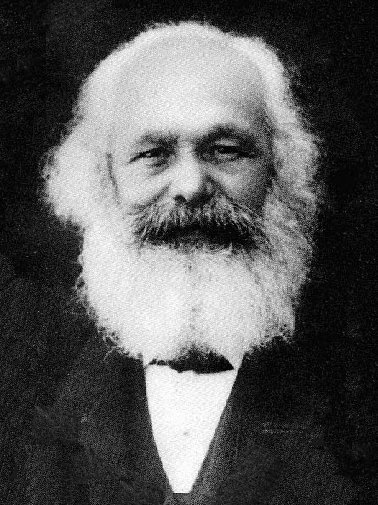
Marxism: Origins
Karl Marx, along with an associate named Friedrich Engels, promoted an interpretation of the world in the mid-1800s that became known as Marxism
In the late 1800s and early 1900s it gained more and more influence around the world
In 1917, the Bolshevik Revolution violently put Marxism to practice in Russia
Later, China and some other smaller countries adopted Marxism
Marxism still has its proponents in many universities

Slide 3
Marxism: Beliefs
Marxism is built on a naturalistic platform:
  No God, no supernatural, no spiritual
  Life is a result of natural forces
  Humans are highly-developed animals; no life after death
  No absolute standard for right and wrong exists
Marxism emphasizes economics as the most powerful force in the world
  Societies begin as small family-like tribes where everyone works together to survive
  The development of technology allows people to specialize and move into different roles and different social classes
  Some of the classes become richer and more powerful, resulting in oppression of the lower classes
Marxism calls for a “new society” in which social classes are eliminated, everything is owned collectively, and everyone works together for the good of all

Slide 4
Marxism: Practices
Revolution is the method needed to bring about this “new society” according to many Marxists; violence is acceptable if creates a better society
Marxists oppose and suppress any kind of religious belief
The “State” or “the new society” demands people’s love, allegiance, and service: this is supposed to define one’s purpose in life and also one’s morality

Slide 5
New Age: Introduction
Notes:
Mr. Meyers included a variety of pictures on this slide that are associated with New Age thought. Because of copyright laws, we needed to remove them.

Slide 6
New Age: Origins
Naturalism—the view that life and the universe are purely material –created a void of meaning for many people (if we are just a flask of chemicals in a big, dark universe, then what is the point of life?)
In the mid-1900s, some people in the Western hemisphere started to look to Eastern religions (Hinduism, Buddhism,etc.) and paganism/animism to find meaning
The result has been a strange mixture of these ideas with Western culture

Slide 7
New Age: Beliefs
The human race is in the process of evolving into a “higher state of consciousness”
At the most basic level, everything in the universe is part of the same super-natural reality; it is manifested in two different ways though: the visible universe and invisible universe (Mind-at-Large)
People access the visible universe through their ordinary consciousness but need an “altered consciousness” to access this Mind-at-Large
Humans should pursue this “cosmic consciousness” so they can experience an “unity with the universe”
Quote from MacLaine: “Know that you are God; know that you are the universe.”
Life does not end at death, it just assumes another form (reincarnation)

Slide 8
New Age: Practices
There’s a huge range in the practical expression of this worldview: everything from exercise routines and piano music to drug use and witchcraft
Pursuit of an “altered” or “higher” state of consciousness: meditation, yoga, drugs, “channeling”
Morality is very relative: if you are god, then you decide for yourself what is right and wrong
Other associated practices: psychic readings, crystals, massages, acupuncture, homeopathic medicine

