Slide 1
Atheism—A Negative Theology
Worldviews 1.3-Secular Humanist/Marxist Theology

Slide 2
"Science shares with religion the claim that it answers deep questions about origins, the nature of life, and the cosmos. But there the resemblance ends. Scientific beliefs are supported by evidence, and they get results. Myths and faiths are not and do not."
— Richard Dawkins
Notes:
Add picture of Richard Dawkins

Slide 3


Slide 4
Religion is "the main source of hatred in the world."
-Christopher Hitchens
Notes:
Include picture of Christopher Hitchens

Slide 5
"I think that religion is the most dangerous and divisive ideology that we have ever produced.
Sam Harris
Notes:
Add picture

Slide 6
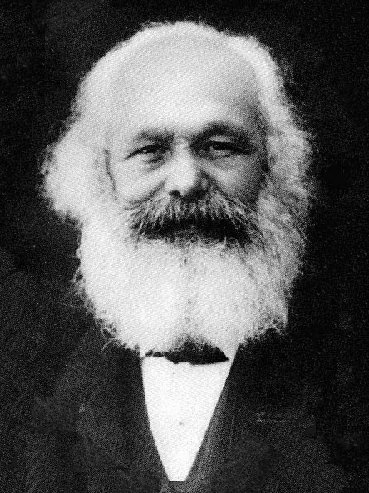
“Religion is the opium of the masses.”
Karl Marx

