Slide 1
Early English History
World History Chapter 9c

Slide 2
United Kingdom
Notes:
Add map of the United Kingdom

Slide 3
Overview of English History
Celtic period (B.C)
Roman Empire control (0-410)
Takeover by Germanic tribes—Angles and Saxons (450-1100)
Norman (French-speaking) control and influence (1100-1300)
English Kingdom (1300-

Slide 4
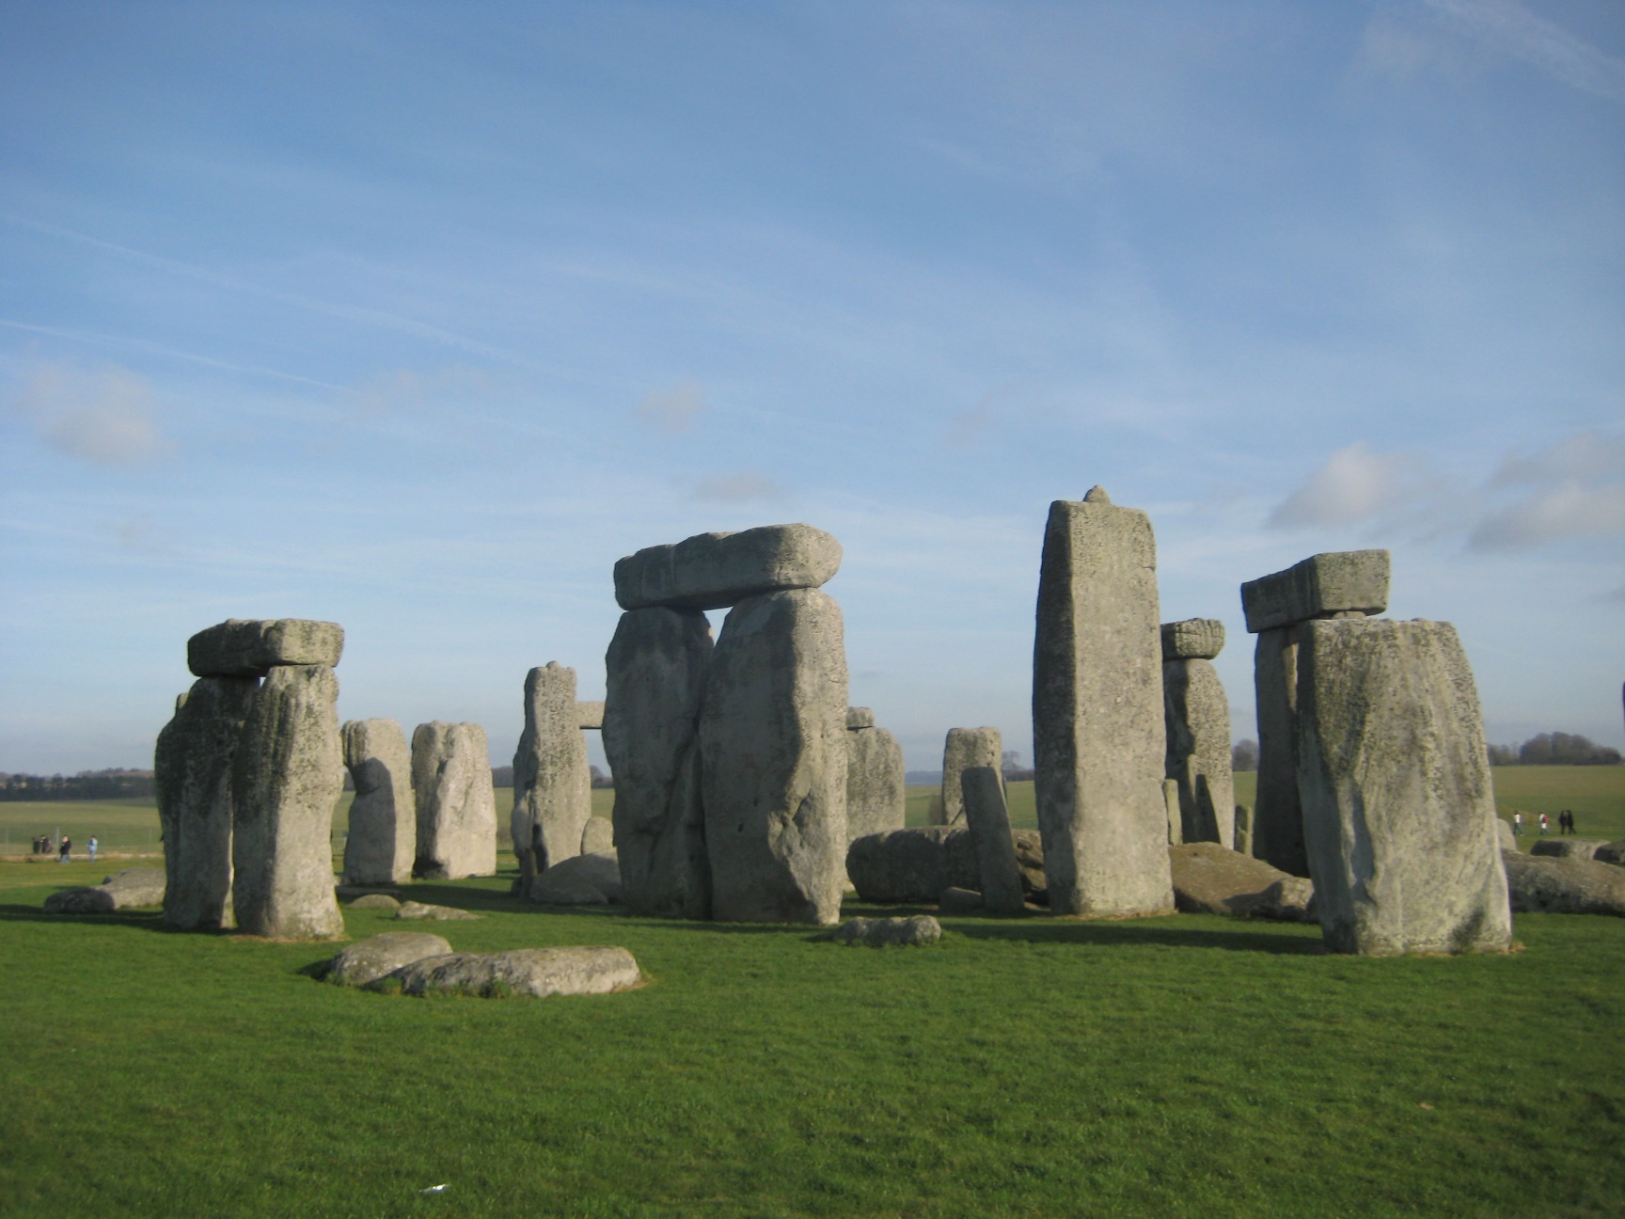
Early English Inhabitants—Celts
Notes:
Add picture of Stonehenge.

Slide 5
Roman Control
Notes:
Add map of Europe and northern Africa showing areas of Roman control.

Slide 6
Germanic Invasions
Angles and Saxons invaded England in 500s
Notes:
Add map showing invasion of Angles, Jutes, and Saxons and their settlements.

Slide 7
Alfred the Great
First English leader to begin to bring unity to the Germanic tribes (late 800s)
Notes:
Add picture

Slide 8
The Early English Language
Caedmon's Hymn
Nu scylun hergan hefaenricaes uard
metudæs maecti end his modgidanc
uerc uuldurfadur sue he uundra gihuaes
eci dryctin or astelidæ
he aerist scop aelda barnum
heben til hrofe haleg scepen.
tha middungeard moncynnæs uard
eci dryctin æfter tiadæ
firum foldu frea allmectig.

Slide 9
Caedmon's Hymn
MODERN ENGLISH TRANSLATION
Now let me praise the keeper of Heaven's kingdom,
The might of the Creator, and his thought,
The work of the Father of glory, how each of wonders
The Eternal Lord established in the beginning.
He first created for the sons of men
Heaven as a roof, the holy Creator,
Then Middle-earth the keeper of mankind,
The Eternal Lord, afterwards made,
The earth for men, the Almighty Lord.

Slide 10
French (Norman) Influence
Money (from the French 'monnaie'), bottle (from the French 'bouteille'), chair (from the French 'chaise'), road (from the French 'route'), table (from the French 'table'),chamber (from the French 'chambre'), air (from the French 'air'), flower (from the French 'fleur'), fork (from the French 'fourchette'), garden (from the French 'jardin'), lamp(from the French 'lampe'), farm (from the French 'ferme'), forest (from the French 'forêt'), hotel (from the French 'hôtel'), brick (from the French 'brique'), image (from the French 'image'), plate (from the French 'plateau'), story (from the French 'histoire'), odour or odor (from the French 'odeur'), stranger (from the French 'étranger'), beef (from the French 'boeuf'), vinegar (from the French 'vinaigre'), parent (from the French 'parent'), herbs (from the French 'herbes'), arm (from the French 'arme'), army (From the French 'armée'), source (from the French 'source'), grand (from the French 'grand'), joy (from the French 'joie'), fluid (from the French 'fluide'), ray (from the French 'rayon'),bicycle (from the French 'bicyclette'), tube (from the French 'tube'), car (from the French 'char'), eagle (from the French 'aigle'), lake (from the French 'lac'), mountain (from the French 'montagne'), lion (from the French 'lion'), voyage (from the French 'voyage'), lizard (from the French 'lézard'), bullet (from the French 'balle'), hero (from the French 'héro'), hazard (from the French 'hasard'), cave (from the French 'cave'), current (from the French 'courant'), carbon (from the French 'charbon'), autumn (from the French 'automne'), case (from the French 'cas'), pedestal (from the French 'piédestal'), parachute (from the French 'para-chute'), habit (from the French 'habitude'), altitude (from the French 'altitude'), attitude (from the French 'attitude'), final (from the French 'finale'), revenge (from the French 'revanche'), itinerary (from the French 'itinéraire'), orange(fruit) (from the French 'orange'), ticket (from the French 'ticket'), barrel (from the French 'baril'), retard (from the French 'retarder'), appeasement (from the French 'apaisement'),aviation (from the French 'avion'), miracle (from the French 'miracle'), tablet (from the French 'tablette'), pincer (from the French 'pincer'), tennis (from the French 'tenir'),

