Slide 1
A New European Empire
World History 8b

Slide 2
The Franks
Of the various Germanic tribes in Europe, the Franks were the most powerful.
Around 500, a Frank named Clovis became king of the Franks and expanded the Frankish kingdom in central Europe
Notes:
Add maps of the Frankish kingdom’s expansion in central Europe.

Slide 3
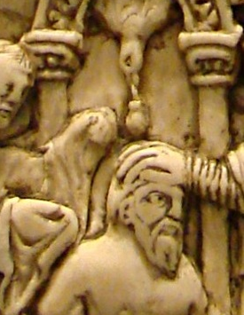
Clovis’s Conversion
During his reign, Clovis “converted” to Christianity, bringing Christianity to the Franks and also creating an alliance with the Roman Catholic Church

Slide 4
The “Hammer” Dynasty
(properly known as the Carolingian House)
Charles Martel → Pepin the Short → Charlemagne
Charles Martel—stopped the advance of Muslim forces in 732 at the Battle of Tours
Pepin the Short—anointed by the pope as king, establishing an official “marriage” between Frankish kings and the Roman pope
Charlemagne—great warrior and leader who greatly expanded the Frankish kingdom and established an impressive civilization throughout it

Slide 5
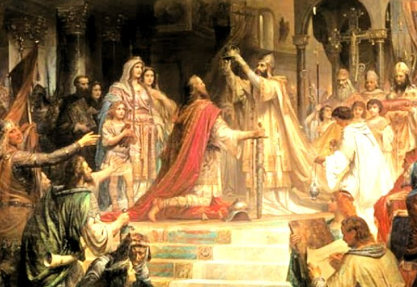
Charlemagne
Greatest Frankish leader
Brutal and effective warrior
Efficient administrator
Promoted learning and education throughout his empire
In 800, Charlemagne was crowned emperor by the pope himself

Slide 6
Charlemagne’s Empire
Notes:
Add map of Charlemagne’s Empire including tributary states.

