Slide 1
Growth of the Medieval Church
World History 8a

Slide 2
Medieval Europe
Notes:
Add map of Europe in 600 AD

Slide 3
Rise to dominance
When the Roman government disintegrated in the late 5th century, the most stable organization left in Europe was the Church.
Almost, by default, church leaders began to fill roles that the government had filled earlier.
The church was further institutionalized to carry out these roles.
Throughout the Middle Ages, the Catholic church was the dominant force in organizing European society

Slide 4
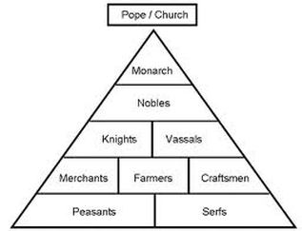
Medieval Social Structure

Slide 5
Notes:
Add map showing areas controlled by Christianity and Islam in Medieval Europe (approximately 1050)

Slide 6
From NT church to Roman Catholic
Bishops in all of the churches were gradually given more respect and authority
Bishops began to look to the bishop at Rome for leadership
Eventually, the bishop of Rome gained complete control over all the churches and was called the pope

Slide 7
