Slide 1
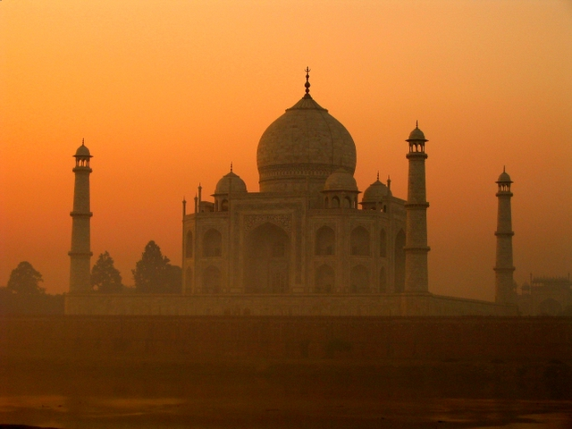
India
World History 7a

Slide 2
India
Notes:
Add map of India.

Slide 3
Importance of Rivers
Mesopotamian
Civilizations
Tigris and Euphrates Rivers
Egyptian
Civilization
Nile River
Indian Civilization
Indus and Ganges Rivers

Slide 4
Indian Society
Joint Family—extended families live together and marriages are arranged by parents
Villages rather than cities
Caste system—rigid social classes that define a person
    Brahmans—priests
    Rulers and warriors
    Merchants and traders
    Servants and serfs
          “Outcastes” or “untouchables”

Slide 5
Hinduism
Developed among early Indian civilizations
Pantheistic: Brahman is that name that they use for this “force” that permeates the universe; it manifests itself in many, many different ways
Reincarnation—the “wheel of life”

Slide 6
Buddhism

