Slide 1
From Republic to Dictatorship
World History 4d

Slide 2
Agriculture in Italy
Notes:
Add picture of the lush, green, cultivated fields of Italy.

Slide 3
Problems of Imperialism
The decline of the small farmer
      Fighting instead of farming
      Falling prices because of foreign markets
      Availability of slaves made labor worth less
      Wealthy landowners bought the small farms

Slide 4
Problems of Imperialism
2. Extreme gap between the rich class and the poor class

Slide 5
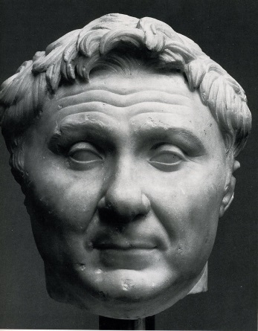
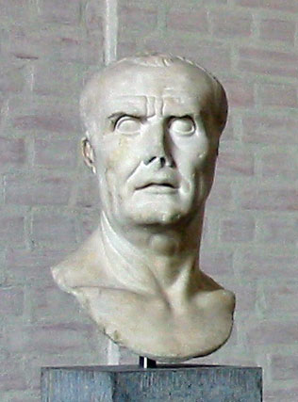
Problems of Imperialism
3. Political conflict and chaos
    Huge gaps between social classes led to tensions and fighting
    Between 100 B.C. and 0, three civil wars rocked the Roman Republic
    Military leaders dominated politics

Slide 6
Julius Caesar
Emerged on top in the 2nd Civil War
Popular with the common people
Achieved numerous reforms
    Provided land for army veterans
    Made people from conquered territories Roman citizens
    Established the Julian calendar,
    similar to the one that we use today

Slide 7
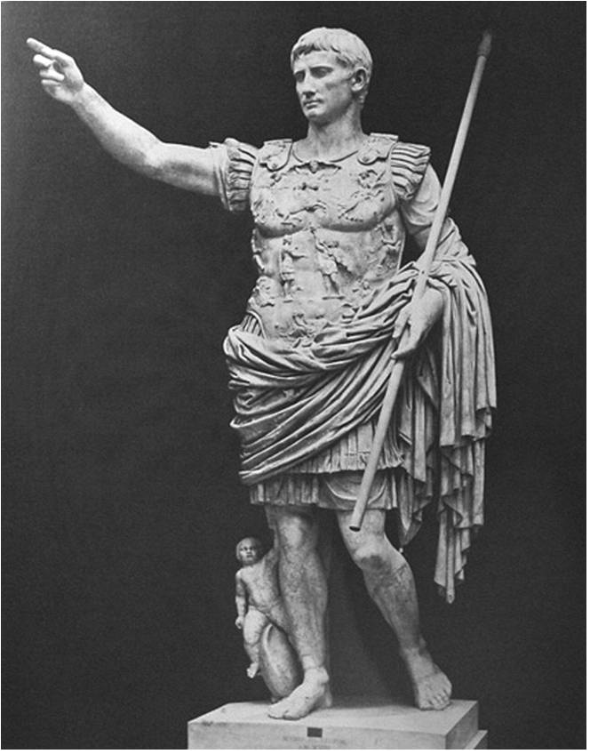
Octavian (Caesar Augustus)
Defeated Antony in the 3rd Civil War to become the sole ruler of Rome
Historians mark Octavian’s rise to power as the beginning of the Roman Empire (as opposed to Roman Republic)

