Slide 1
Rome at War
World History 4c

Slide 2
Reading quiz: (83-87)
What great city in northern Africa was a serious competitor with Rome in the quest for control of the Mediterranean region?
What general marched elephants over the Alps to fight the Romans?
True or False? This general successfully captured the city of Rome.
How many wars were fought between Rome and its north African enemy?

Slide 3
Stage 1 of Rome’s Expansion--Overview
Italy
500 B.C -265 B.C.
Carthage
Three Punic Wars
264 B.C. -146 B.C.
Eastern
Mediterranean
Macedonia, Asia Minor, Egypt

Slide 4
Rome vs. Carthage
Notes:
Add map of the Western Mediterranean around 264 BC, showing the Roman Republic and their allies, the Carthaginian Empire, and Syracuse.

Slide 5
The Punic Wars
First Punic War:
  Fought over the island of Sicily
  Won by Rome after it built a navy to compete with the Carthaginian navy
Second Punic War:
  Fought over the control of the Mediterranean region
  Much of the fighting took place on the Italian peninsula—Hannibal marched his troops, equipment, and elephants all the way from Spain and over the Alps to invade Italy
  Rome won when the Roman general Scipio attacked the city of Carthage
Third Punic War:
  Out of fear and revenge, the Romans annihilated the city of Carthage, razing its buildings and sowing salt on the land

Slide 6
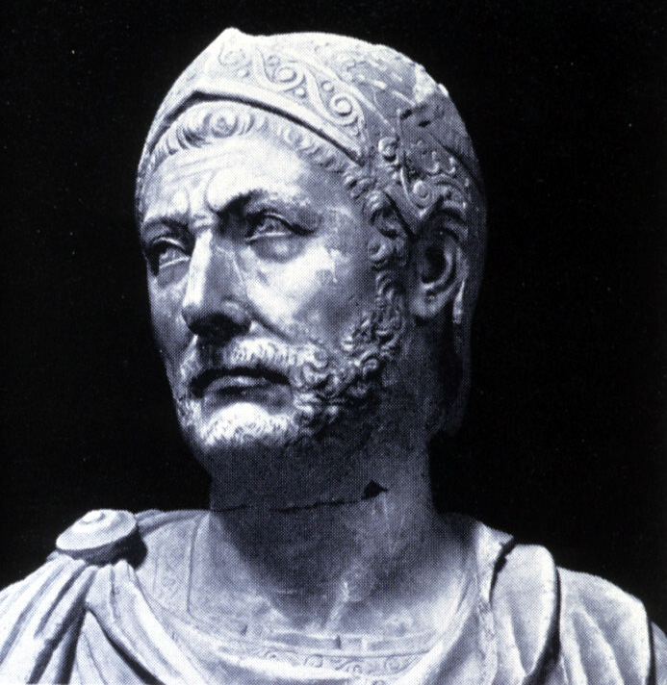
Hannibal

Slide 7
Hannibal’s Elephants
Notes:
Add picture of soldiers fighting from the backs of elephants.

Slide 8
Hannibal’s Elephants
Notes:
Add picture of elephants and soldiers crossing the Alps in the snow.

Slide 9
Conquest of Eastern Mediterranean
In addition to conquering the western half of the Mediterranean world in the Punic Wars, Rome also took over most of the eastern region in the same era of time
Notes:
Show a map of the territory gained by Rom during time of the Punic Wars.

