Slide 1
Land of Canaan-
The Hebrews
World History 2D

Slide 2
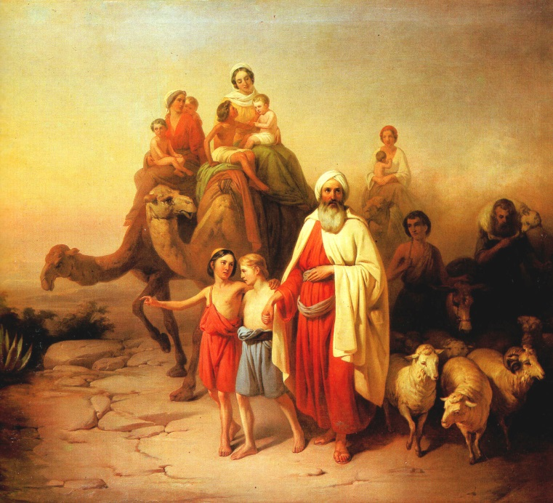
Abraham
Moved from Ur (Mesopotamia) to Canaan around 2100 B.C.
God establishes the Abrahamic Covenant
    His family would grow into a large nation
    Canaan would be his descendants’ homeland
    The whole world would be blessed by his descendants
Isaac and Jacob become the line of people who inherit this covenant

Slide 3
Periods of Israelite History
(c. 2100 B.C. –AD70)
Patriarchal (225 years)
Egyptian (400 years)
Wilderness (40 years)
Conquest (17 years)
Judges (340 years)
United Kingdom (120 years)
Divided Kingdom (340 years)
Exile (70 years)
Persian (200 years)
Hellenistic (164 years)
Maccabean (100 years)
Roman (130 years)

Slide 4
The Hebrews: Religion
Monotheistic

