Slide 1
Land of Canaan
World History 2c

Slide 2
Overview of Canaanites
Hittites
Phoenicians
Arameans
Notes:
Add a map showing the location of the Hittites, Phoenicians and the Arameans in ancient history.

Slide 3
Hittite Civilization
  Specialized in warfare
  Skillful in iron-working

Slide 4
Phoenician Civilization
Specialized in shipbuilding and sailing; merchants sailed as far as Great Britain and perhaps farther
Developed the first alphabet, creating symbols for each sound of their language

Slide 5
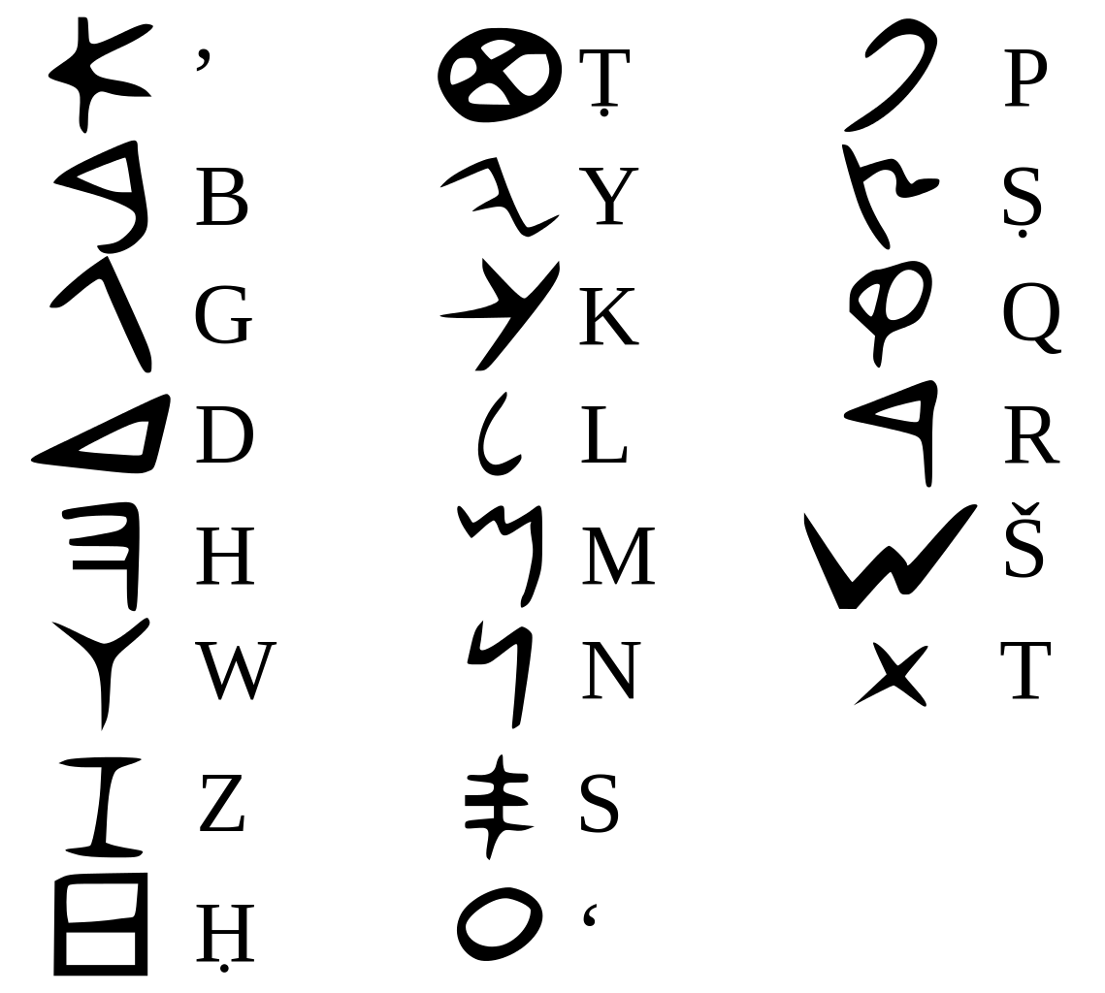
Phoenician Alphabet

Slide 6
Aramean Civilization
Ancestors of the Syrians
Center of trade in the Middle East

