Slide 1
Collapse of the Soviet Union
WH 23e

Slide 2
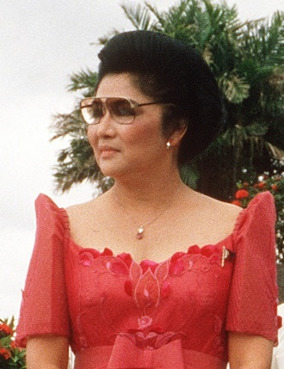
Imelda Marcos

Slide 3
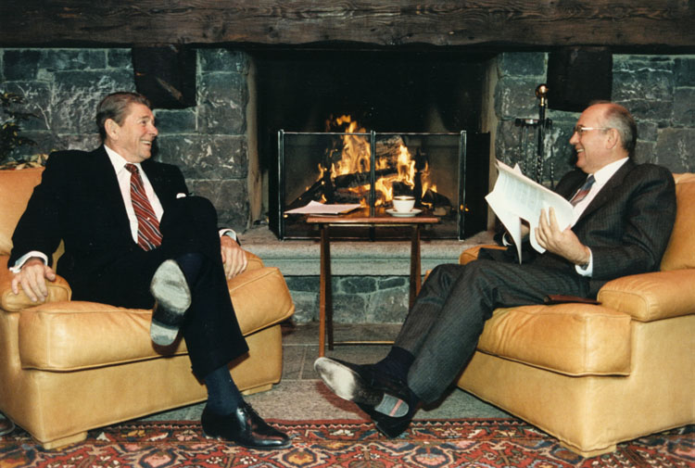
Mikhail Gorbachev
Came to power in the Soviet Union in 1988
New kind of Communist leader
Formed friendships with leaders in the West and initiated reforms in the Soviet Union

Slide 4
Reforms under Gorbachev
Perestroika— “restructuring”: an attempt to increase the country’s productivity, stimulate the growth of technology, decentralize the management of the economy, and allow some free market
Glasnost– “openness”: allowed greater freedoms to the Soviet people such as more freedom of speech and freedom of the press; Gorbachev wanted the govt. to be more accountable to the public

Slide 5
Revolution in Eastern Europe
The result of the loosened grip of the Soviet Union was mass desertion in Eastern Europe
The following countries abandoned their Communist governments around 1989-1990.
  Poland
  Hungary
  Czechoslovakia
  Romania
  East Germany

Slide 6
Disintegration of the Soviet Union
The next step was the disintegration of the Soviet Union itself
Support for deeper changes emerged throughout the Soviet Union, both from the public and within the government
Responding to the pressure, Gorbachev resigned his position on Christmas Day 1991, effectively ending the Soviet Union
Boris Yeltsin took over as president of Russia

Slide 7
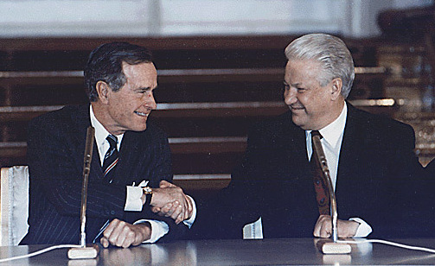
Boris Yeltsin
Huge changes took place in Russia under Yeltsin as the country attempted to move from a Communistic system to a democratic, capitalistic society
It’s been a very difficult process for Russia

