Slide 1
Spread of Communism
WH 22c

Slide 2
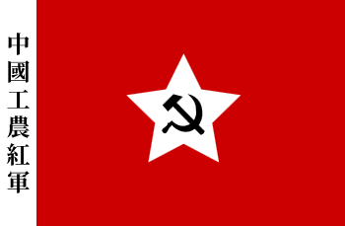
Communism in China
In the years after WWII, the Chinese people were caught in a civil war between Nationalist forces of Chiang Kai-shek and the Communist forces of Mao Zedong
The Communists beat the Nationalists back until Kai-shek and his supporters were forced to leave the mainland and move to Taiwan
Notes:
Add map of China showing its proximity to Taiwan.

Slide 3
The Korean War
Just as Germany’s defeat left a power vacuum in central Europe, Japan’s defeat in the Pacific left a power vacuum in Southeast Asia
After the Japanese were forced out of the Korean peninsula, Korea was divided into zones just like Germany was: the USSR controlled the north half and western countries controlled the southern half.
In 1950, North Korea invaded South Korea in an attempt to unify all of Korea under the Communist government
In accordance with the Truman Doctrine, the United States responded quickly, sending its military to defeat the Communists
After 3 years of fighting and 54,000 American troops had been killed, a truce reestablished the pre-war status quo

Slide 4
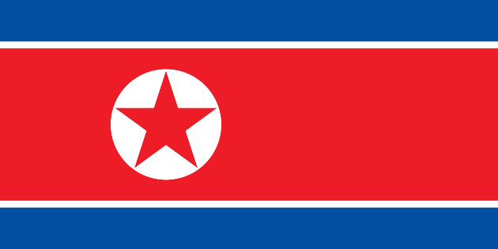
Notes:
Add pictures of Korea, including missiles ready to be launched and a picture taken from space at night (showing how dark North Korea is compaired to the many lights in South Korea).

Slide 5
The Vietnam War-Background
Vietnam divided into North (Communist) and South (Republic) as part of plan for independence
Late 1950s—Groups of Communists in the South called the Viet Cong (supported by North Vietnam) start a Communist revolution in South Vietnam
Again, America’s policy of containment was put to the test

Slide 6
American Involvement
President Eisenhower sent military advisors to Vietnam and money but did not want to send American troops to fight
President Kennedy felt like America’s reputation was in jeopardy and increased America’s involvement in Vietnam from less than 1,000 to 16,000
Still not a major event in the public’s mind

Slide 7
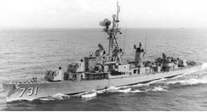
Johnson and Escalation of War
Gulf of Tonkin Resolution
  In 1964, the US govt. reported a couple of attacks on American military ships off the coast of North Vietnam (it was later admitted that the one never happened at all)
  Congress gave President Johnson the power to use as much force as necessary in Vietnam, a major escalation in the US official policy
In less than a year, US troops had increased to 200,000 and by 1968, 500,000

Slide 8
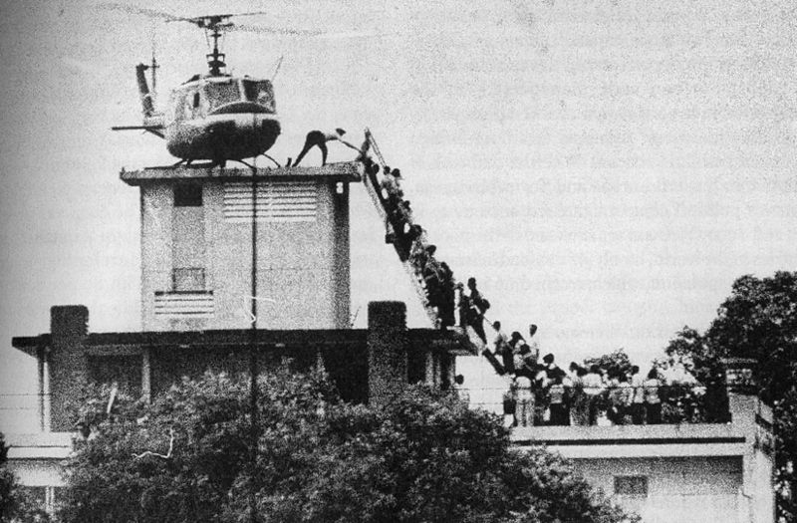
US Withdrawal
In spite of great effort and huge expense, the war did not go very well for the anti-Communist forces, and much of the American public lost support for America’s involvement
Evacuation of Saigon: Finally, in 1975, President Nixon withdrew all American personnel from Vietnam
Saigon fell to the Communists the next day, and all of Vietnam became Communist

