Slide 1
Into Cold War
WH 23b

Slide 2
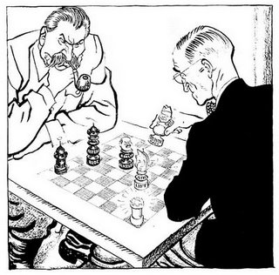
Cold War: “Political Chess”
WWII leads directly into the Cold War
Cold War: ideological conflict between Communist and non-Communist countries
Chief players: Soviet Union and the United States

Slide 3
Notes:
Add map showing the division of Germany in 1945.

Slide 4
Notes:
Add map of the Union of Soviet Socialist Republics, showing its different states.

Slide 5
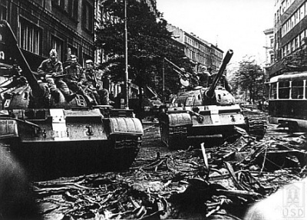
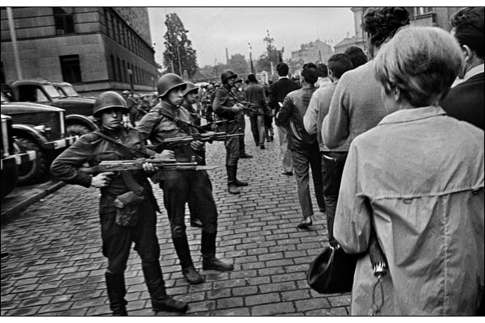
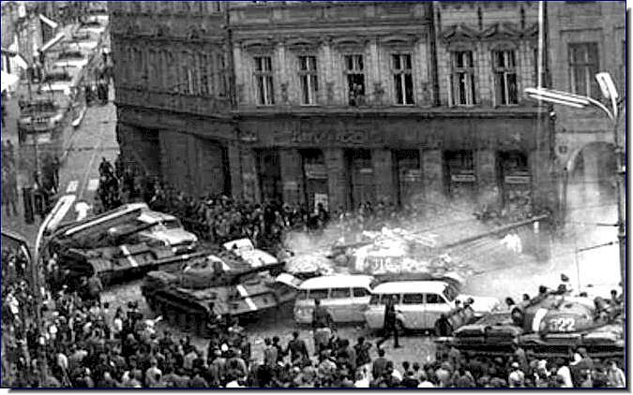
By 1948, the Soviet Union exerted control over:
Poland
Romania
Bulgaria
Albania
Hungary
Czechoslovakia

Slide 6
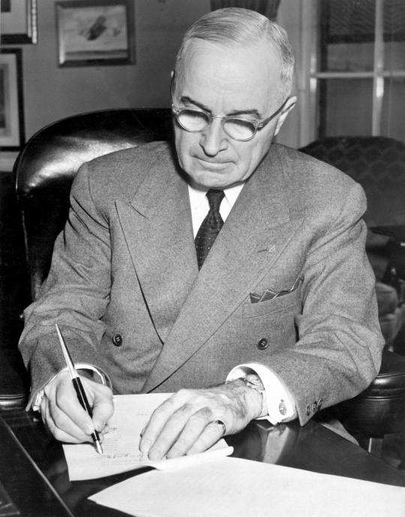
Truman Doctrine
Although the United States mostly stood by while the Soviets gained control of central Asia and eastern Europe, when the Soviets began support Communist movements in Greece and Turkey, the US reacted strongly
Truman Doctrine: “the US would support any country threatened by Communist aggression” (this was known as the policy of containment)

Slide 7
Marshall Plan
One of the ways the United States sought to counteract the Soviet influence in Europe was the Marshall Plan
The Marshall plan provided 5.3 billion dollars to European countries to help them rebuild after the war
This action intensified the conflict between the US and Soviet Union
Notes:
Add map showing the amount of money that the United States gave to different countries in Europe.

Slide 8
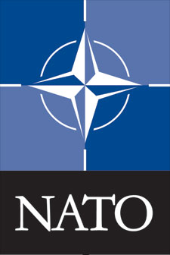
Formation of NATO
Another action taken by non-Communist countries to oppose Communist countries was the formation of the North Atlantic Treaty Organization
The core members of this organization were: US, Canada, Great Britain, France, and Italy
Notes:
Add map of the world showing the countries that became a part of NATO.

Slide 9
Warsaw Pact
The Soviet Union reacted to NATO with its own military alliance: the Warsaw Pact
Notes:
Add map showing the countries in the Warsaw Pact.

Slide 10
Notes:
Add map of Europe and western Asia showing the countries that were a part of the Warsaw Pact and NATO.

Slide 11
Notes:
Add map showing the division in Europe between the “Eastern Bloc” and the “Western Bloc” with the “Iron Curtain” stretching in between.

