Slide 1
WWII: Part 3
WH 22c

Slide 2
Reading Quiz
Who replace Neville Chamberlain as British prime minister during WWII?
Who was the US President during the main part of WWII?
T or F: The Nazis successfully invaded and defeated the Soviet Union.
Did the Nazi offensive on Great Britain use primarily land troops or the air force?
What leader ordered the attack on Pearl Harbor?

Slide 3
Fall of France
After taking the lowlands, the Nazis continued their sweep toward France
They were able to slip through the Allied defense line by going through the Ardennes forest
This movement completely threw the Allies off balance and the Nazis were able to force the French to surrender in a mere 42 days
France was divided up into two sections: a Nazi-occupied France and a non-occupied, pro-German Vichy France
Notes:
Add map showing the division of France during Nazi occupation.

Slide 4
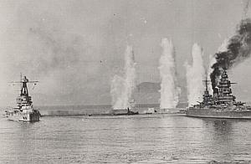
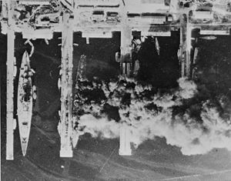
French Fleet
Battle of Mers-el-Kébir
Operation Lila

Slide 5
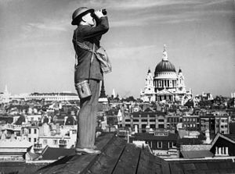
Battle of Britain
Hitler’s main opponent left was Great Britain
Hitler actually offered to make peace with Great Britain, but Britain rejected it
The Nazis began their attack with heavy and relentless bombing of military and civilian targets within Britain
Toward the end of the campaign, Nazi bombers took to bombing out London
Even though much damage was inflicted, the bombing raids were unsuccessful in crippling the British
Hitler never launched an actual invasion of Great Britain

Slide 6
Operation Barbarossa: Invasion of Russia
Hitler turned to Russia next
Invasion was extremely bloody but ultimately unsuccessful

Slide 7
Japan’s Ambitions
Under Tojo’s leadership, Japan set out to create a huge and powerful empire in the Pacific.
Notes:
Add map showing land controlled by Japan in 1942.

Slide 8
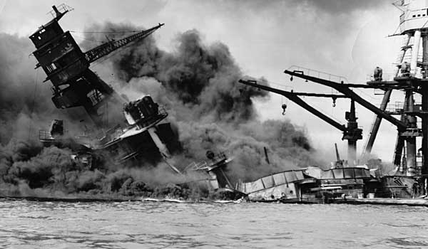
Attack on Pearl Harbor
Thinking that the United States would be an obstacle to Japan’s Pacific empire, Tojo ordered the attack on Pearl Harbor, hoping to knock out the US’s naval power and its ability to challenge Japan’s ambitions
On Dec. 7, 1941, 400 Japanese planes pour across the Hawaiian skies in a surprise bombing attack
Damage: 2/3 of America’s airplanes, five battleships, three cruisers, and more than 2,000 people
US declares war on Japan on Dec. 8

