Slide 1
Beginning of WWII
WH 22b

Slide 2
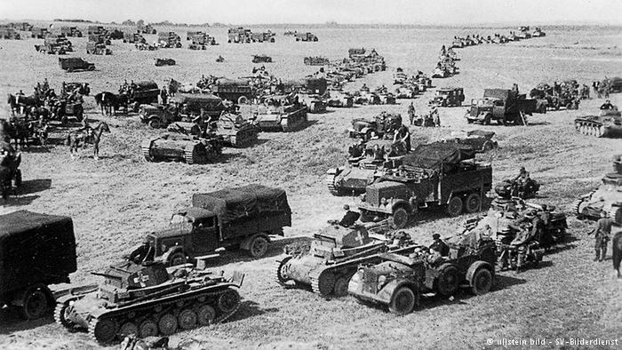
Hitler’s Aggression
Austria
Sudetenland, along with much of Czechoslovakia
Poland
Denmark
Norway
Holland
Luxembourg
Belgium
France

Slide 3
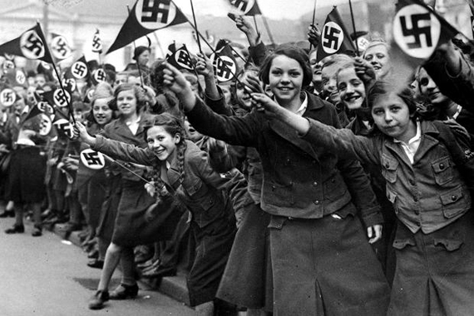
Austria
Hitler used diplomatic pressure to bring about a government in Austria that was favorable toward the Nazis and which “invited” him to bring German troops into Austria

Slide 4
Sudetenland (Czechoslovakia)
Sudetenland, the western part of Czech., contained many German-speaking people
Hitler claimed this territory as rightfully belonging to the Third Reich
In order to avoid war, England and France accepted his demands in a policy of appeasement
Hitler occupied Sudetenland, then kept going until he controlled most of Czechoslovakia
The rest of Europe began to realize that Hitler posed a menace to everyone in Europe

Slide 5
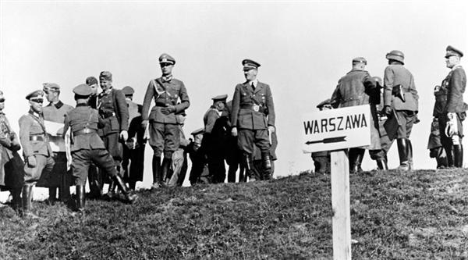
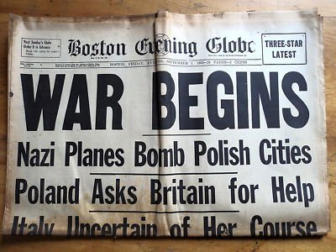
Poland
The question of Russia: Both sides courted their assistance--where would it side?
  “Pact of Steel”—Russia and Nazis sign a nonaggression pact; they also agree to split Poland between them
Sept. 1, 1939—Hitler invades Poland; France and Britain declare war on Germany

Slide 6
Notes:
Add map showing Europe at the beginning of World War II, including major battle sites and the land controlled by the Allies and the Axis.

Slide 7
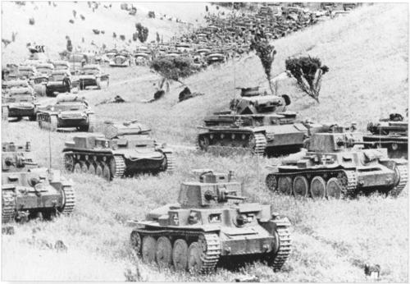
Attack on Western Europe
Due to bad weather, little happened for seven months after Poland
Then in April 1940, Hitler attacked Denmark and Norway and then continued his aggression in the Netherlands, Luxembourg and Belgium
Terms:
  Blitzkrieg: “lightning war”
  Luftwaffe: Nazi air force
  Panzer division: armored vehicles

Slide 8
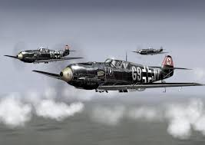
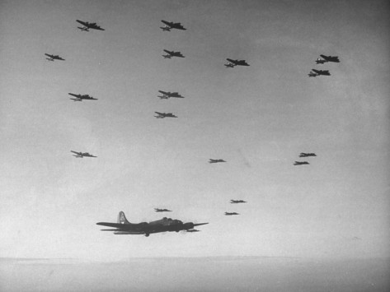
Luftwaffe

