Slide 1
Global Storm Clouds in the 1930s
Chapter 22a

Slide 2
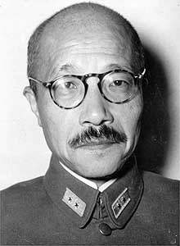
Japanese Aggression
In the 1930s, Hideki Tojo created a military-controlled government in Japan and embarked on an expansionist agenda
One of the first and largest targets was China—by the end of the ’30s, Japan controlled much of China’s resources

Slide 3
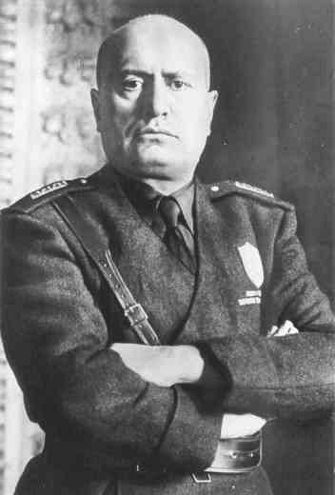
Italian Aggression
Italy invaded and conquered Ethiopia in 1935

Slide 4
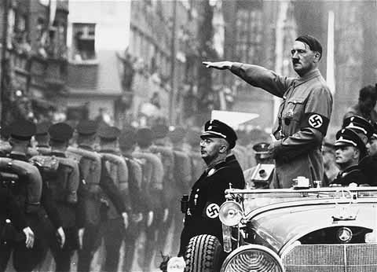
German Aggression
Hitler wanted more land for his thousand year Third Reich—he talked about the German people needing more “lebensraum” (living space)
He began to build the German military
He also reoccupied the Rhineland

Slide 5
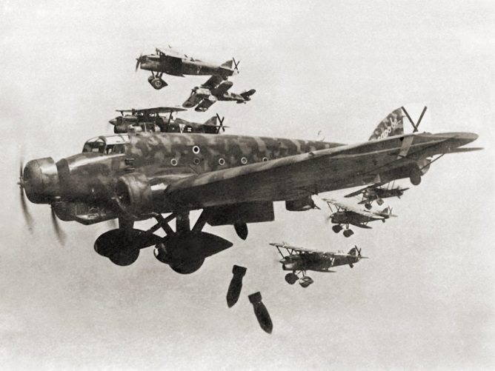
Spanish Civil War

Slide 6
German Aggression

