Slide 1
Settling the War
WH 20d

Slide 2
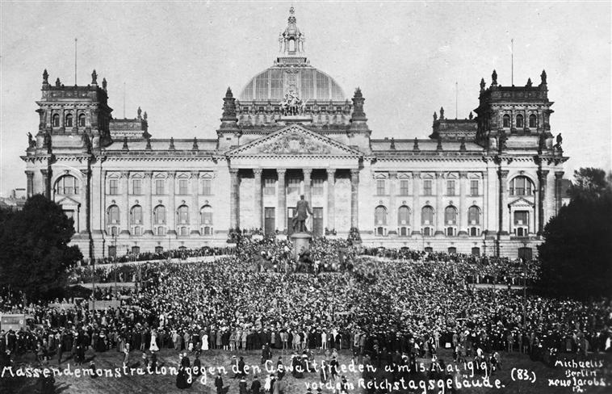
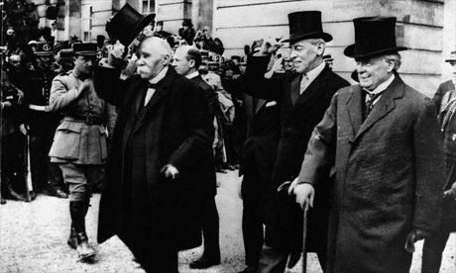
Treaty of Versailles
Germany would relinquish large amounts of territory to Allied nations
Germany would pay Allied nations war reparations of 37 billion dollars
Germany’s military would be kept very small
Germany would accept all the blame for the war

Slide 3
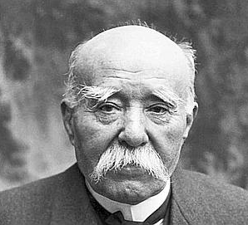
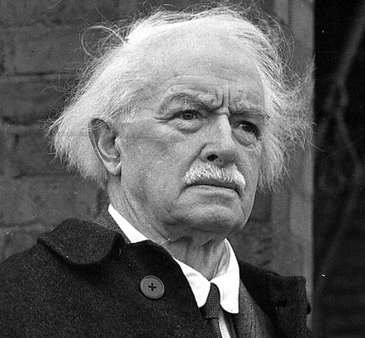
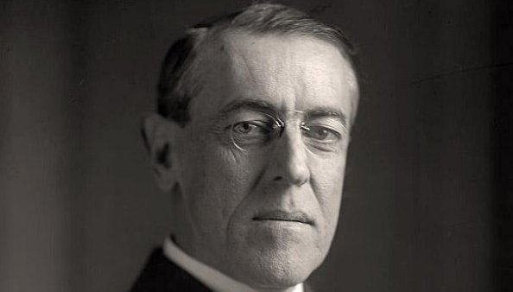
Big Three
Georges Clemenceau from France was delegate who advocated the harshest terms for Germany
David Lloyd-George from England was slightly more moderate
Woodrow Wilson from the USA promoted a much gentler response to Germany

Slide 4
Notes:
Add map showing German territorial losses, 1919-1921.

Slide 5
Response to Treaty
Germany protested that the terms were not fair but the Allied countries threatened to use more force if necessary
Bitterness over these terms in Germany directly contributed to the WWII conflict

Slide 6
Treaty of Saint-Germain
Notes:
Add map showing the dissolution of Austria-Hungary in the Treaty of Saint-Germain.

Slide 7
Break-up of Hungary
Notes:
Add map showing the break-up of Hungary and the changes the Treaty of Trianon brought in 1920.

Slide 8
Break-up of Ottoman Empire
Notes:
Add map showing the break up if the Ottoman Empire and the countries that got portions of it.

Slide 9
Attempts at Keeping the Peace
League of Nations—Wilson’s plan for a large organization of nations committed to finding peaceful solutions to their disagreements
Locarno Pact—Agreement between France, Germany, and Belgium to recognize each other’s borders and not to go to war
Washington Naval Conference—agreement to limit the size of navies
Kellogg-Briand Pact: an international agreement to make war illegal

