Slide 1
The Great War-Part 3
WH 20c

Slide 2
Collapse of Russia
Russia ran out of steam a couple of years into the war against the Central Powers
In 1917, the Bolshevik Revolution brought Lenin and the Communists into power
Lenin signed the Treaty of Brest-Litovsk, ending its participation in the war and giving up over a million sq. miles of land to Germany

Slide 3
Notes:
Add map showing territory lost by Russia in the Treaty of Brest-Litovsk

Slide 4
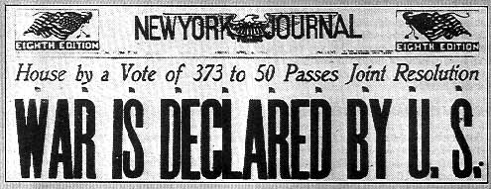
The United States:
From Neutrality to War
  Anger at Germany’s policy of sinking merchant ships (see Act. 20.3 in text)
  Ties to Great Britain and France
  Zimmerman telegraph—the German plot to instigate Mexico to declare war on the US
  Financial investments in Allied countries
  Propaganda

Slide 5
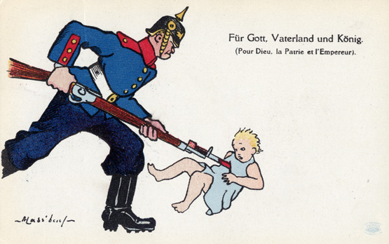
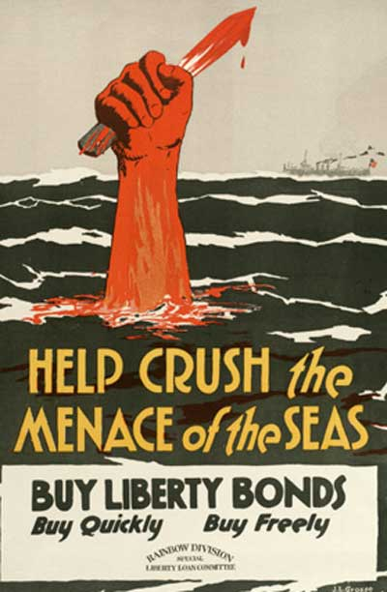
Allied
Propaganda

Slide 6
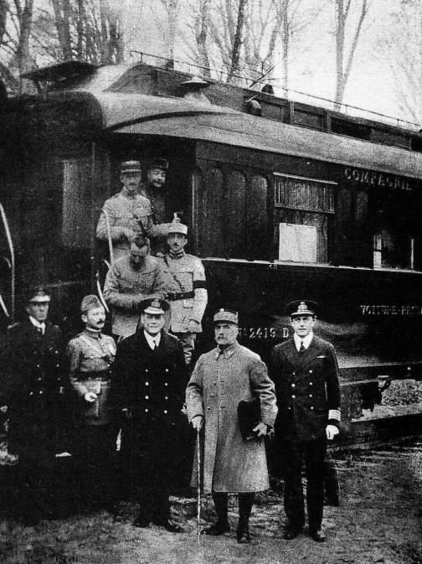
End of War--1918
By 1917 and 1918, all of the forces were getting weak.
Before the US entered the war, France and Great Britain were near defeat.
But the US entry combined with the collapse of Germany’s allies brought about Germany’s defeat.
An armistice ending the war was signed on Nov. 11, 1918 at 11:00 a.m.

Slide 7
Cost of the War
Human lives lost: 17-18 million
Financial cost: $200 billion

