Slide 1
Imperialism-the english world
WH 19a

Slide 2

United states
Notes:
The pictures on this slide showed how the United States grew in power and land mass.

Slide 3

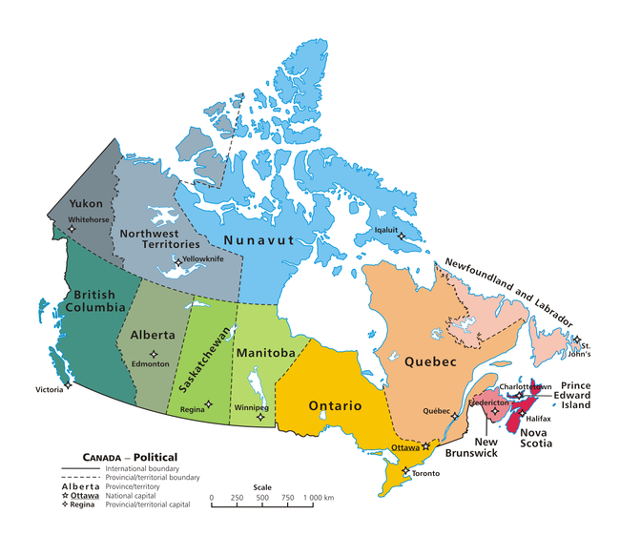
Canada
Canada grew in independence from Britain in a number of steps in the mid-1800s

Slide 4

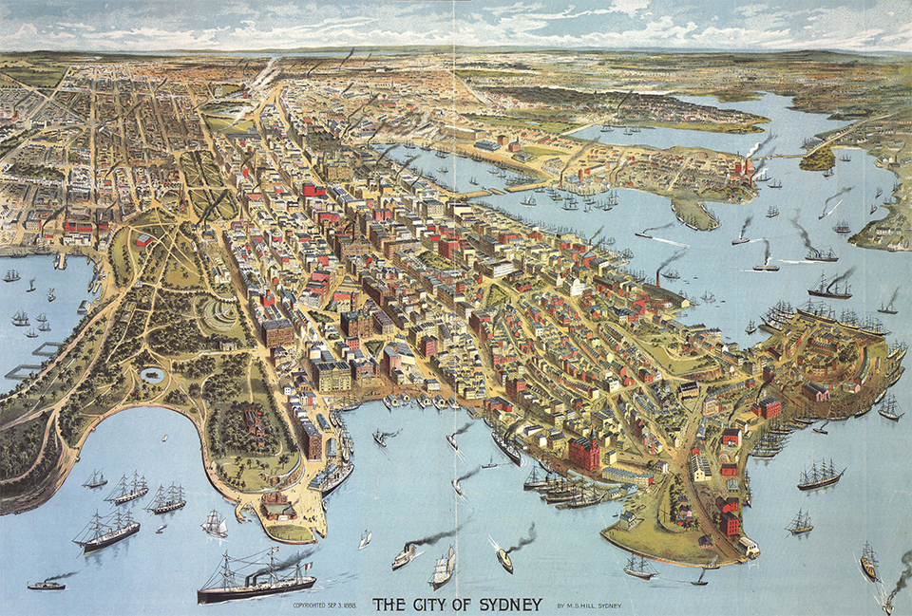
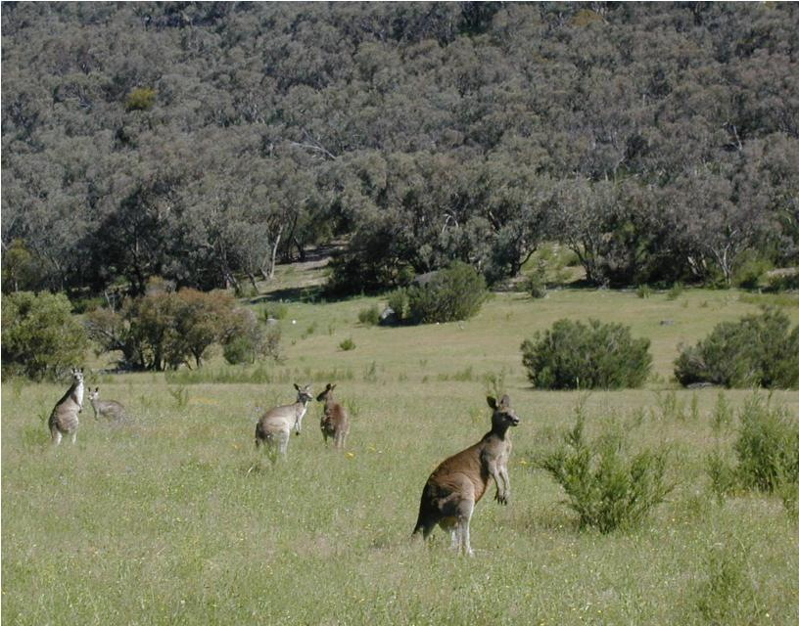
Australia and new zealand
Claimed as British territory in 1770
Sydney established as a British penal colony
Self-rule was established in 1901
Self-rule for New Zealand established in 1907

Slide 5
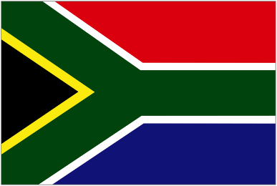
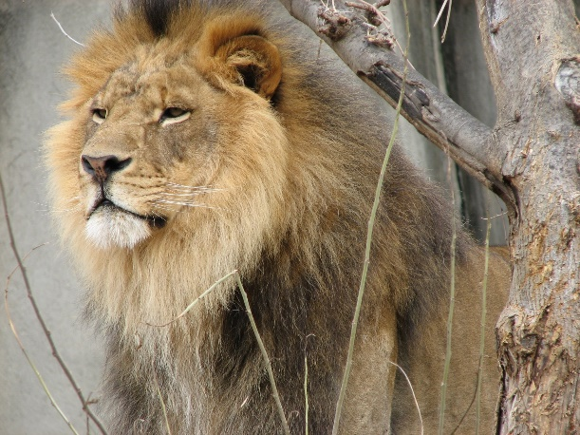
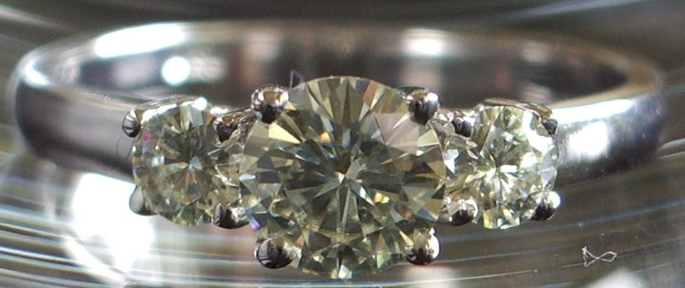
South africa
Dutch establish a colony in 1652. The descendants of these colonists were called Boers.
The British seized the colony in the early 1800s.
Resenting British rule, the Boers mostly moved inland, where they established a couple of independent republics.
When gold and diamonds were discovered in these areas though, British prospectors poured into the region, sparking the Boer War (c. 1900)
Around 1910, South Africa established self-rule.

