Slide 1
Responses to the
Industrial Revolution
World History 18c

Slide 2
Social Reforms in Britain
Factory Act: No child under 9 to work in textile mills; children 9-13 to work no more than 8 hours; ages 13-18 to work no more than 12 hours
Mines Act: prohibited women and children from working in coal mines
Ten Hour Bill: women and children to work no more than 10 hours/day anywhere

Slide 3
Other reforms:
Outlawing slavery: William Wilberforce was the key player in this move
Expanding suffrage: The right to vote expanded from large landowners to the more common man
Public services for the poor, handicapped, unemployed, sick , and old

Slide 4

Ireland and Great Britain
Tension and conflicts continued between the English govt. and Ireland during the mid-1800s
Catholic Irish vs. Protestant England
After England claimed Ireland as British territory, English nobles came to control much of the land, and the Irish people were forced to serve as peasants on those lands

Slide 5
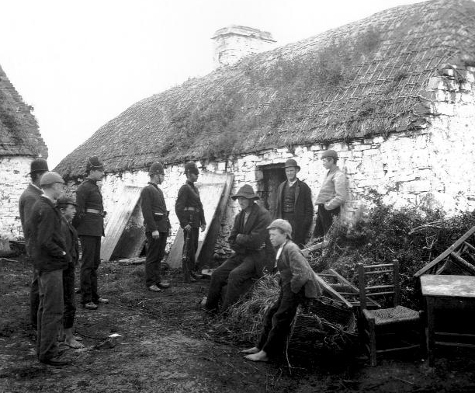

Slide 6
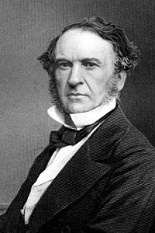
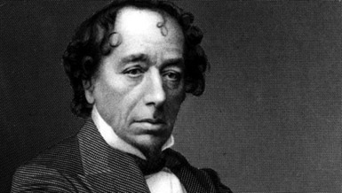
Liberal vs. Conservative--Modern parallels

