Slide 1
Romanticism in
Music and Painting
World History 17e

Slide 2
Composers to listen to:
Beethoven (listen to Symphonies 5,6, & 9)
Chopin (piece in slideshow, Polonaise no. 6 in A flat)
Liszt (Second Hungarian Rhapsody)
Tchaikovsky (1812 Overture-beginning and end)
Verdi (grand march from Aida)
Wagner (The Ride of the Valkyries)
Brahms (Lullaby)

Slide 3
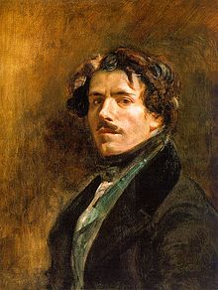
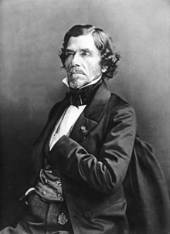
Eugene Delacroix

Slide 4
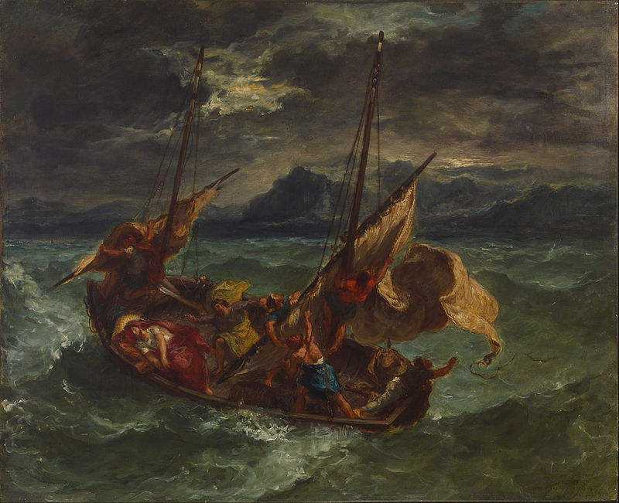

Slide 5
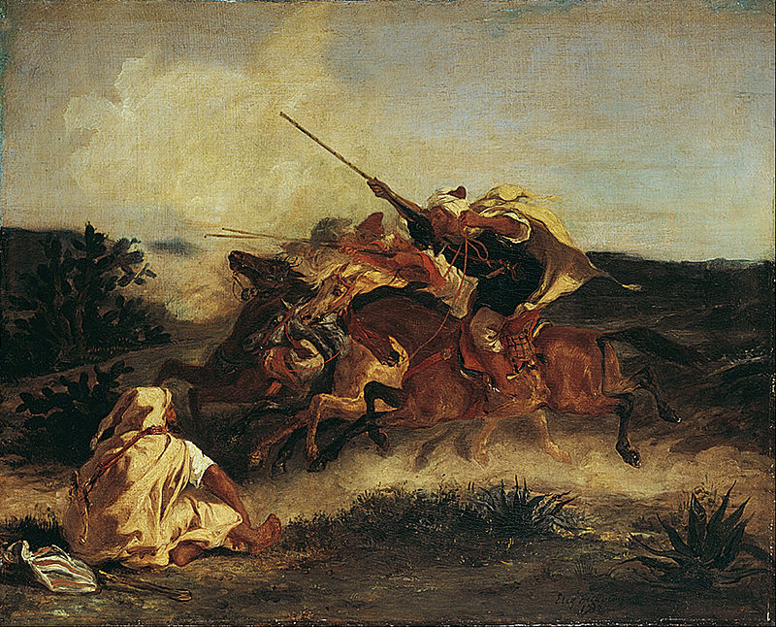

Slide 6
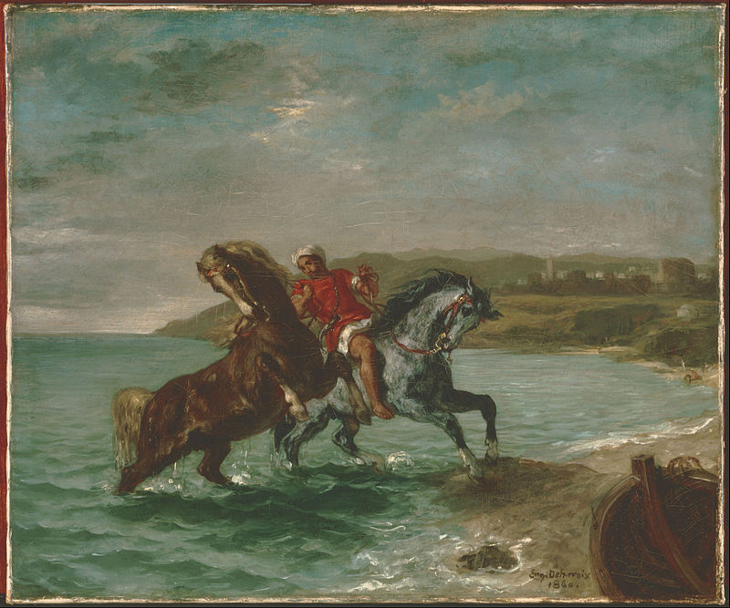

Slide 7
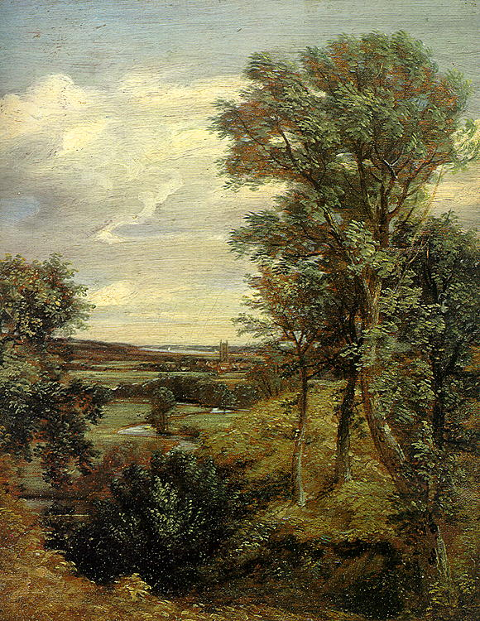
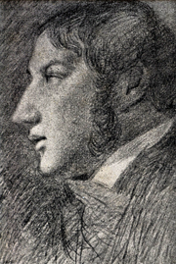
John Constable

Slide 8
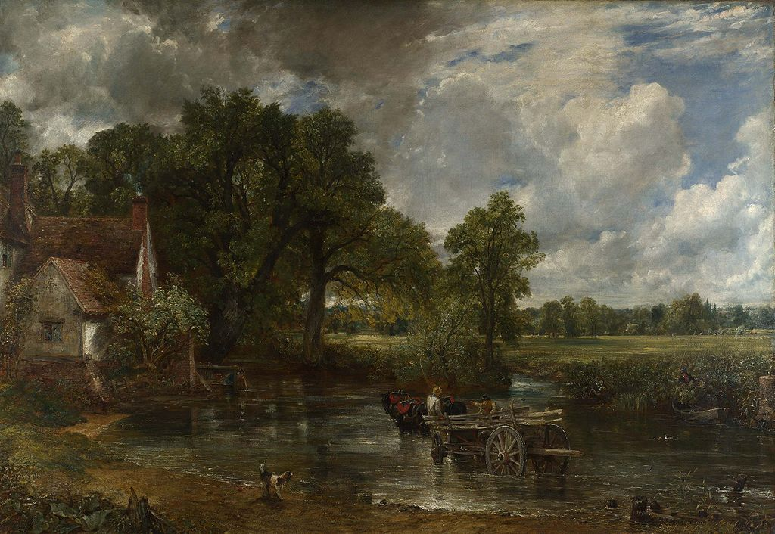

Slide 9
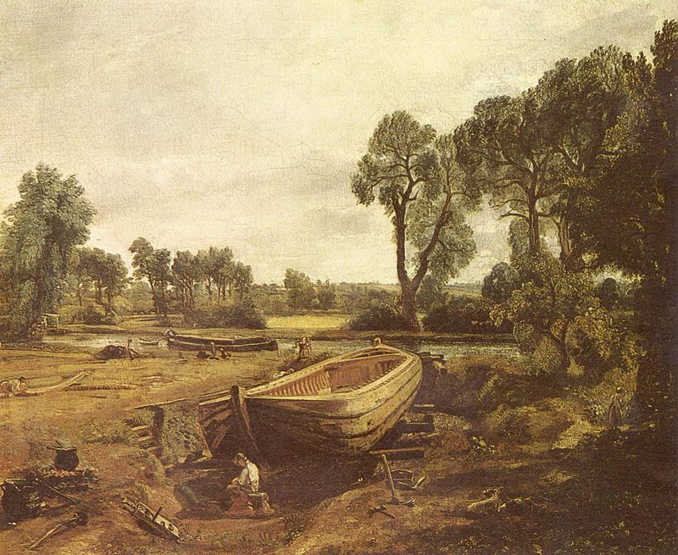

Slide 10
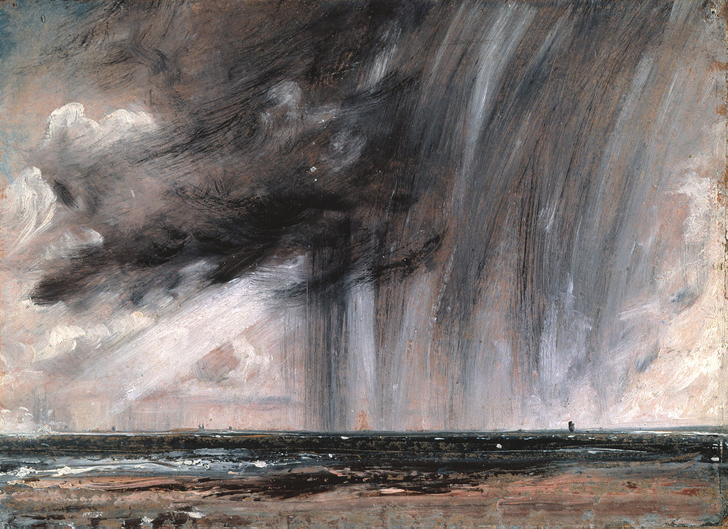

Slide 11
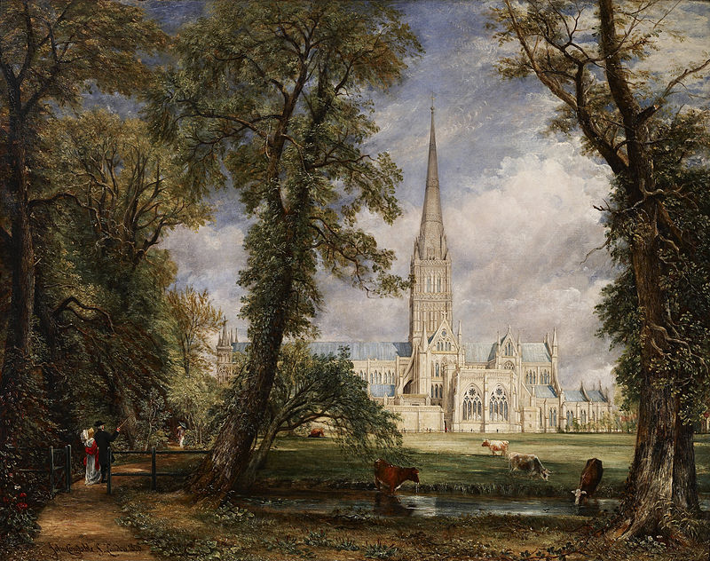

Slide 12
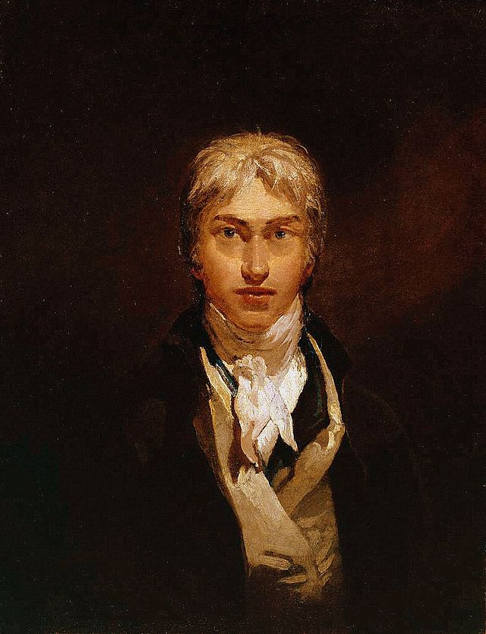
J.M.W. Turner

Slide 13
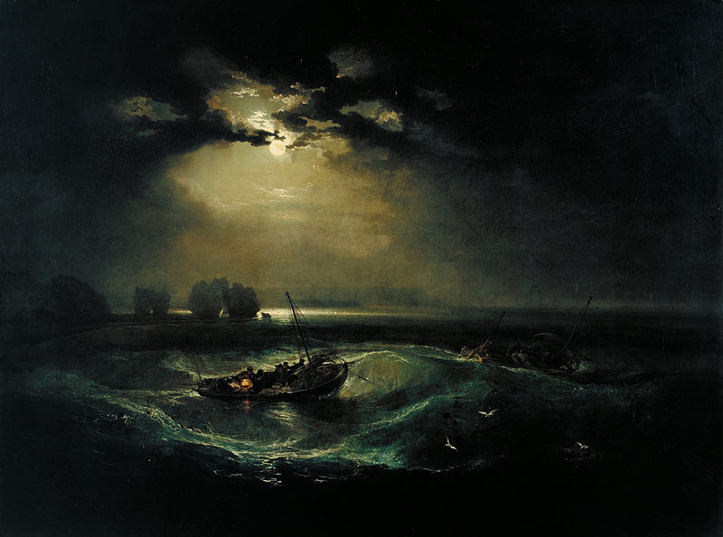

Slide 14
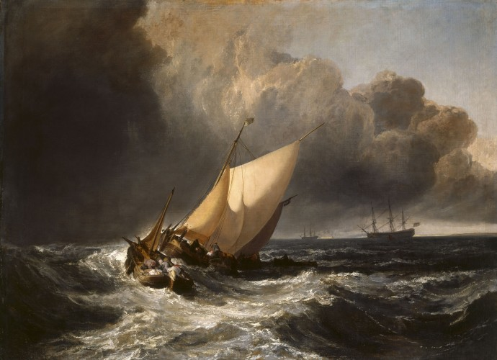

Slide 15
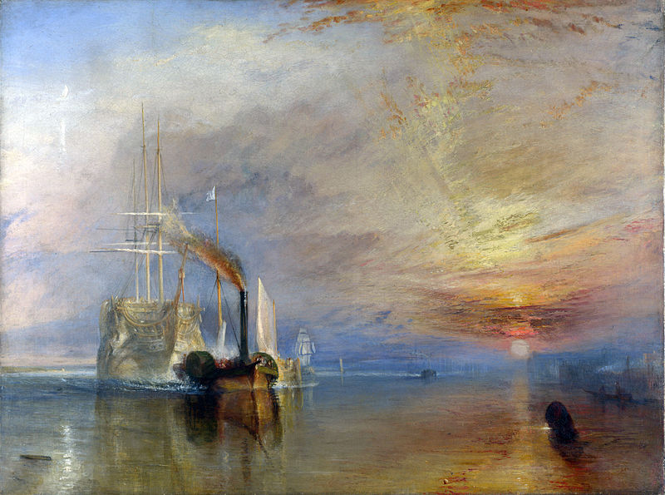

Slide 16
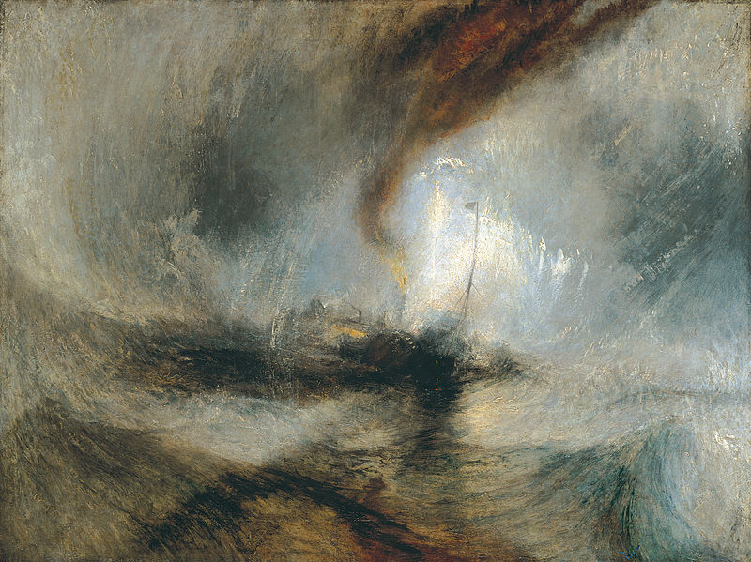

Slide 17
