Slide 1
Romanticism: Literature
World History 17d

Slide 2
Romanticism in the Arts
Romanticism was a cultural movement in Europe in the first half of the 1800s that glorified nature, emotions, and the imagination in reaction to the rationalism of the Enlightenment

Slide 3
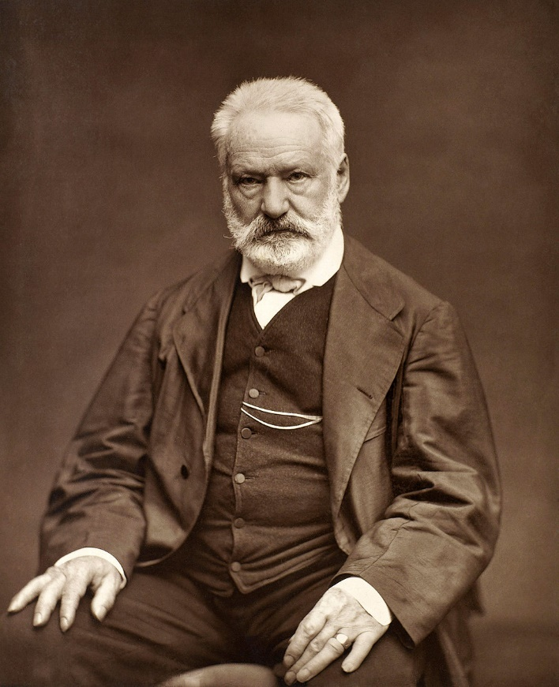
Romanticism in Literature
Victor Hugo (French)
  Les Miserables, The Hunchback of Notre Dame

Slide 4
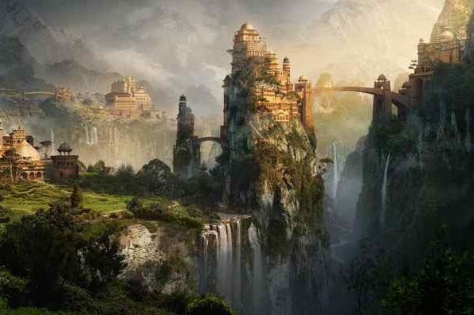
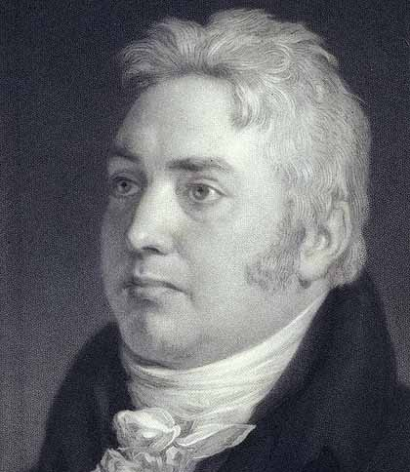
Romanticism in Literature
Samuel Taylor Coleridge (English)
  Poems depict exotic places and fantastic experiences
  “Kubla Khan” and “Rime of the Ancient Mariner”

Slide 5
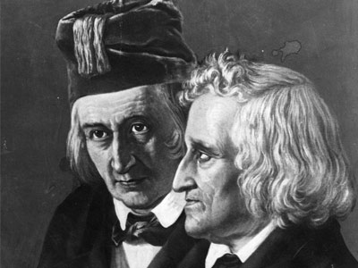
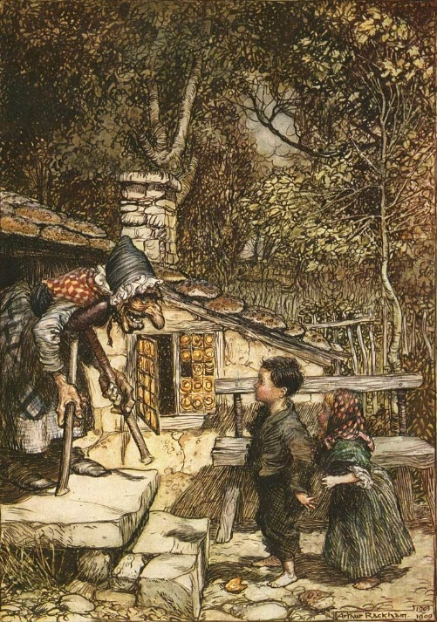
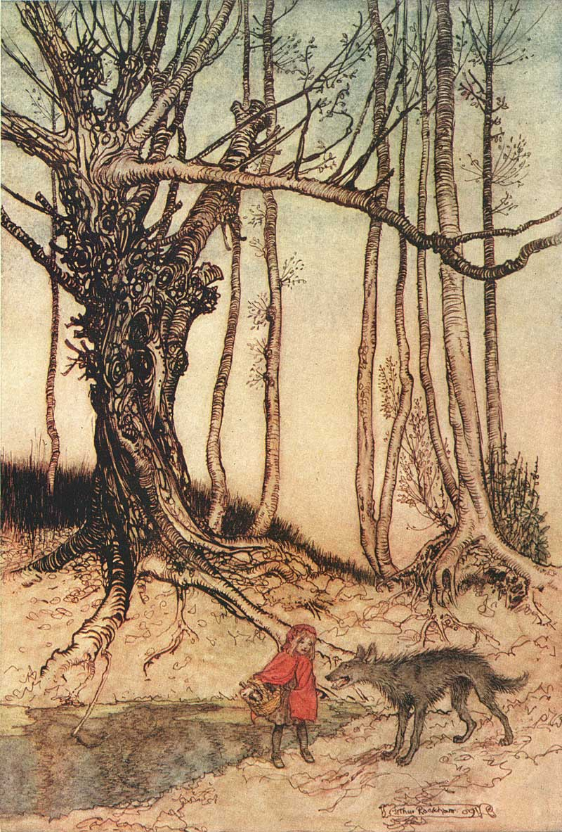
Romanticism in Literature
Grimm Brothers (German)
  Collected German folk stories and fairy tales
  “Little Red Riding Hood,” “Hansel and Gretel,” “Cinderella”

Slide 6
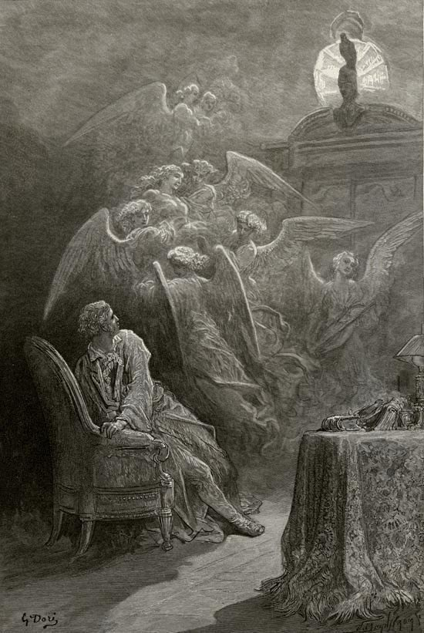
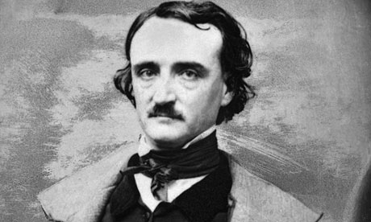
Romanticism in Literature
Edgar Allan Poe (American)
  Stories and poems of mystery and terror
  “The Pit and the Pendulum” and “The Raven”

Slide 7
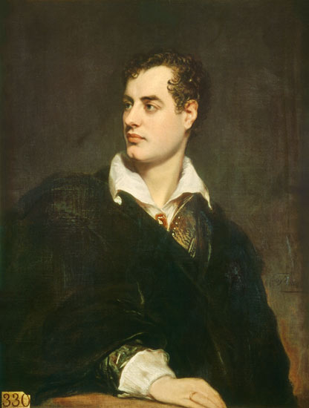
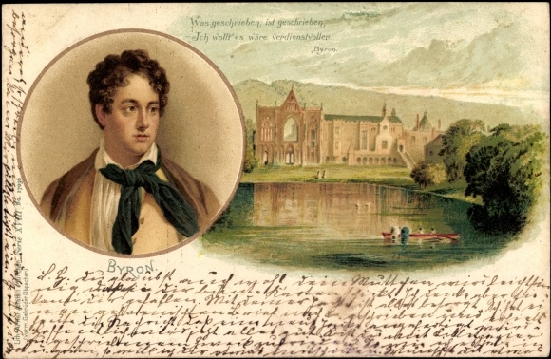
Romanticism in Literature
George Gordon, Lord Byron (English)
Rebelled against the constraints of society and morality

Slide 8
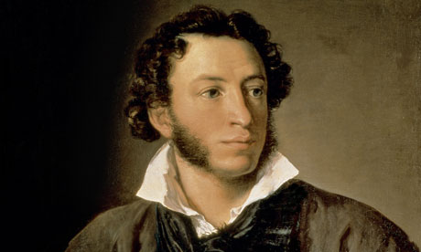
Romanticism in Literature
Alexander Pushkin (Russian)
Promoted nationalism by popularizing Russian folklore and history

