Slide 1
French Revolution
World History 16b

Slide 2
French Revolution--Background
Notes:
Add chart (or text) showing
1 % of the people owned 10% of the land
2% of the people owned 25% of the land
97% of the people owned 65% of the land.

Slide 3
Causes of the French REvolution
Money Troubles
    French government deeply in debt
    Large Gap between the king’s court/nobility and the majority of workers
      Nobility was living it up (think Louis XIV) while peasants were starving
Political ideas from the Enlightenment
    All men have basic rights that the government should recognize
    Authority comes from those who are governed

Slide 4
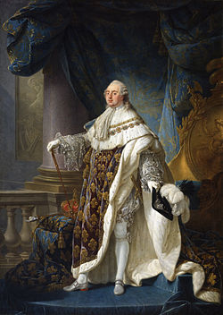
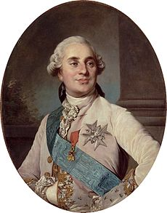
State of affairs
King Louis XVI was king of France when the French Revolution occurred.

Slide 5
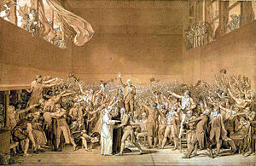
Convention of the estates General
The King needs money, so he calls the Estates General to raise taxes
The Third Estate refuses to be counted as only one vote, so they form a new assembly that they call the National Assembly of France, and meet on their own, with the intention of writing a new constitution that will give them more influence.
They are locked out of their room by the king; they meet in the tennis court and swear to not disband until they have a new constitution—Tennis Court Oath
King says OK, but starts to send troops to Paris

Slide 6
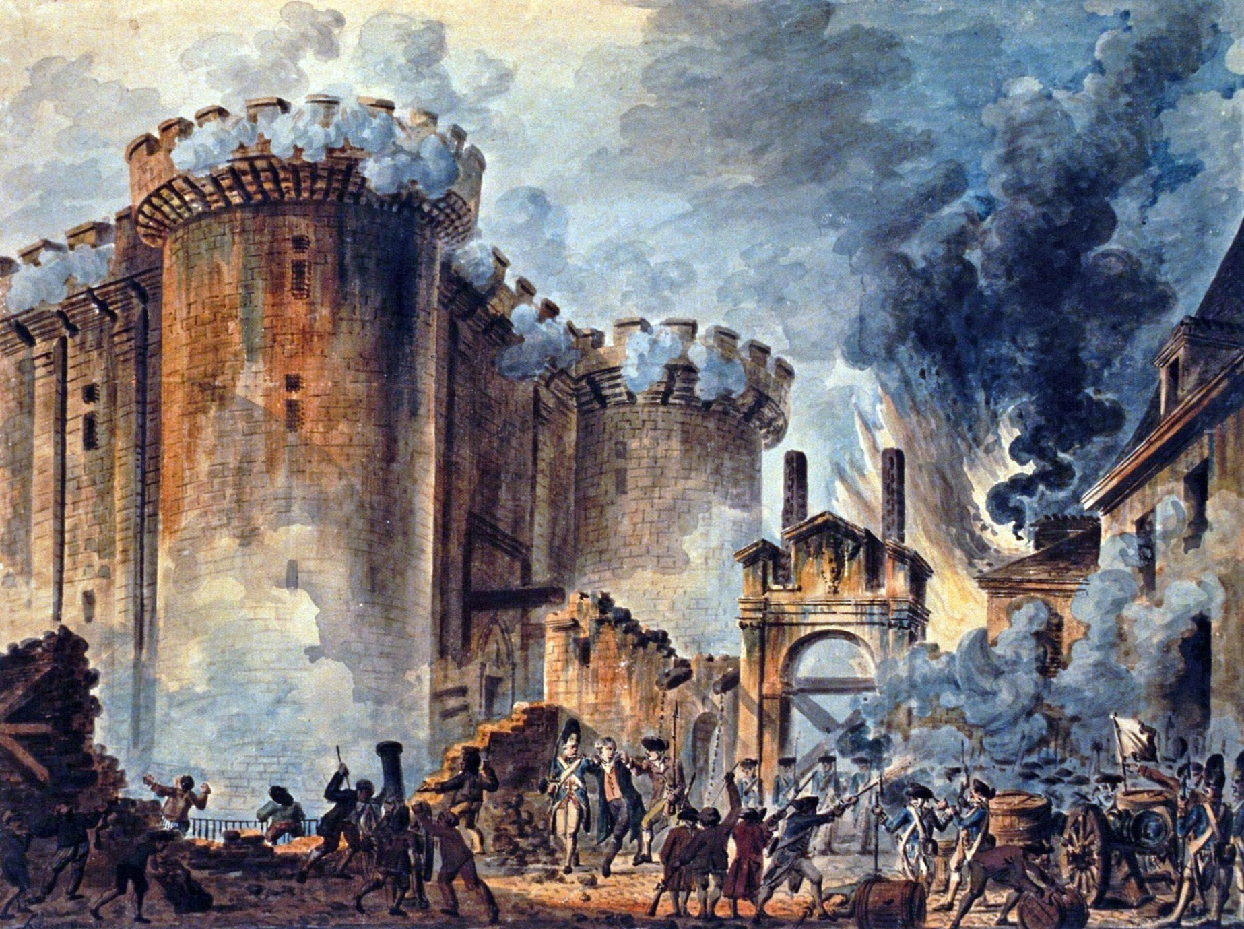
Storming of the Bastille—july 14, 1789

Slide 7
Actions of the National Assembly
Produces “Declaration of the Rights of Man” (note parallel here with events in Middle East and Asia)
    Around the same time, popular discontent is growing: a mob of women march on Versailles forcing the King to move to Paris
    The king tries to slip out of the country but is forced to return
The Assembly passes the Constitution of 1791 which limited the power of the king and forces him to share power with a representative body

Slide 8
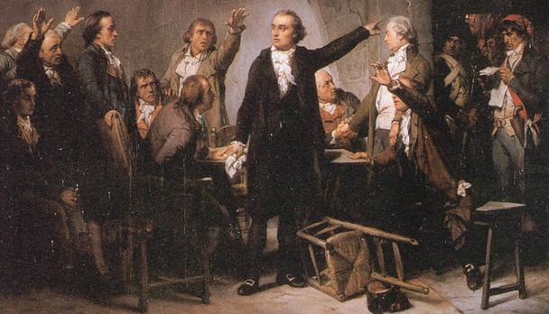
Rise of the Radicals
The representative body develops a right, left, and center
The most radical of the Left, the Jacobins manage to dominate affairs and move things their way
They accuse the king of treason, convict him by trial, and guillotine him
The establish the French Republic

Slide 9
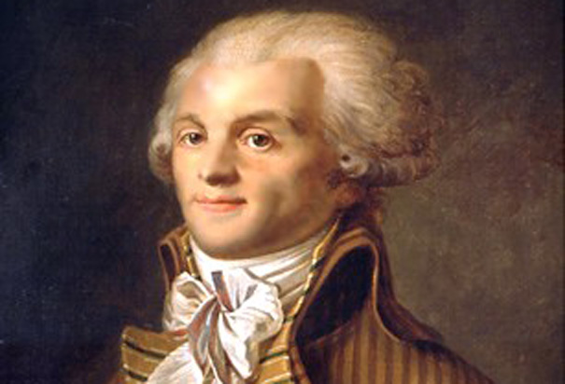
First French Republic-A study in Extremes
With the most radical revolutionaries in charge, French society is radically restructured: weeks are changed to 10 days, Sundays are eliminated, days have 10 hours, hours have 100 minutes, and minutes have 100 seconds, and years have 10 months; atheism is promoted
Robespierre is the most prominent leader of the group
Reign of Terror: Anyone who could be seen as opposing the Revolution is guillotined
Within a few years, the leaders of this movement have killed each other out of fear and suspicion

Slide 10
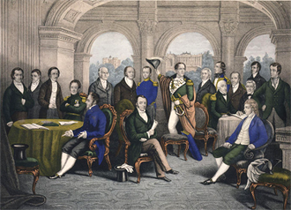
The directory
The Republic is restructured with a bicameral legislature and a five-man executive called the Directory
The Directory calls on Napoleon to lead the army and defend France from her enemies

Slide 11
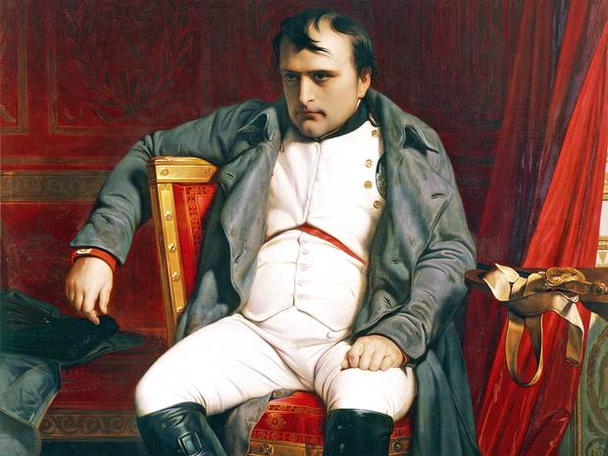
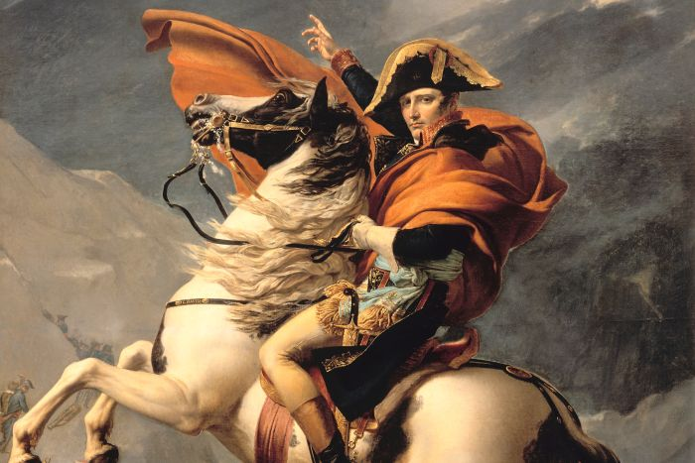
Napoleon’s Rise to Power
Successful in protecting France
Becomes very popular with the French masses
Takes a break from the field to return to Paris, perform a coup detat, and seize control of the French government
After a few transition stages, Napoleon proclaims himself emperor for life, creating the French Empire--1804

Slide 12
