Slide 1
American Independence
World History 16a

Slide 2
Early Settlements
Pilgrims—1620—Plymouth, Mass.
  Mayflower
  “Mayflower Compact”—established a precedent of self-government
Puritans—1630—Boston
  Became the dominant group in New England

Slide 3
British Colonies
Notes:
Add map of British Colonies.

Slide 4
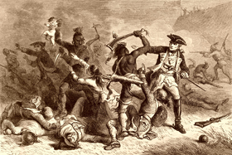
French and Indian War
Notes:
Add map showing the eastern United States and what area was claimed by the French, British, and Spanish during the French and Indian War.

Slide 5
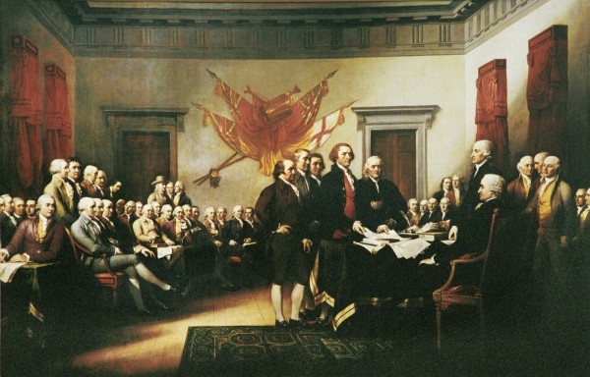
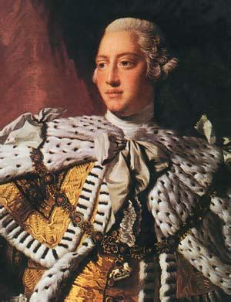
Conflict between Colonies and Crown

Slide 6
Declaration of Independence
Notes:
Add pictures.

Slide 7
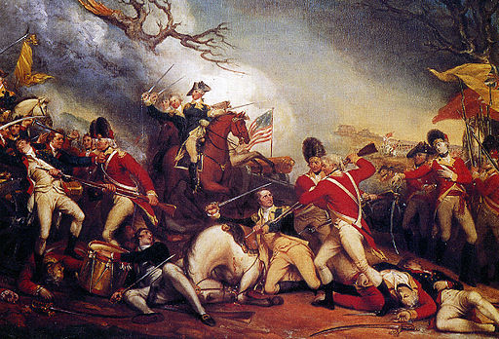
Revolutionary War
Notes:
Add map of major battles and routes during the Revolutionary War.

Slide 8
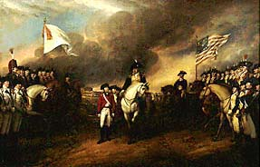
End of the War
As the war wore on, the Americans grew more organized and more effective while the British grew more tired and less determined.
The war was finally and officially ended in 1783 with the Treaty of Paris
  America was recognized as an independent state
  America’s boundary extended all the way to the Mississippi River but did not include Florida

