Slide 1
Age of Reason:
Spiritual Awakening
World History 15c

Slide 2
Common Threads in Spiritual Awakening
Recognition that an intellectual assent to a list of beliefs was inadequate
A call for:
  personal conversion
  daily Bible study and prayer
  holy living
“Awakened” Christians often started small groups within the larger churches

Slide 3
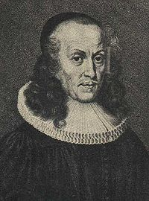
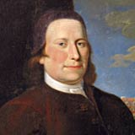
Revival in Germany
Philipp Spener: Lutheran minister who started small group Bible studies and called for personal piety
His work grew into a movement called Pietism and spread throughout Germany and beyond
Pietism influenced Zinzendorf and the Moravians

Slide 4
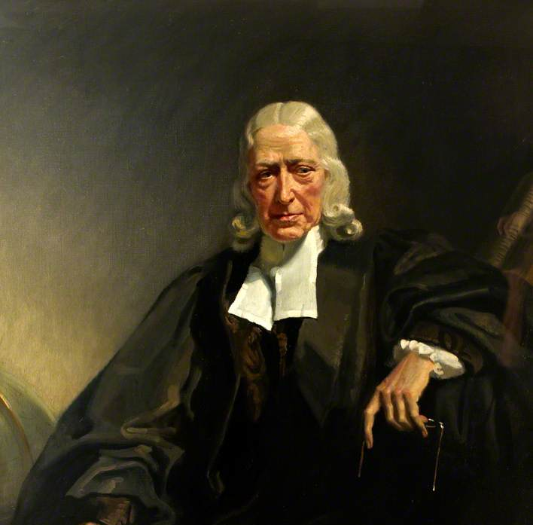
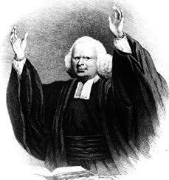
Revival in England
Whereas revival in Germany arose within the Lutheran church, revival in England arose within the Anglican church
John Wesley is the major figure in the renewal movement in England
George Whitefield was another powerful preacher
Eventually, this movement grew into the Methodist Church

Slide 5
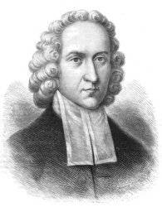
Revival in America
A corresponding revival took place in America — here it was called the Great Awakening
Religious context: “state” Anglican churches and New England Congregationalist churches
Important figures
  Jonathan Edwards
  George Whitefield

