Slide 1
Age of Reason:
Philosophy and Ideas
World History 15b

Slide 2
The Enlightenment
The Age of Reason (this shift from ancient authorities and church tradition to self-confidence and science) culminated in a movement called the Enlightenment
Enlightenment—intellectual movement in the 1700s that looked to human reasoning as the answer to all of life’s problems

Slide 3
Inductive vs. Deductive Reasoning
Inductive Reasoning: deriving general truths from specific cases (e.g. concluding that gravity pulls all objects toward the earth at the exact same speed after performing 300 different experiments)
Deductive Reasoning: deriving more specific truths by applying a general truth (e.g. “since the sum of interior angles in a triangle is always 180, I know that the angle in this problem is x”

Slide 4
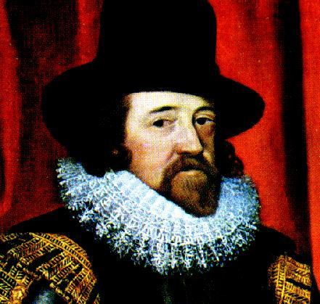
Bacon and the Inductive Method
Sir Francis Bacon promoted the inductive method of reasoning through the use of the scientific method
Empiricism—the idea that all knowledge comes through experience

Slide 5
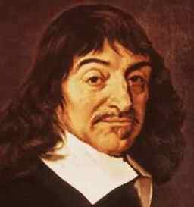
Descartes and the Deductive Method
Rene Descartes emphasized deductive reasoning in trying to begin with the fundamental realities in life and then logically building on them

Slide 6
Inductive vs. Deductive Reasoning

Slide 7
Reason and Deism
The Enlightenment’s emphasis on reason led many people to reject revelation and the miraculous and instead develop a completely rational religion: deism

Slide 8
Reason and political theories
Political ideas that became popular in Enlightenment
  The idea of majority rule
  The idea that people have certain natural and unalienable rights and that govt. must respect those rights

