Slide 1
Age of Reason: Advances in Science
World History 15a

Slide 2
Age of Reason—1600 & 1700s
A clear shift in epistemology occurs in Europe as people move from the Middle Ages into the 1600 and 1700s
People in the Middle Ages relied heavily on ancient authorities and church teaching as a basis for their beliefs; those two sources of knowledge were largely replaced with a confidence in one’s own ability to reason and with scientific experimentation

Slide 3
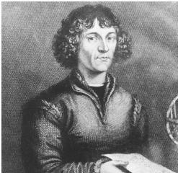
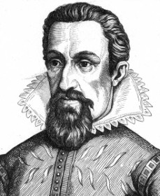
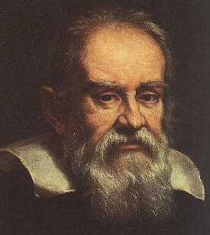
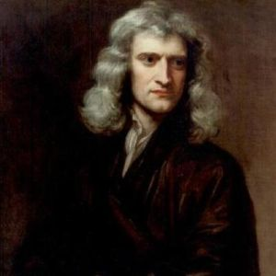
Astronomy
Nicolaus Copernicus
Johannes Kepler
Galileo Galilei
Isaac Newton

Slide 4
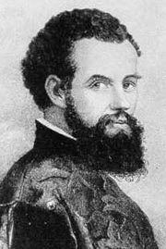
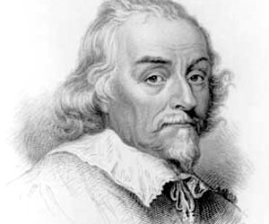
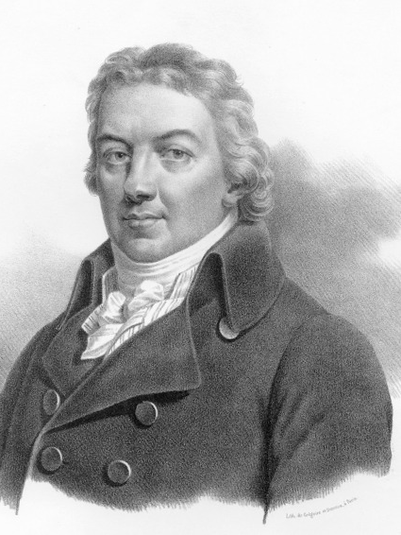
Medicine
Andreas Vesalius
William Harvey
Edward Jenner

Slide 5
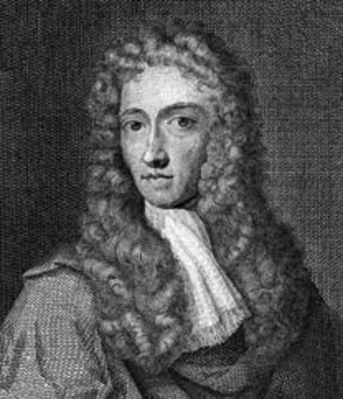
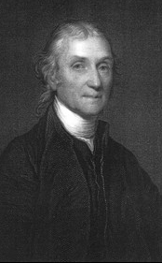
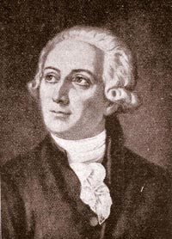
Chemistry
Robert Boyle
Joseph Priestley
Antoine Lavoiseir

