Slide 1
Rise of Brandenburg-Prussia and Russia
World History 14b

Slide 2
Brandenburg-Prussia in 1700
Notes:
Add map showing Brandenburg-Prussia in 1700.

Slide 3
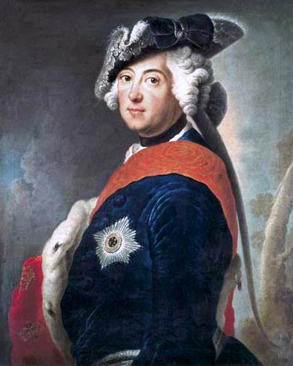
Formation of Brandenburg-Prussia
The Fredericks
Dynasty
Notes:
Add map showing how Brandenburg-Prussia changed from 1600-1795.

Slide 4
Expansion of Russia
Notes:
Add map showing the different expansions of Russia from 1533- the reign of Alexander III in 1890.

Slide 5
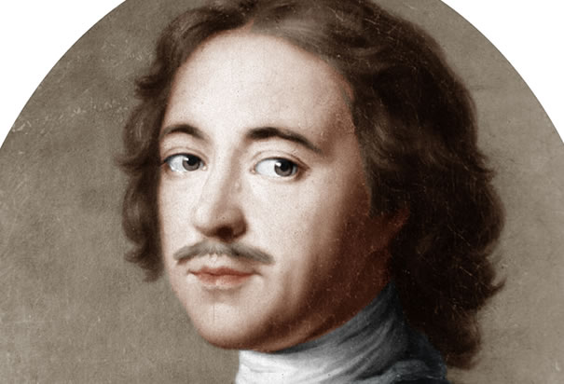
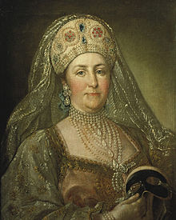
Russia becomes a European player
History of tyranny and oppression
Peter the Great (c. 1700)—Modernized and Westernized Russia
  Brought European culture and technology to Russia
  Expanded Russian territory
  Exerted control over the Russian Orthodox Church
Catherine the Great
  Capable but ruthless ruler
  Expanded Russian territory further

Slide 6
Summary
Strong absolutist countries in Europe
  France (Louis XIV)
  Brandenburg-Prussia (the Fredericks)
  Russia (Peter the Great and Catherine the Great)

