Slide 1
Absolutism and Louis XIV
World History Chapter 14A

Slide 2
Reading Quiz
Where did absolutist kings claim to get their power?
What war between Protestants and Catholics left France as the most powerful country in Europe?
Who became known as the “Sun King”?
Where did the Sun King build the most elaborate palace of Europe?
Was the Sun King Catholic or Protestant?

Slide 3
Absolute Power in Europe
Just as the solar system revolves around the sun, the country and all of its affairs revolve around the king
“Divine Right”—this power comes from God

Slide 4
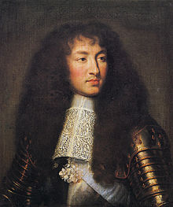
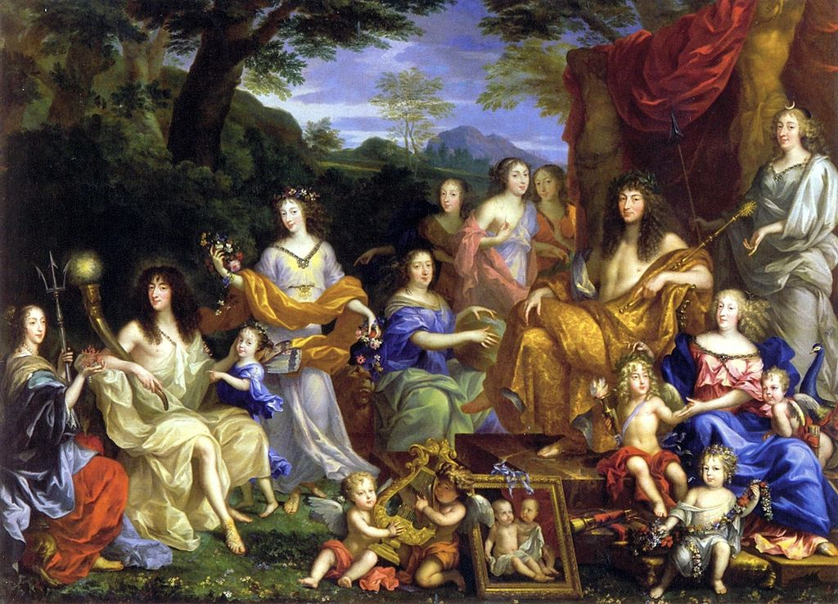
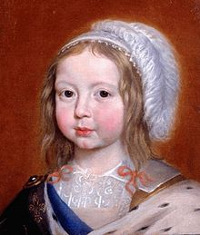
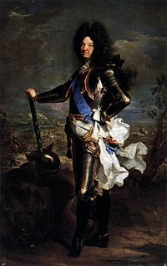
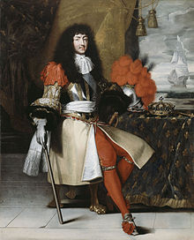
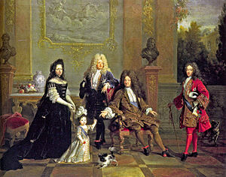
Louis XIV—The “Sun King”

Slide 5
Louis XIV “Accomplishments”
Gained complete control of French affairs to become the epitome of an absolute monarch
Revoked the freedom of Huguenots (French Protestants), persecuting them and driving many of them out of the country
Expanded French territory
Built the Palace of Versailles , the most elaborate palace of Europe
Reigned for 70 years (longer than any other European monarch)

Slide 6
Palace of Versailles
Notes:
Insert picture (Wikipedia has a good one) of the palace of Versailles.

