Slide 1
Reformation-Part 2
World History 12c

Slide 2
From Germany to Rest of Europe
Notes:
Add map of Europe.

Slide 3
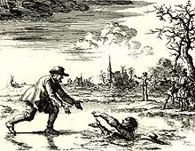
Radical Reformation: Anabaptists
While Luther and numerous other reformers around Europe were attempting to carry out reforms within the state-church system, a group in Zurich, Switzerland saw a need for more radical changes in the church
This group, called the Anabaptists, endeavored to establish a church modeled on the early New Testament churches

Slide 4
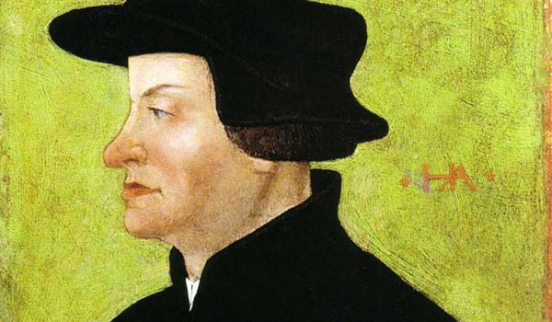
Anabaptists: History of the movement
The movement in Zurich began under Ulrich Zwingli, priest at the largest church in the city

Slide 5
Key Differences between the Anabaptists and other Protestants
Put more emphasis on discipleship than on doctrine (right living over right thinking)
Practiced believer’s baptism and believer’s church
Practiced love in all areas of life rather than force (no participation in war, non-involvement in government, no litigation)

Slide 6
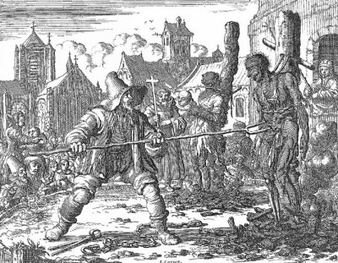

Slide 7
Notes:
Add map of Europe showing Anabaptist centers and communities and areas that were predominantly Calvinist or Lutheran.

Slide 8
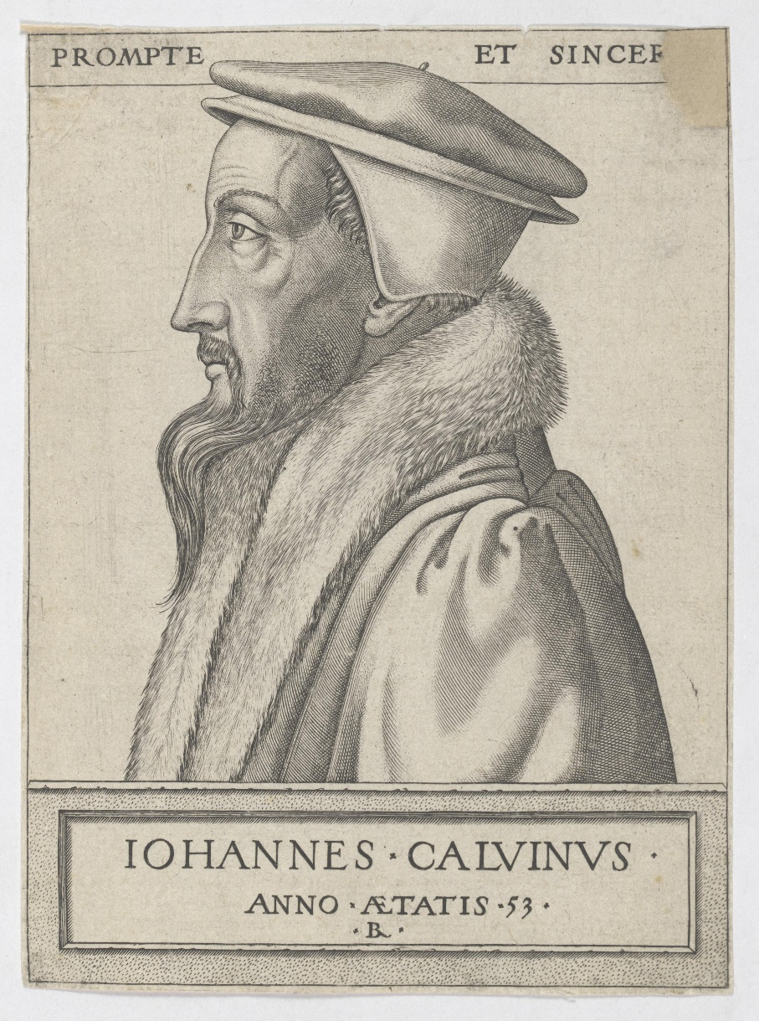
Calvin’s World in the 16^{c}
Notes:
Add map of western Europe in the 16th century.

Slide 9
John Calvin
Calvin emphasized God’s sovereignty: the idea that God controls all things to work out for His glory, even to the extent of choosing who will be saved and who will not be (predestination)
Founder of Reformed or Calvinistic churches

Slide 10
Protestant
Churches
in
France
(Late 16^{c})
Notes:
Add map showing the Protestant Churches in France in the late 16th century.

Slide 11
Notes:
Add map of Europe showing the predominant religions in 1555.

