Slide 1
The Renaissance-Part 1
World History 11a

Slide 2
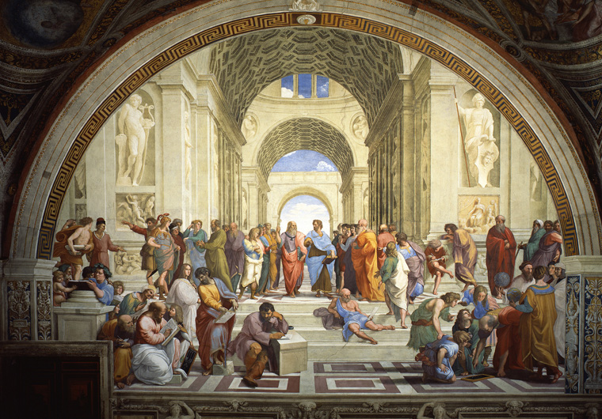
Renaissance—”rebirth”

Slide 3
Two Arenas of Renaissance
Southern Renaissance—centered in Italy
    Focused on the arts and culture
    Big names: Petrarch, Michelangelo, Raphael, Castiglione
Northern Renaissance—centered in Northern Europe
    Focused on religious and intellectual matters
    Big names: Erasmus, Thomas More

