Slide 1
Medieval Learning and Art
World History 10b

Slide 2
Steps in Medieval Epistemology
Tradition (culture)
    Institution of the Catholic church
    Ancient “authorities” such as Aristotle
Reason
    A movement known as scholasticism arose during the Middle Ages which combined faith and reason
Experience
    In the late Middle Ages, people began to see the value of observation and experimentation in the discovery of truth

Slide 3
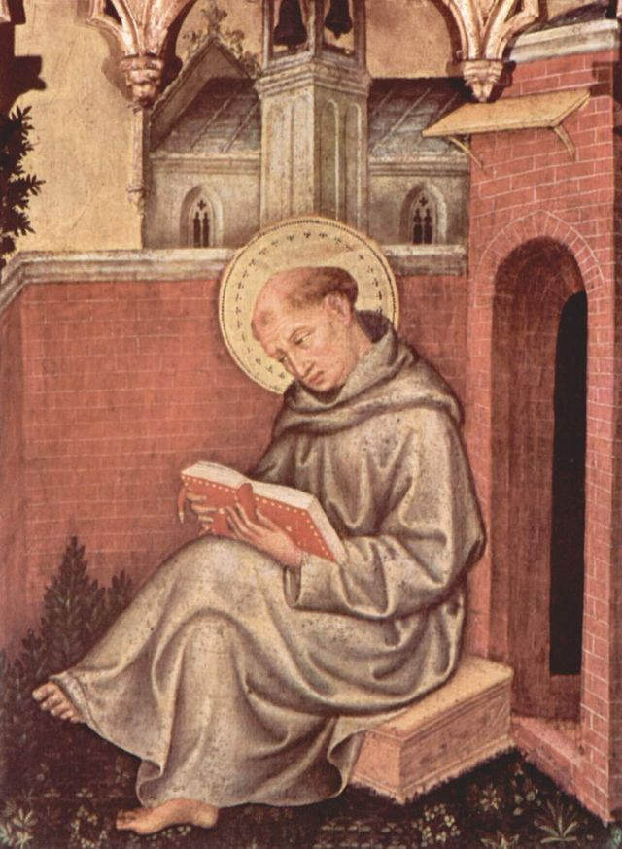
Thomas Aquinas
Part of the scholasticism movement, Thomas Aquinas was the most important theologian and philosopher of the Middle Ages
His most important work is the Summa Theologica

Slide 4
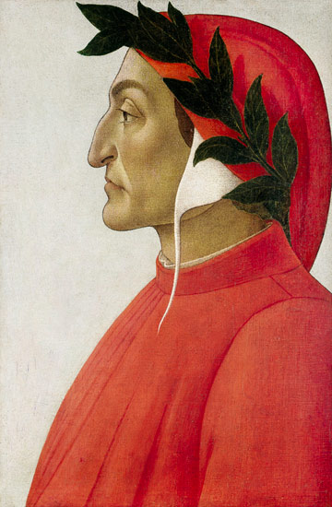
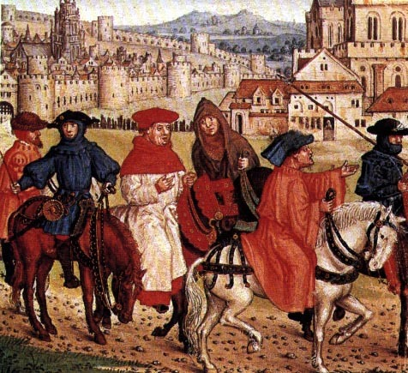
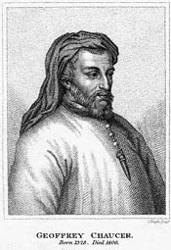
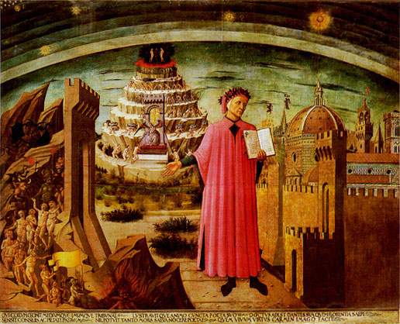
Medieval Literature
Dante— Divine Comedy
Chaucer—The Canterbury Tales

Slide 5
Medieval Architecture
Romanesque
Gothic
Based on Roman styles of architecture
Characterized by thick walls, arches and domed ceilings
Based on new ideals of the Middle Ages
Characterized by higher ceilings, thinner walls, and larger windows and doors
Notes:
Mr. Meyers added more slides with pictures of each style of architecture.

