Slide 1
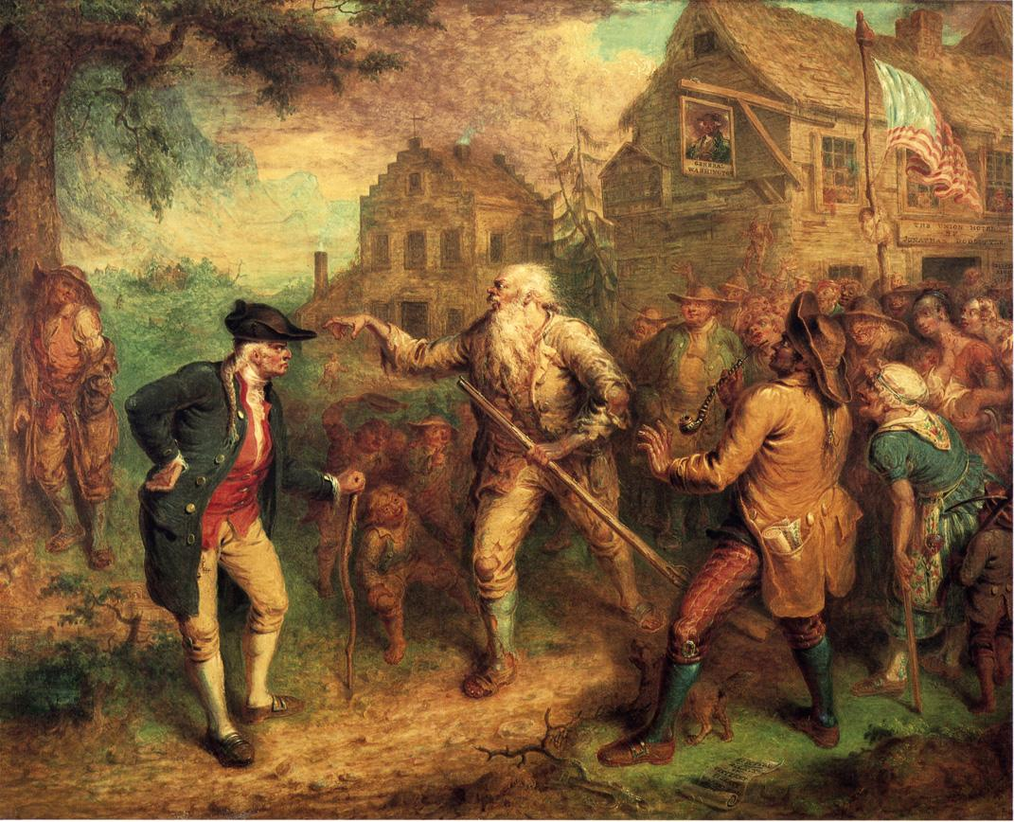
Washington Irving
&
The American Short Story
The “Dean”—and Dawn—of American Literature
Notes:
John Quidor, Public domain, via Wikimedia Commons

Slide 2
What is a short Story?
A short work of narrative fiction whose plot, characters, settings, point of view, style, and theme reinforce one another, often in subtle ways, creating an overall unity (1434).
From Literature: A Portable Anthology, 4th ed., edited by Janet E. Gardner, et al., Bedford/St. Martin’s, 2017.

Slide 3
What is a short Story?
Elements of narrative
  Narrator (POV) – who tells the story
  Plot – what happens
  Setting – where it happens
  Characters – who makes it happen
  Theme – what it means

Slide 4
What is a short Story?
Edgar Allan Poe’s criteria:
  Produces single effect—every element in story designed to produce effect.
  Short enough to be read in one sitting—no interruption to dramatic effect.

Slide 5
AN American Form
Modern short story form one of the unique contributions of American literature to the world.
“The American imagination releases itself very easily in the short story—and has done so since the beginning of our national history. We have been a country of tall-tale tellers, and swappers of anecdotes, certainly since the frontier began to move westward.” –Henry Seidel Canby

Slide 6
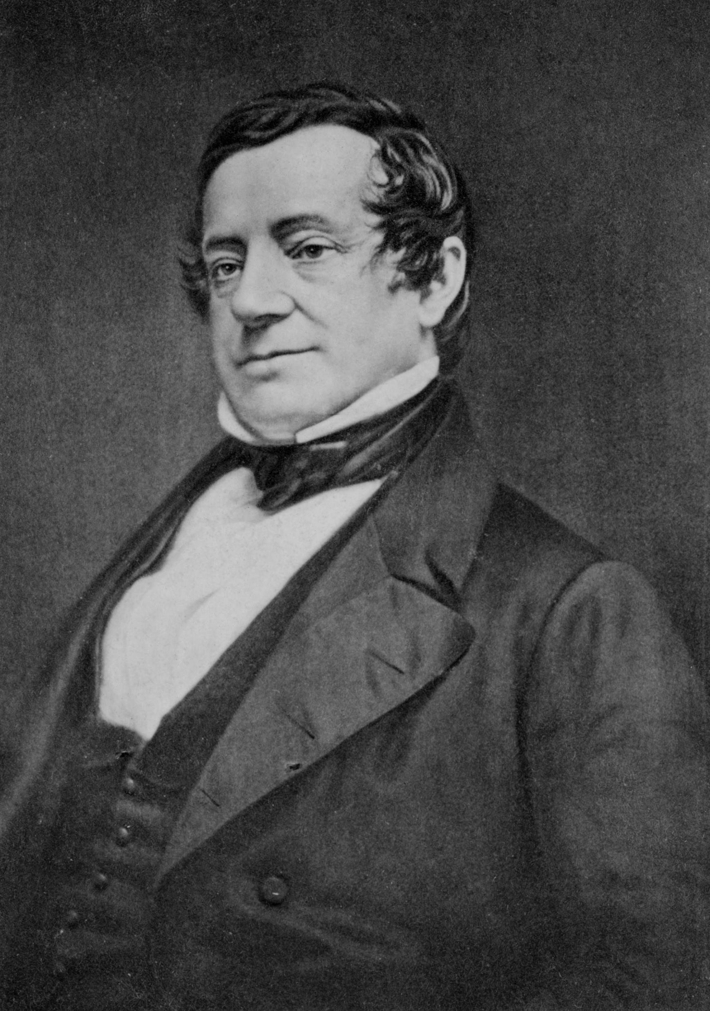
Washington Irving (1783–1859)
Born in NYC in 1783; youngest of 11 children.
Major contributor to emerging literary nationalism
First American writer to achieve major international status and recognition
First professional American writer (supported himself financially with writing)
Arguably first American short story writer

Slide 7
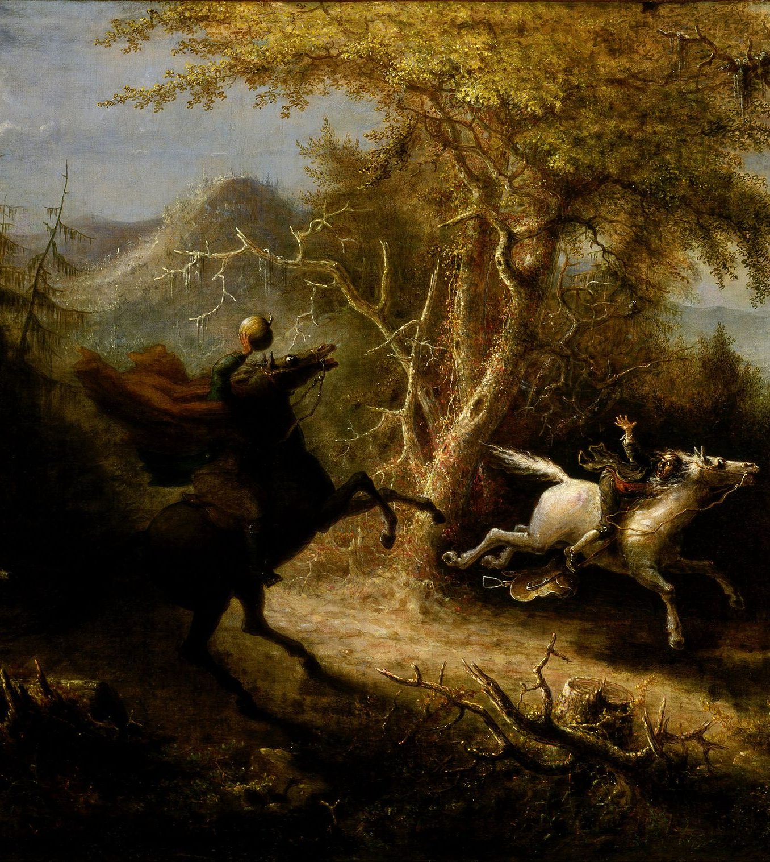
Characteristics
Sets many stories in New York’s Hudson River area.
Based on Old World legends (Dutch and German).
Haunted, ghostly, and folkloric; participating in tall-tale tradition.
Romantic influences—interested in nature and the supernatural.
Memorable characters.
  Rip Van Winkle
  Ichabod Crane (from “The Legend of Sleepy Hollow”)
Notes:
Public Domain, John Quidor (1858): https://en.wikipedia.org/wiki/File:John_Quidor_-_The_Headless_Horseman_Pursuing_Ichabod_Crane_-_Google_Art_Project.jpg

Slide 8
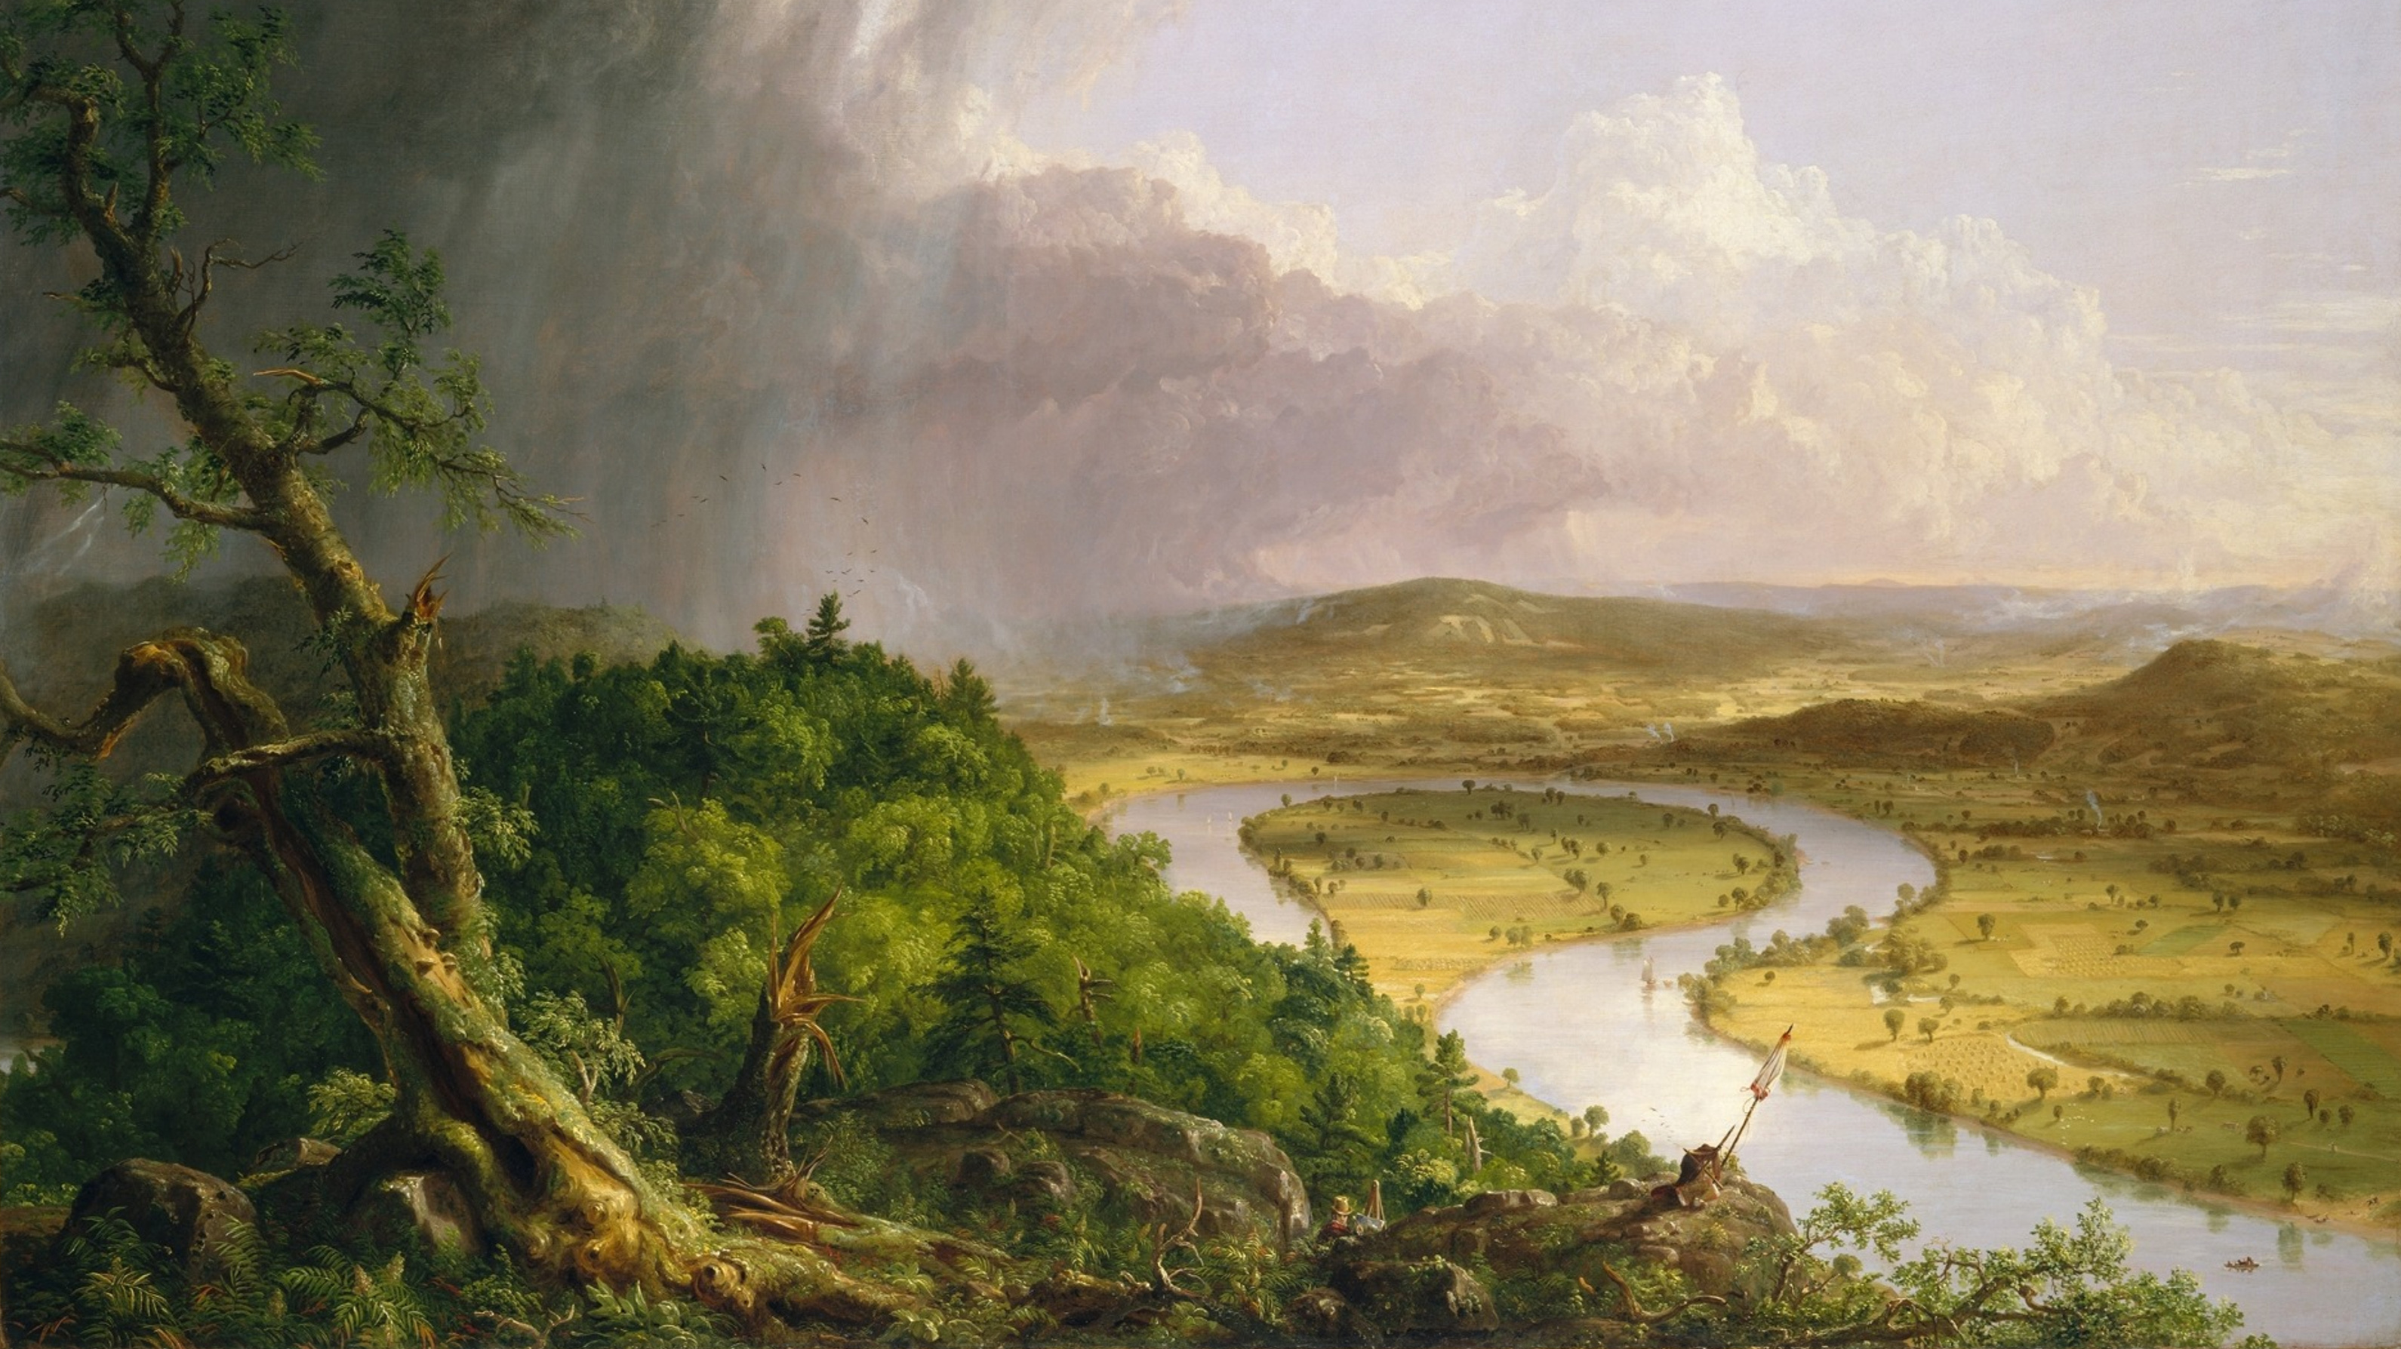
Notes:
Thomas Cole (1801–1848), The Oxbow, View from Mount Holyoke, Northampton, Massachusetts, after a Thunderstorm (1836), Metropolitan Museum of Art https://commons.wikimedia.org/w/index.php?curid=182973

Slide 9
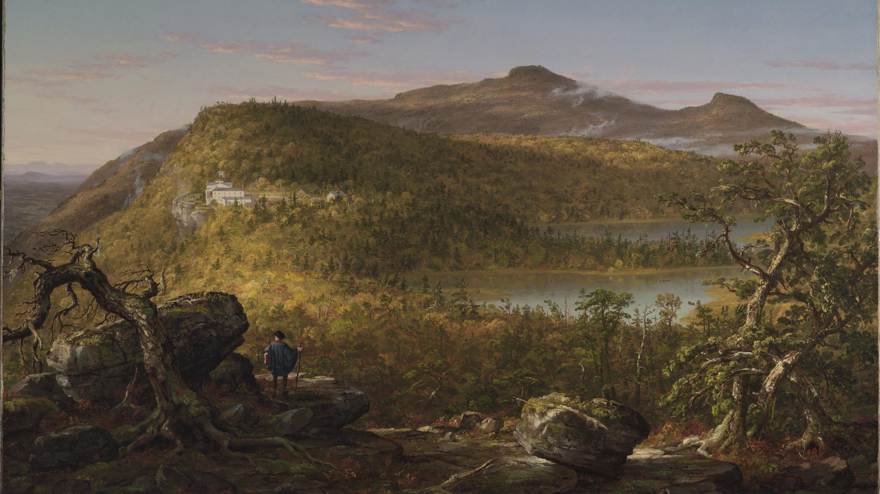
Notes:
Thomas Cole, A View of the Two Lakes and Mountain House, Catskill Mountains, Morning, 1844, Brooklyn Museum of Art By Thomas Cole - EwEdL_BjaJ-KYg at Google Cultural Institute, zoom level maximum, Public Domain, https://commons.wikimedia.org/w/index.php?curid=21372607

Slide 10
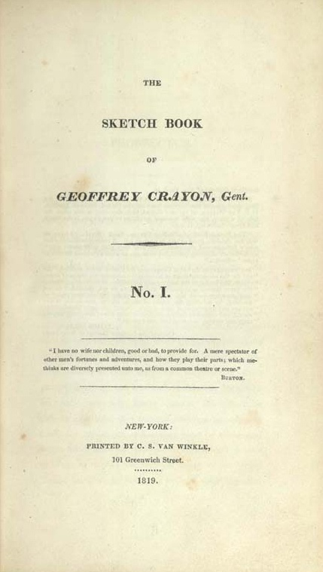
“Rip Van Winkle”
Published in 1819 in The Sketch Book, authored by Irving’s pseudonym Geoffrey Crayon.
Story attributed to and narrated by Diedrich Knickerbocker, Irving’s fictional Dutch historian (also “Sleepy Hollow”)

Slide 11
“60-Second Game”
Discuss your favorite line or scene from the story. Why do you find it interesting, remarkable, challenging, or amusing?
Comment on the narrator’s point of view, voice, and style. Describe the narrator based on his narration.
Analyze one of the characters (agents) of the story. Remember that characters do not necessarily need to be human.
Discuss one or more of the larger themes of the story.
Discuss the significance of setting, especially the dynamics of nature and town.
Consider the historical and political setting of “Rip Van Winkle” and Irving’s contribution to a self-consciously American literary tradition. What about America—its identity, character, or values—does it celebrate or critique?
Make a connection with another story or poem from class.
Comment on a previous student’s reflection.
For exactly sixty seconds, comment on some aspect of “Rip Van Winkle” using one of the prompts to the right. If you run out of things to say, read from the story until your time concludes.

