Slide 1

The Emergence of American Christianity
Denominationalism and Revivalism in the Early 19th Century

Slide 2
Changes in 19th-Century Protestantism
“It is not an exaggeration to claim that…nineteenth-century Protestant evangelicalism differed from the religion of the Protestant Reformation as much as sixteenth-century Reformation Protestantism differed from the Roman Catholic theology from which it emerged” (Noll 3).
Notes:
“Western Protestantism in the eighteenth and early nineteenth centuries was moving from establishment forms of religion, embedded in traditional, organic, premodern political economies, to individualized and affectional forms, adapted to modernizing, rational, and market-oriented societies. Theological manifestations of these changes can be described in several ways. They first reoriented specific beliefs: God was perceived less often as transcendent and self-contained, more often as immanent and relational. Divine revelation was equated more simply with the Bible alone than with Scripture embedded in a self-conscious ecclesiastical tradition. The physical world created by God was more likely to be regarded as understandable, progressing, and malleable than as mysterious, inimical, and fixed. Theological method came to rely less on instinctive deference to inherited confessions and more on self-evident propositions organized by scientific method” (Noll 4).

Slide 3
Christianity Becoming American
Growth of American Protestant churches relative to other institutions
Growth of evangelicalism within Protestantism
  Rejection of traditional confessions and structures of ecclesial authority
  Bible alone as source of religious truth
  Conversionist soteriology (being “born again”)
Christian republicanism: post-Revolutionary synthesis of evangelical theology and commonsense Enlightenment reasoning
(Noll 161)
Notes:
“Transplanted European theology became truly American theology when three interrelated developments occurred.” First, the significance of Protestant churches increased relative to the significance of other American institutions. Second, within the churches, evangelical influence grew rapidly, especially from groups that rejected ecclesiastical tradition, inherited authority, and historical confessions in order to insist upon the Bible and born-again human conscience as the primary religious authorities. Third, the churches, led by the Protestant evangelicals, adopted forms of the republican and commonsense reasoning that the nation’s founders had employed to justify independence and build a new nation.” (Noll 161)

Slide 4
Noll, 162
Notes:
Noll, 162

Slide 5
Noll, 166
Notes:
Noll, 166

Slide 6
Denominationalism
Denomination: a voluntary, self-organizing, and self-perpetuating religious organization (Richey 95)
Product of Enlightenment modernity
  Increasing religious pluralism
  Free market capitalism
  Printing press and the marketplace of ideas
  Political parties and voluntary associations
  Egalitarianism and disestablishment
Also influenced by the egalitarian impulses of revivalism (the “democratization of American Christianity”)
Notes:
Lippy: “[Denominationalism] emerged in Western societies as they searched for stratagems and policies other than coercion and repression for coping with the religious diversity and discord that emerged from the sixteenth-century reformations and seventeenth-century religious wars.”
Noll: “Western Protestantism in the eighteenth and early nineteenth centuries was moving from establishment forms of religion, embedded in traditional, organic, premodern political economies, to individualized and affectional forms, adapted to modernizing, rational, and market-oriented societies” (4).

Slide 7
Revivalism – Contexts
“Second Great Awakening” (1790s to 1830s)
  Widespread evangelical religious fervor
  Comes after relative decline during Revolutionary period
  Genetically connected to “First Great Awakening” (early 1700s) but with key distinctives
Methodist and Baptist Arminian theology of salvation
  Anti-Calvinist—rejected limited atonement, unconditional election, and eternal perseverance
  Sola gratia but more allowance for free will
  Individual conversion (being “born again”)
Increasingly populist and anti-intellectual (McClymond 313-5)

Slide 8
Revivalism – Characteristics
Intensified experience
Bodily manifestations—weeping, shouting, fainting, dancing
Extraordinary occurrences—visions, healings, revelations
Issues of spiritual discernment—tension over how to interpret signs
Issues of lay or clerical authority—how much weight to give a private revelation, especially if it conflicts with established teaching?
Conflict and division in church community—new movements/denominations and splits within denominations
Emergence of new associations, organizations, and institutions—“transdenominational Evangelicalism”
(McClymond 311-2)
Notes:
“George Thomas found a close correlation between entrepreneurship and revivalist religion in the nineteenth-century United States, and suggested that revivalism can be seen as an adaptation of Christianity to fit the economic, social, and cultural milieu of entrepreneurial capitalism. Self-determining individuals from the marketplace entered the house of worship on Sunday as self-determining individuals. “The revivalist myth,” says Thomas, “was cognitively compelling because it corresponded to their everyday experience as shaped by the dominant cultural myth of individualism” (1989: 7, 83). (McClymond 318)

Slide 9
Revivalism – Methods
Frontier camp meetings (“field preaching”)
  Open-air meetings characterized by mass conversion and religious experiences
  1801 Cane Ridge Revival in Kentucky considered foundational
Circuit-riding folk preachers
  “Marginally educated ministers preached extempore to illiterate audiences, leaving no record of their sermons or work in the field. Camps of thousands dismantled in the early dawn, leaving little in their wake but the embers of campfires, fields trampled by African American ‘‘ring shouts’’ and the paroxysms of anguish and joy of prostrate penitents, and the contrite hearts of local supplicants newly 'slain’ by the word.” (Jackson 416)
Sensational preaching
  Drew on gothic literary traditions to describe hell
  “Ministers and exhorters seemed locked into a contest to out do each other in the number of souls they slew with words. In vivid images depicting the eternal anguish of hell, ministers scorched the ears of their parishioners with the hot hail of fire and brimstone” (Jackson 417-8).
  Emphasized power of language to move individual and effect conversion
Notes:
“Yoking the Jeffersonian natural-rights liberalism with Christianity’s socially conservative idiom – a contradiction that would, a generation later, lend currency to abolitionist arguments – these evangelical leaders peppered their periodicals, broadsides, and pamphlets with aphorisms calculated to tap the liberal, libertarian, and populist political ethos still saturating the working-class districts and rural zones of the post-Revolution nation. Promising the balm of ‘‘sweet Gospel liberty,’’ the ‘‘unalienable right’’ to pursue ‘‘scripture wherever it leads,’’ and freedom from the oppression of ‘‘an elite class,’’ preachers like Stone, Campbell, and O’Kelly harnessed the pent up resentment that ‘‘common people’’ felt for what they deemed exploitation by ‘‘privileged classes.’’ In so doing, revivalists and their converts naturalized the similarities between Republican egalitarianism and evangelical iconoclasm, suggesting to many that America was destined as a redeemer nation occupied by a chosen people whose bonds had been forged in Godly virtues and service and tempered by self-denial, suffering, and sacrifice. This egalitarianism and iconoclasm fostered a century of unprecedented religious schism, as denominations – the new term coming into vogue for splinter faiths – emerged in enormous numbers, from radical enthusiasts to the more deistic rationalists” (Jackson 414).

Slide 10
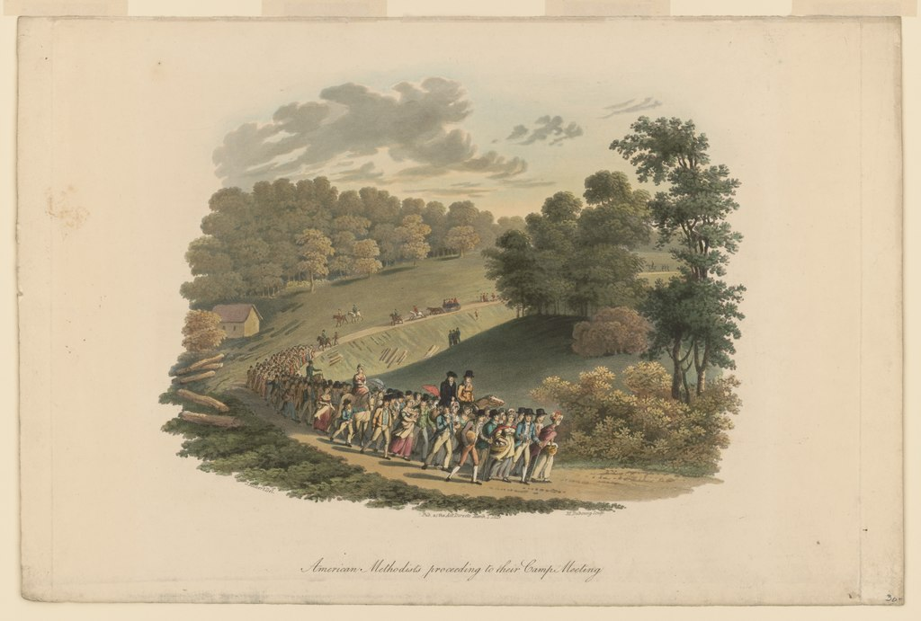
Notes:
“American Methodists Proceeding to their Camp Meeting,” Dubourg, M., engraver; Milbert, Jacques Gérard, 1766-1840, artist, Public domain, via Wikimedia Commons

Slide 11
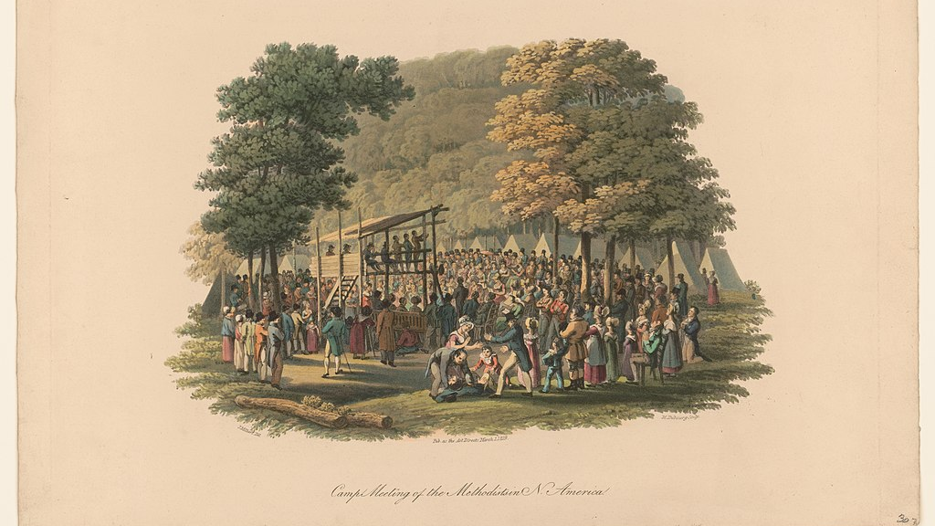
Notes:
“Camp Meeting of the Methodists in N. America,” Dubourg, M., engraverMilbert, Jacques Gérard, 1766-1840 , artist, Public domain, via Wikimedia Commons

Slide 12
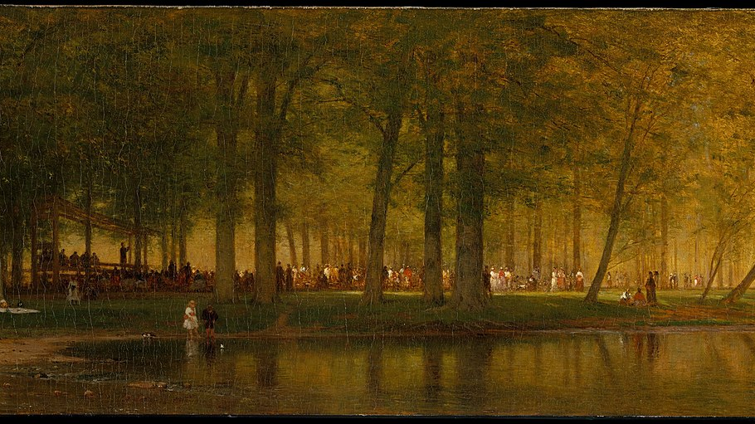
Notes:
Worthington Whittredge, CC0, via Wikimedia Commons, https://commons.wikimedia.org/wiki/File:The_Camp_Meeting_MET_DT228976.jpg

Slide 13
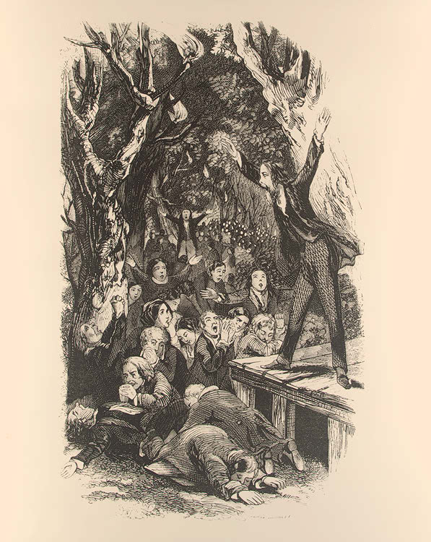
Notes:
By Lossing-Barrett - https://www.loc.gov/exhibits/religion/rel07.htmlLOC: Religion and the Founding of the American Republic, Public Domain, https://commons.wikimedia.org/w/index.php?curid=47371939

Slide 14
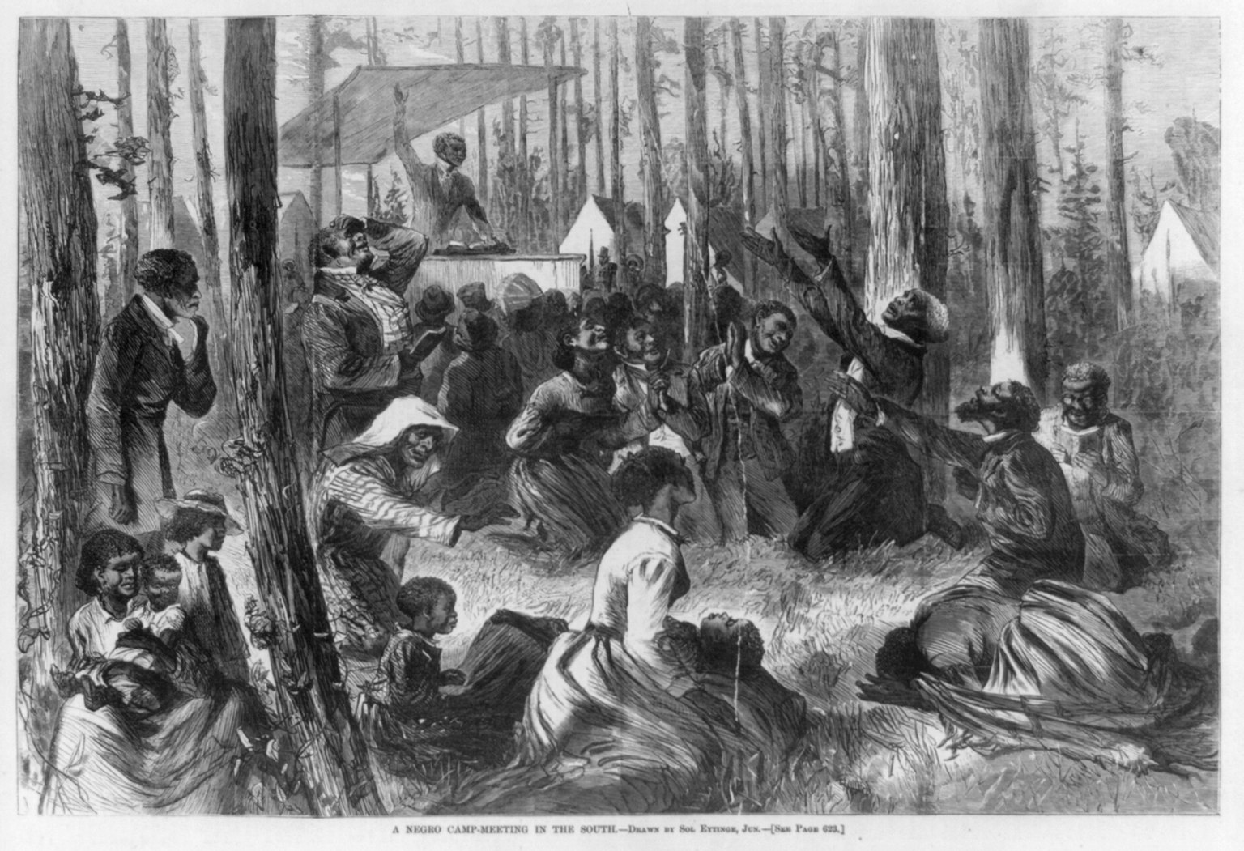
Notes:
“A Negro Camp-Meeting in the South.” Miscellaneous Items in High Demand, PPOC, Library of Congress, Public domain, via Wikimedia Commons.

Slide 15
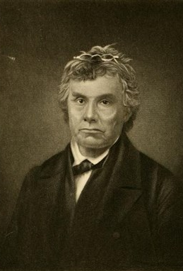
Peter Cartwright, “The Backwoods Preacher”
Excerpts from 1856 Autobiography - http://nationalhumanitiescenter.org/pds/livingrev/religion/text6/cartwright.pdf
Notes:
http://nationalhumanitiescenter.org/pds/livingrev/religion/text6/cartwright.pdf

Slide 16
Contemporary vestiges and manifestations
Religious geography
  Pew Research Center, Religious Landscape Study: https://www.pewforum.org/religious-landscape-study/
Synthesis of Enlightenment liberalism and Christian social conservatism
  Dr. Robert Jeffress invites you to Freedom Sunday on June 24th!: https://www.youtube.com/watch?v=bYf5vq8z_lw
Folk forms of Christian practice
  Snake-Handling Churches (CNN): https://www.youtube.com/watch?v=cwBVcsWYJd8

Slide 17
References and research recommendations
Hatch, Nathan O. The Democratization of American Christianity. Yale UP, 1989
Jackson, Gregory S. “America's First Mass Media: Preaching and the Protestant Sermon Tradition.” A Companion to the Literatures of Colonial America, edited by Susan Castillo and Ivy Schweitzer, Blackwell, 2005, pp. 402-25. Wiley Online Library, doi:10.1002/9780470996416.ch25.
Lippy, Charles H. and Peter W. Williams, editors. "Denominationalism." Encyclopedia of Religion in America. CQ Press, 2010, pp. 542-551. SAGE Knowledge, doi:10.4135/9781608712427.n86.
McClymond, Michael. “Revivals.” The Blackwell Companion to Religion in America, edited by Philip Goff, Blackwell, 2010, pp. 306-20. Wiley Online Library, doi:10.1002/9781444324082.ch21.
Noll, Mark A. America’s God: From Jonathan Edwards to Abraham Lincoln. Oxford UP, 2002.
Richey, Russell E. “Denominations.”The Blackwell Companion to Religion in America, edited by Philip Goff, Blackwell, 2010, pp. 90-104. Wiley Online Library, doi:10.1002/9781444324082.ch7.

