Slide 1
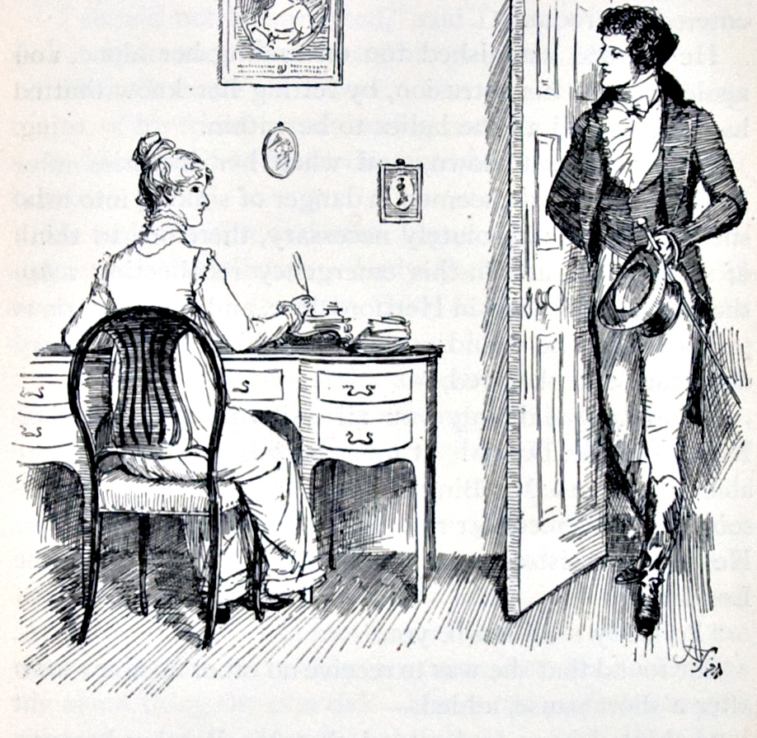
Pride and Prejudice
It is a truth universally acknowledged…
Notes:
By Hugh Thomson (1860-1920) - Lilly Library, Indiana University, Public Domain, https://commons.wikimedia.org/w/index.php?curid=9473525

Slide 2
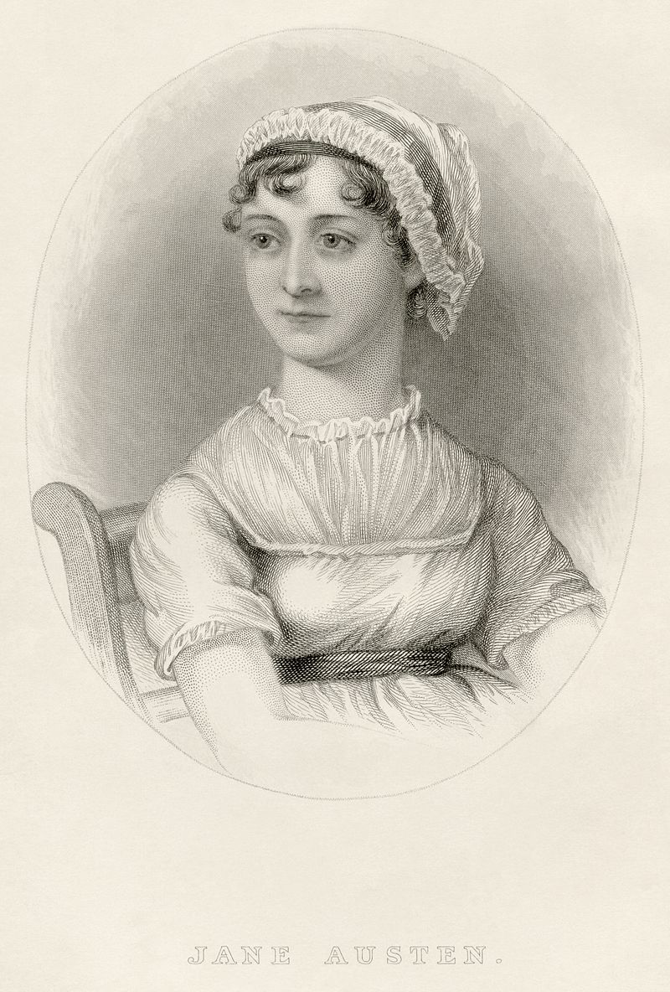
The Author
1775–1817 (41 years)
Regency era in England (1811–1820)
Middle class family – father (George) a rector
Primarily self-educated through reading
Began writing stories and plays as a child
Never married, only one serious prospect
Published anonymously
Well reviewed and received (including Prince Regent) – moderate commercial success
Notes:
By From a watercolour by James Andrews of Maidenhead based on an unfinished work by Cassandra Austen. Engraving by William Home Lizars. - A Memoir of Jane Austen by her nephew J. E. Austen-Leigh, Vicar of Bray, Berks. London: Richard Bentley, New Burlington Street, Publisher in Ordinary to her Majesty, 1870, Public Domain, https://commons.wikimedia.org/w/index.php?curid=7656670

Slide 3
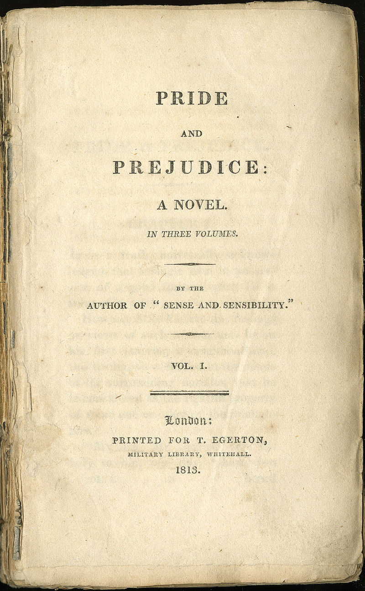
The Book
First Impressions – initial draft, 1797
Rewritten and published as P&P in 1813
Noteworthy literary elements
  Dialogue (https://youtu.be/mP8dllTkpEg?t=2157)
  Point of view
    Third person limited omniscience
    Free indirect speech / narrated monologue
  Setting and centrality of place
  Minimal description
  Social and psychological realism (departure from Romanticism)
  Satirical, ironic tone
  Themes: historically particular and universal
Precursor to modern novel
Notes:
By Jane Austen (1775-1817) - Archive: Lilly Library, Indiana University; Original publication: Austen, Jane. Pride and Prejudice. London: T. Egerton, 1813., Public Domain, https://commons.wikimedia.org/w/index.php?curid=3776031

Slide 4
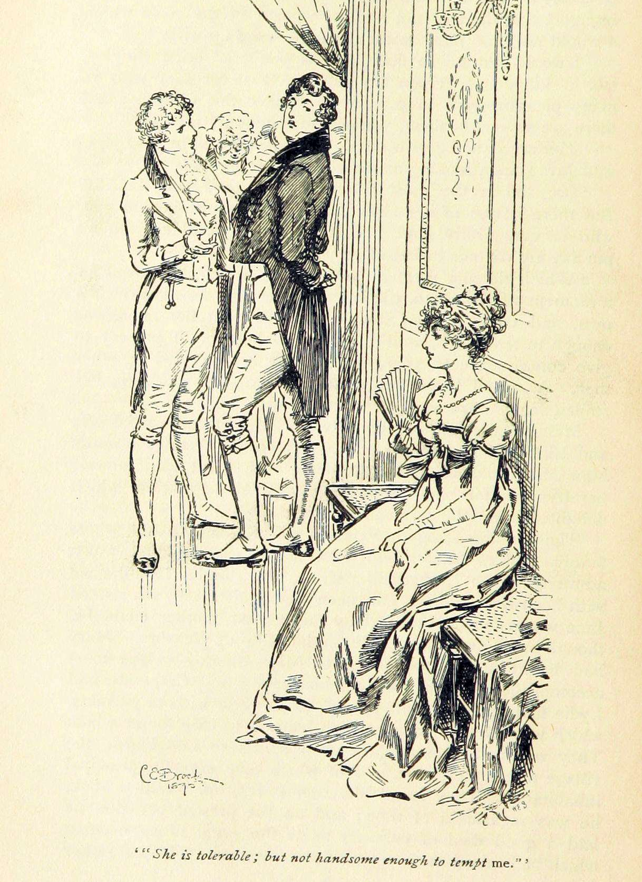
Novel of manners
A realistic novel focusing on the customs, conversation, and ways of thinking and valuing of the upper social class. (Abrams and Harpham, A Glossary of Literary Terms, 254)
Often satirical
Related: domestic comedy, comedy of manners
Notes:
Charles Edmund Brock (1870-1938), Public domain, via Wikimedia Commons

Slide 5
First Impressions
General: Describe your first impressions of the novel, based on what we’ve read so far. If you’re already familiar with the story, either through the book or the various film adaptations, how is this reading different?
Specific:
  What conversation in this initial section do you find most entertaining? Why?
  With which character do you most identify and why?
  Which character do you find most unlikeable?

