Slide 1
US History: Moving West
Chapter 17A
Notes:
Have title enter the slide on a “custom path” animation
Project D5: Create a powerpoint like the one shown on these pages.

Slide 2
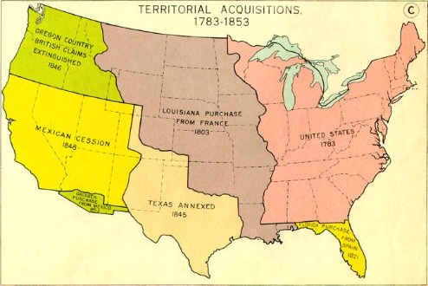
Rapid Expansion West
Notes:
Have slide appear with a “split” transition
No animations

Slide 3
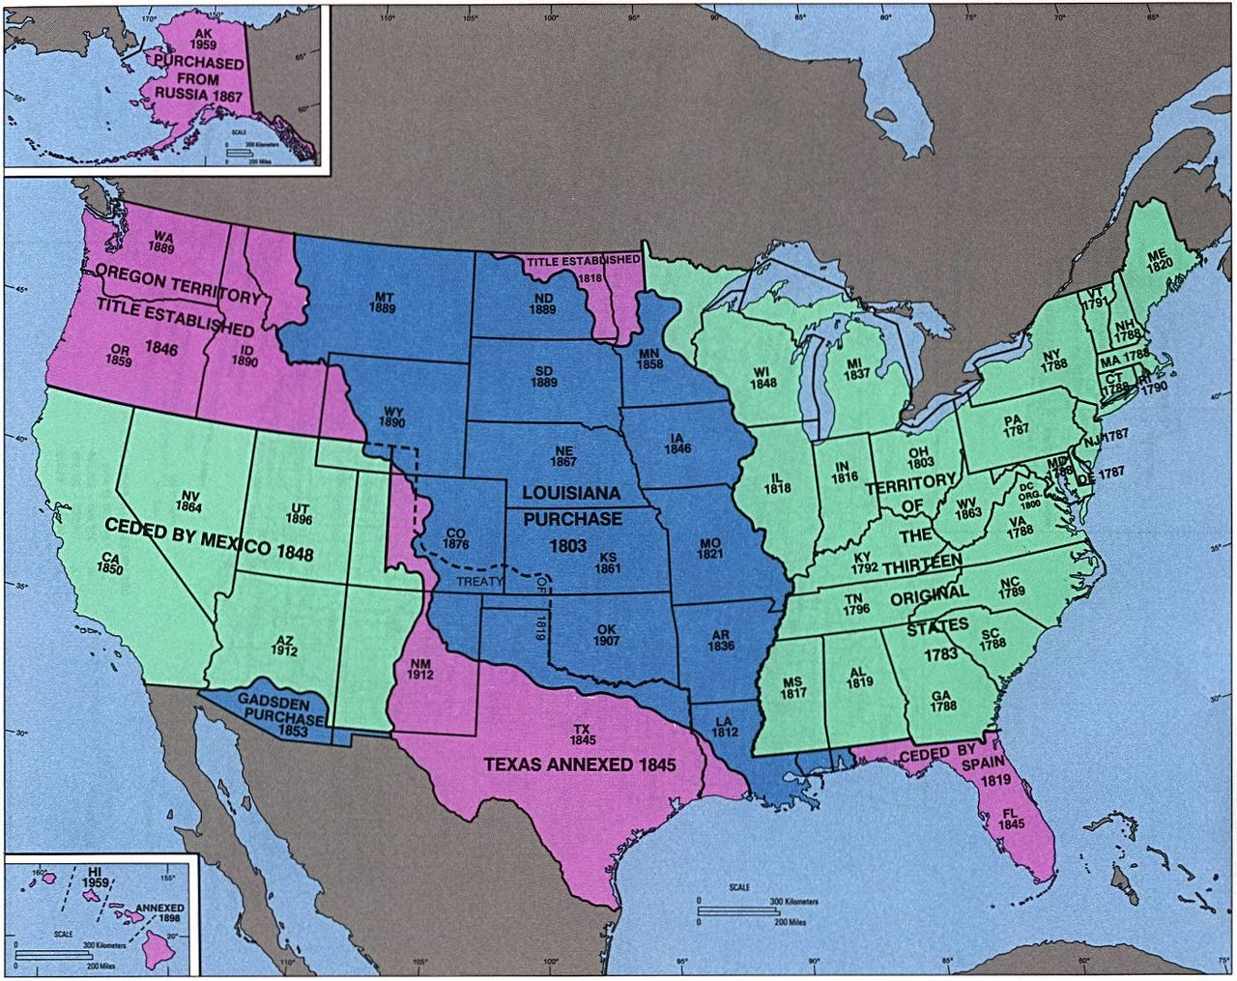
New States in the West
Notes:
Have slide “reveal” for its transition

Slide 4
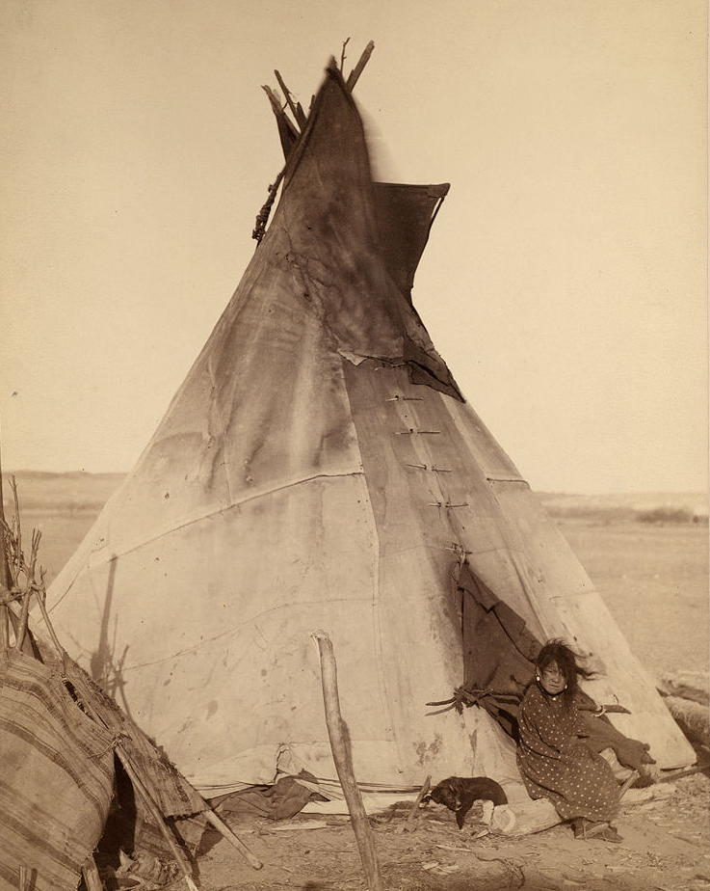
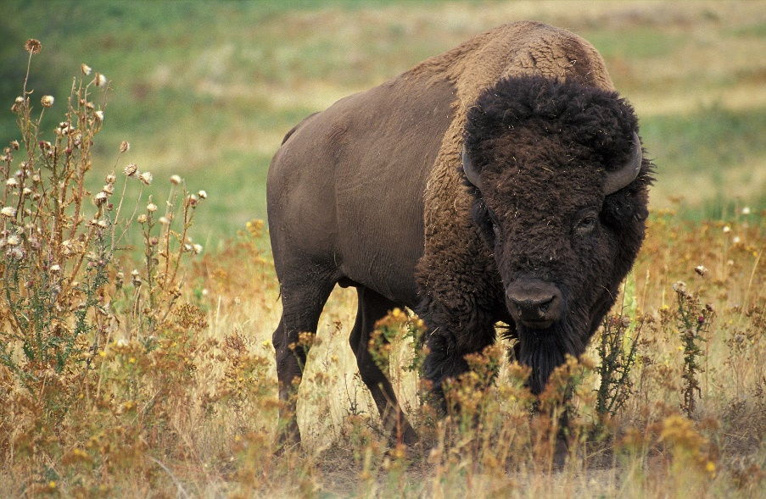
Indians on the Great Plains
Tribes living on the Plains
  Sioux
  Cheyenne
  Comanche
Buffalo culture
  Nomadic—followed the bison herds
  Adapted to horses
  Used buffalo for all needs
Notes:
Each of the points on this page should “wheel in” one after another.

Slide 5
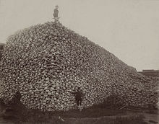
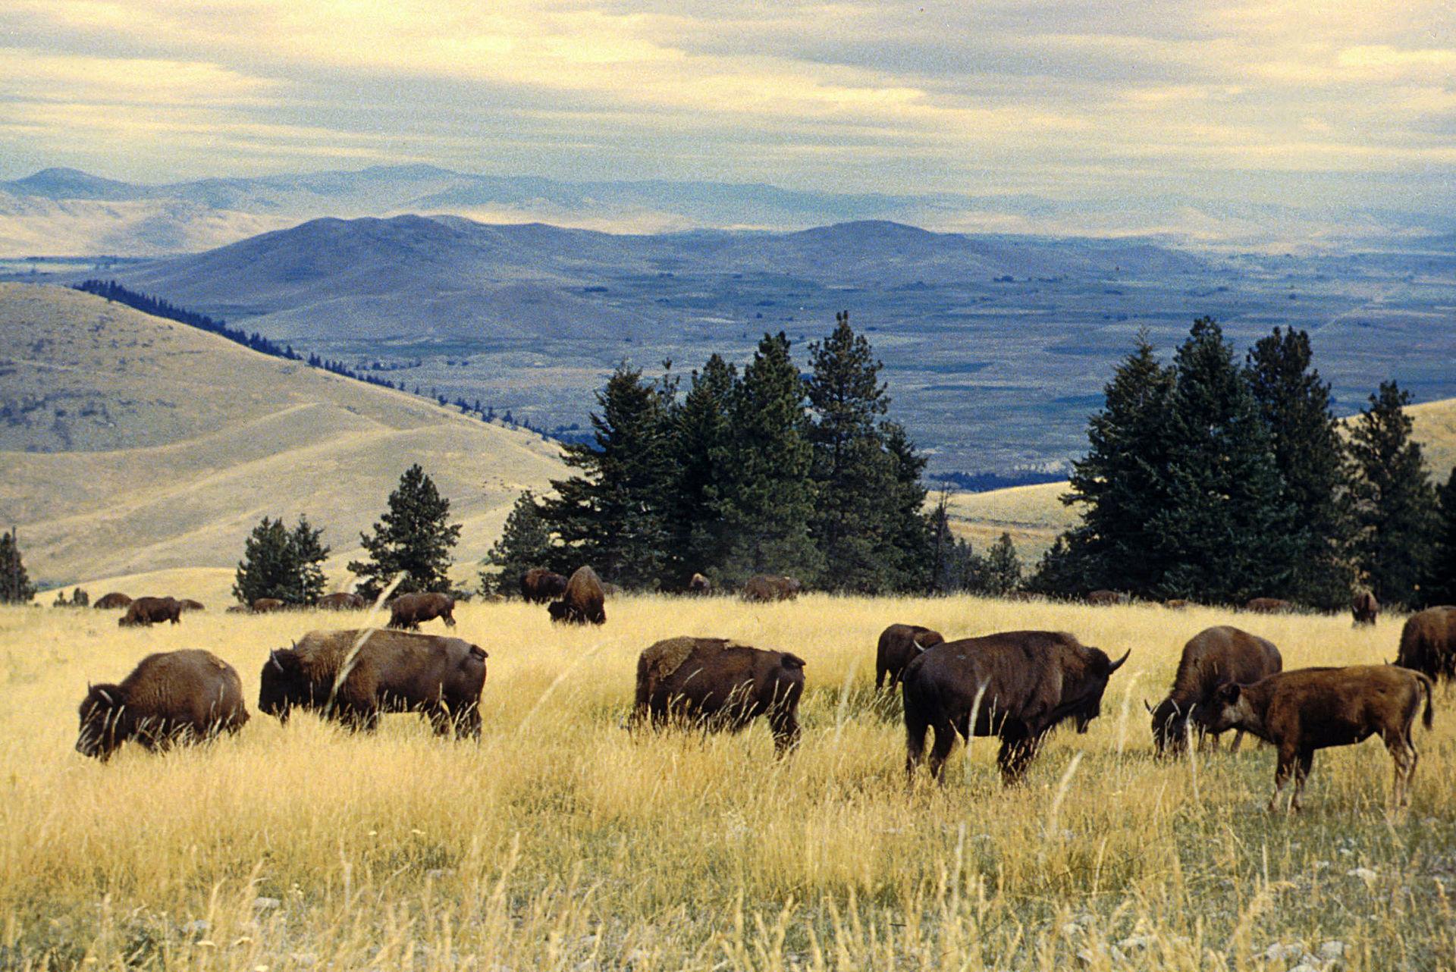
The American Bison
Notes:
Have the picture in the top right “fade in” with a gunshot sound.

Slide 6
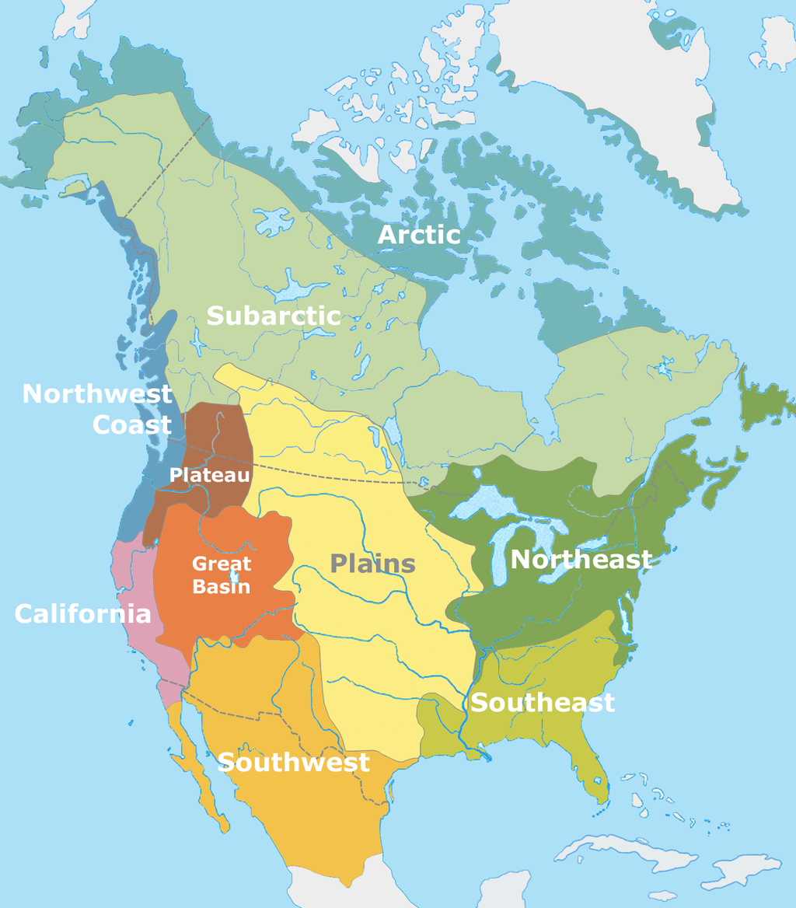
Notes:
Have slide appear with a “wipe”

Slide 7
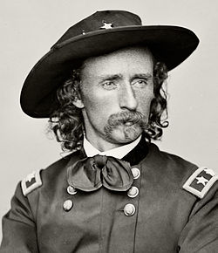
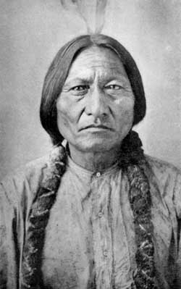
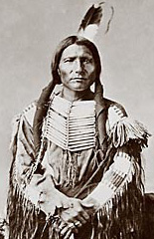
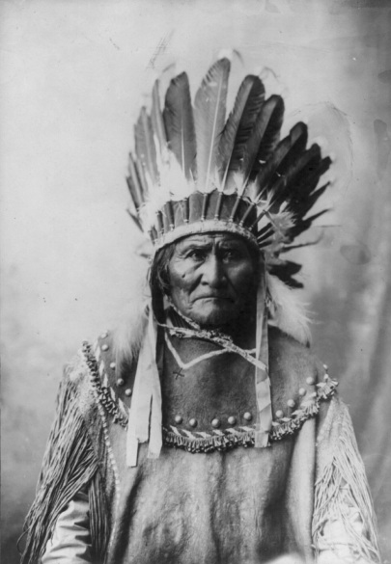
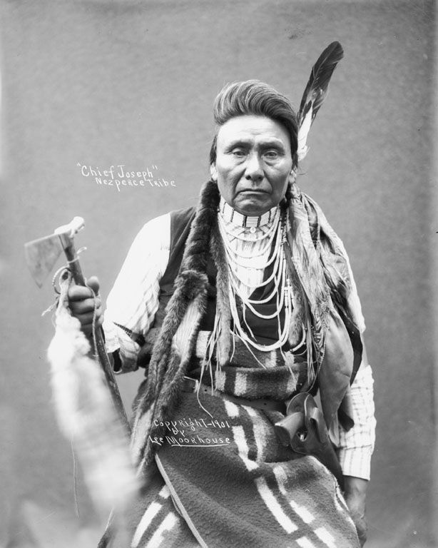
Indian Wars--1850s-1870s
Sioux Wars
  George Armstrong Custer vs. Sitting Bull and Crazy Horse
  Fierce, fierce fighting
Apache Indians
  Geronimo
Nez Perce Indians
  Chief Joseph
Notes:
Only the title should appear at the beginning
Make “Sioux Wars” “fly in” with a click
Then the two bullet points underneath that should “fly in” with the next click,
Three of the pictures should “fly in” with the next click, then disappear with the next click
Make “Apache Indians” and “Geronimo” “fly in” next
Make one of the other pictures appear and disappear with the next two clicks
Make “Nez Perce Indians” and “Chief Joseph” “fly in” next
Make the final picture “fade” in very slowly next and then disappear with the next click

Slide 8
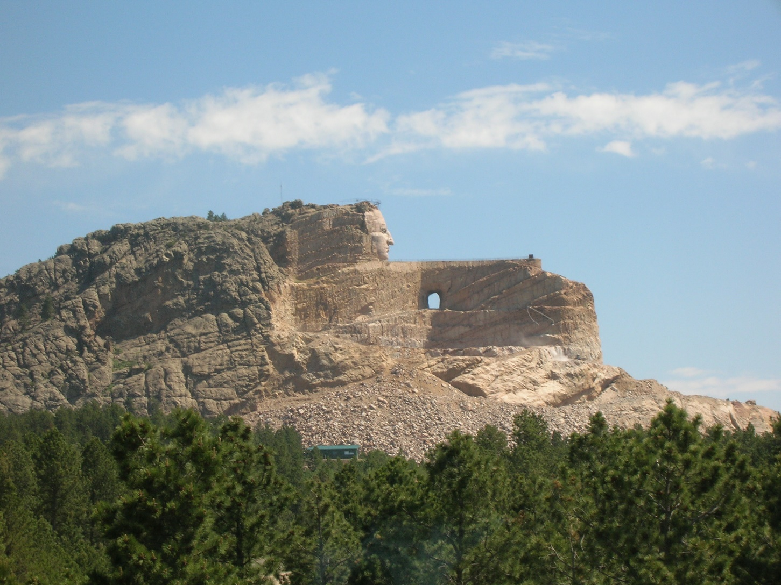
Crazy Horse Monument
Notes:
Have the title appear immediately
Make the picture appear on the next click with a “shape” animation starting at the center and working its way out toward the edges.

