Slide 1
US History: The 70’s
Chapter 25B
Notes:
No animations on any of the slides in this presentation.
Make each slide advance automatically in 2-second intervals.
Project D4: Create a powerpoint like the one shown on these pages.

Slide 2
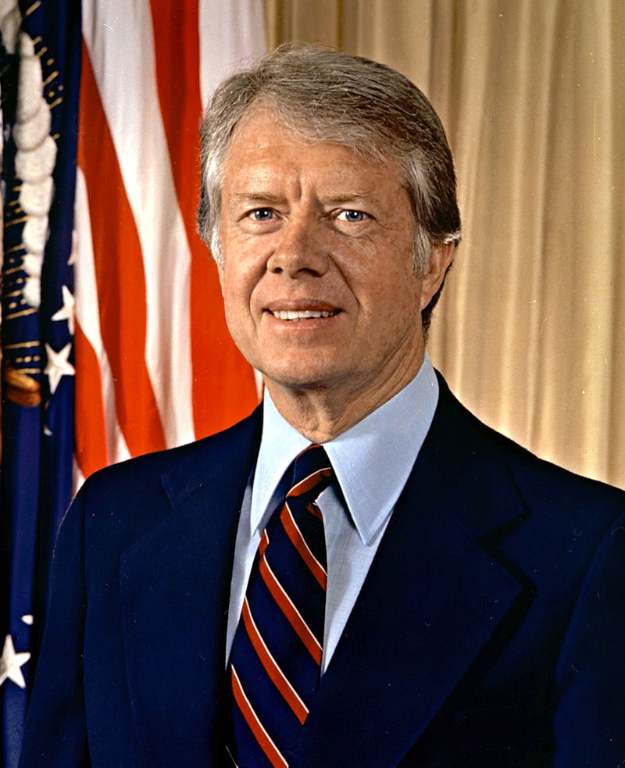


Jimmy Carter

Slide 3
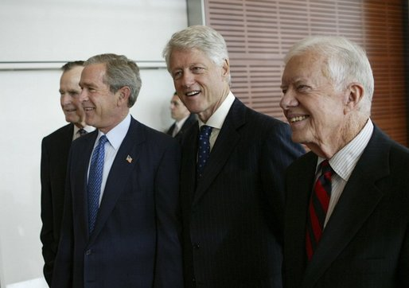

Slide 4
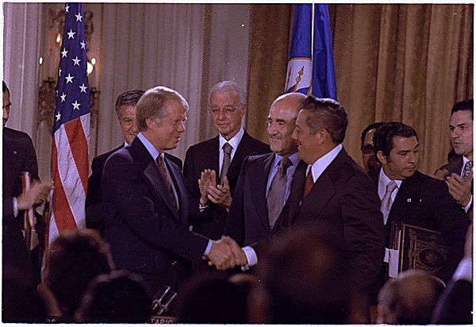
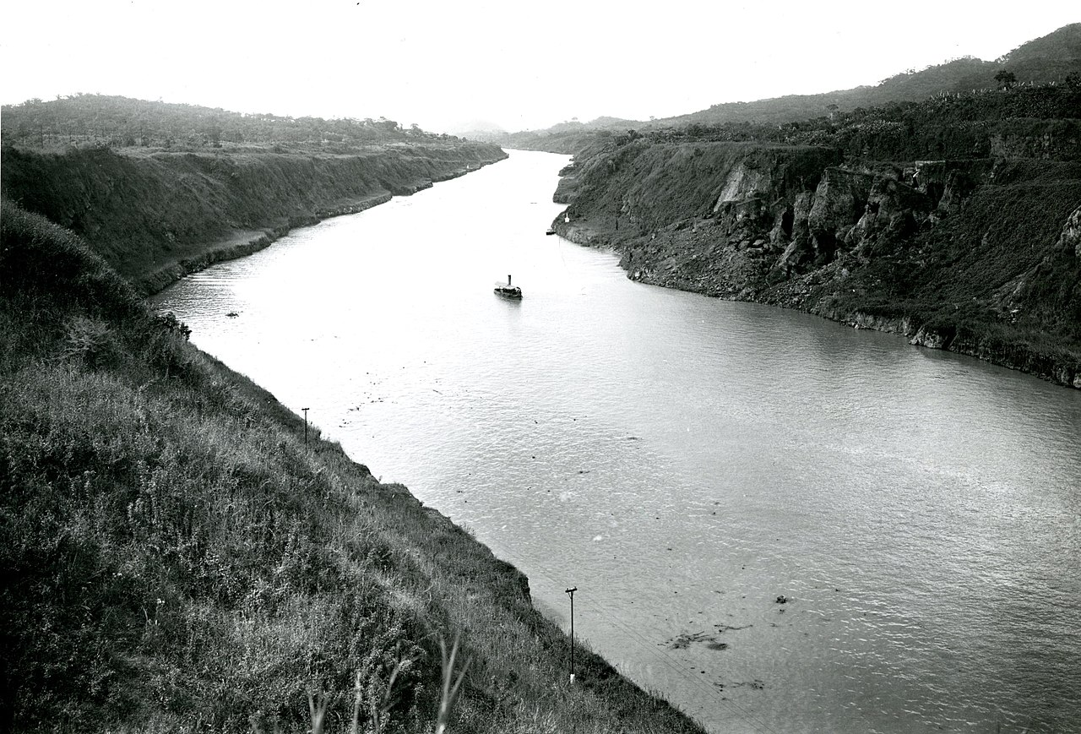
Panama Canal Treaty
In 1977, the US agreed to turn the Panama Canal over to Panama in 2000

Slide 5
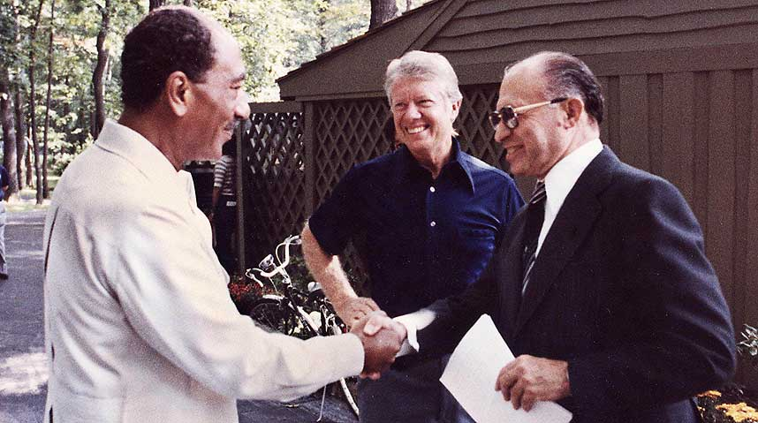
Camp-David Accords-1978
Agreement between Egypt and Israel
  Israel returns the Sinai peninsula
  Egypt accepts Israel as a state

Slide 6

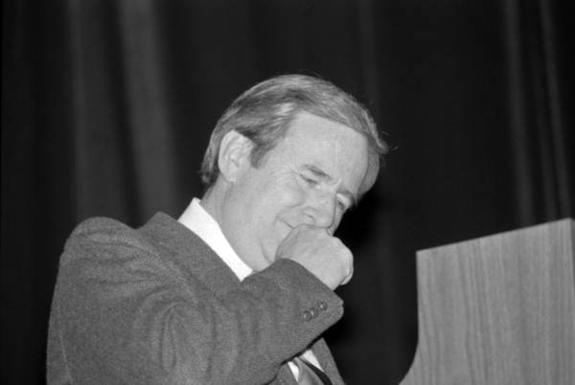
The Religious Right

