Slide 1
US History: Chapter 2
Early English Settlements
Notes:
Find the “Design” and color that matches the one shown here.
No animations on this page.
Project D3: Create a powerpoint like the one shown on these pages.

Slide 2
How had the King of England
come by all of this land in the new world
that he was dishing out?
Notes:
No animations

Slide 3
How did the king disperse and administrate this land?
Charter colony | Proprietary colony | Royal colony
Still less direct rule; a trade company administrated affairs | Less direct rule; a group appointed by the king controlled the area | Direct rule by king through a governor
Examples: Virginia Massachusetts Rhode Island Connecticut | Examples: New York Pennsylvania Georgia | Examples: Virginia Massachusetts New York (all became royal later)
Notes:
Insert a chart into this slide and fill in the information shown here.
No animations.

Slide 4
Religious Climate in England
What was the Church of England like during this era?
  Very formal and ritualistic
  Very similar to Catholicism in theology and practice
  Closely connected to the current power structure
  Harsh and oppressive toward dissidents
Notes:
Have the question appear with the slide.
Make each point underneath the question appear one-by-one with the “split” motion.

Slide 5
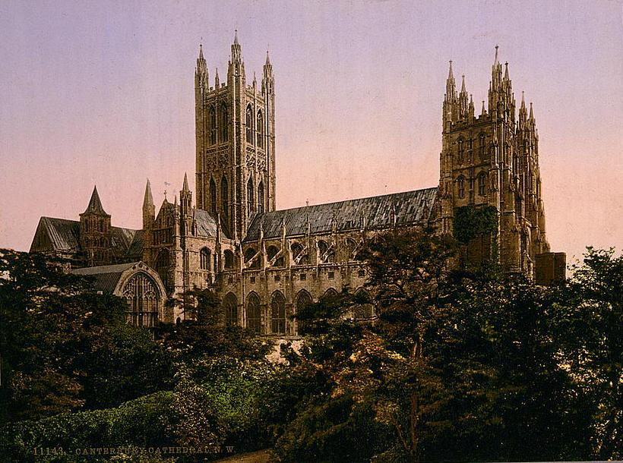

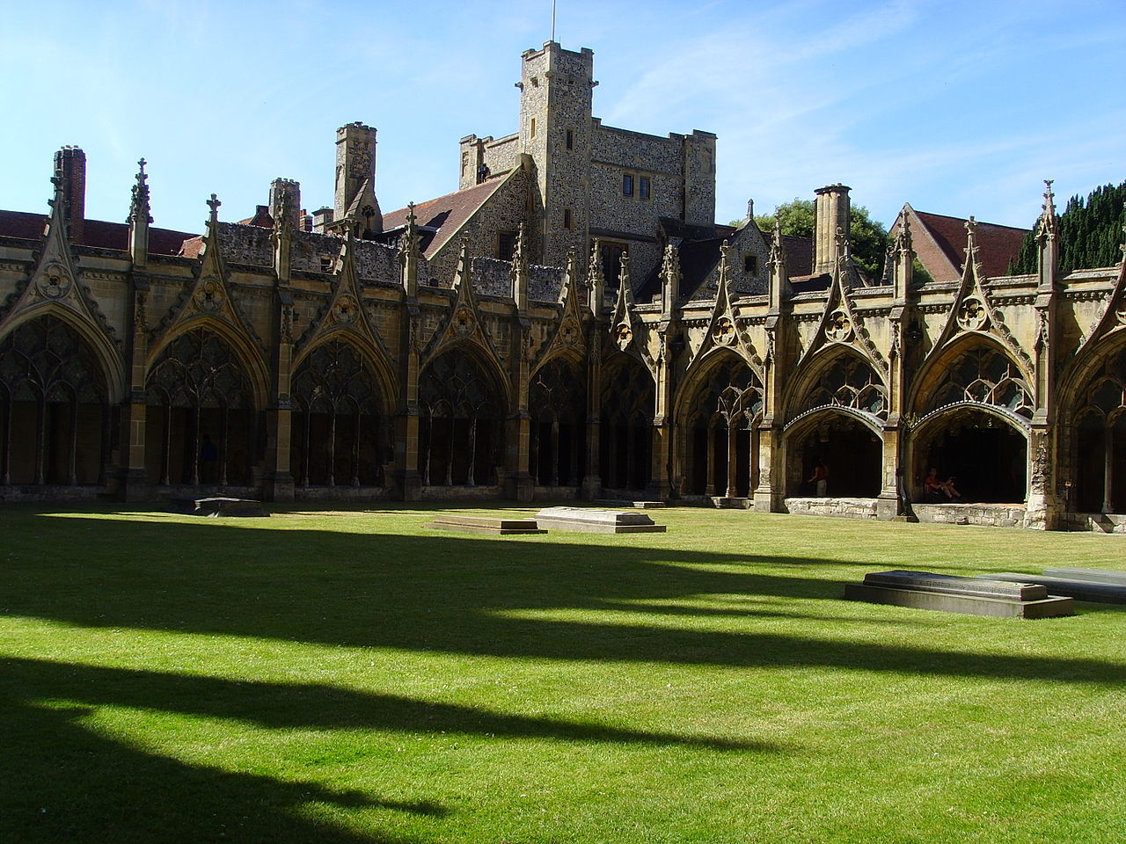
Church
of
England
(Anglican Church)
Notes:
No animations.

Slide 6
Dissidents
English people unhappy with the status quo of the Anglican Church fell into two basic groups:
Puritans—accepted the basic organization of the church but wanted serious reforms in theology and practice
Separatists—more radical than Puritans, they wanted to abandon the entire religious system and establish their own independent congregations
Notes:
Make the title of the slide and the introductory sentence appear immediately.
Make points 1 and 2 “fly in” one after each other.

Slide 7
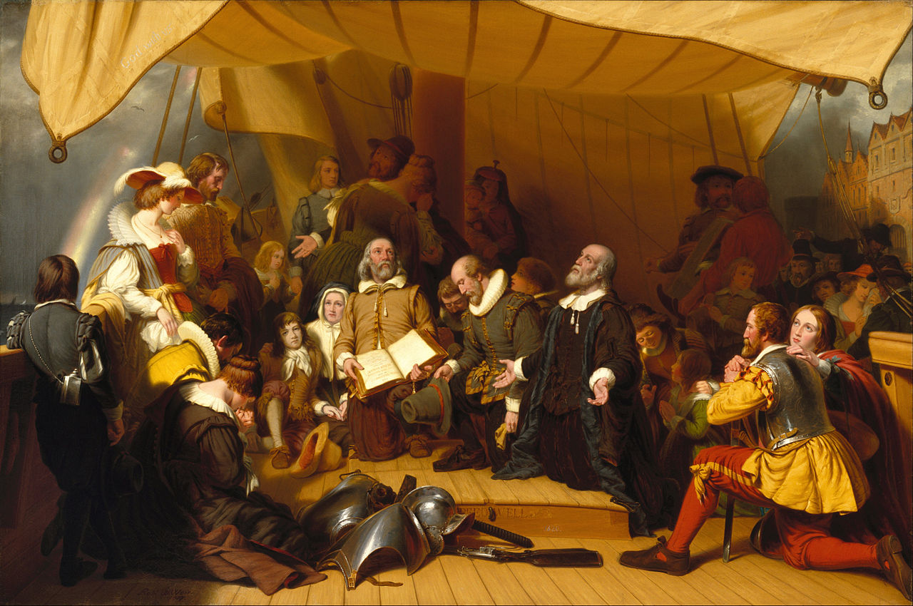
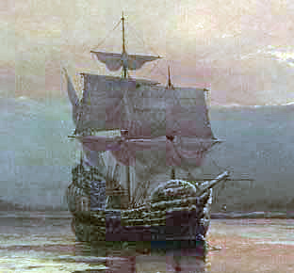
New England Landing #1
1620
Pilgrims (part Separatists, part status quo-ers)
Arrived on the Mayflower
Established Plymouth Colony
Notes:
Make the title and pictures appear immediately.
Make each bullet point “wheel” in upon command.

Slide 8
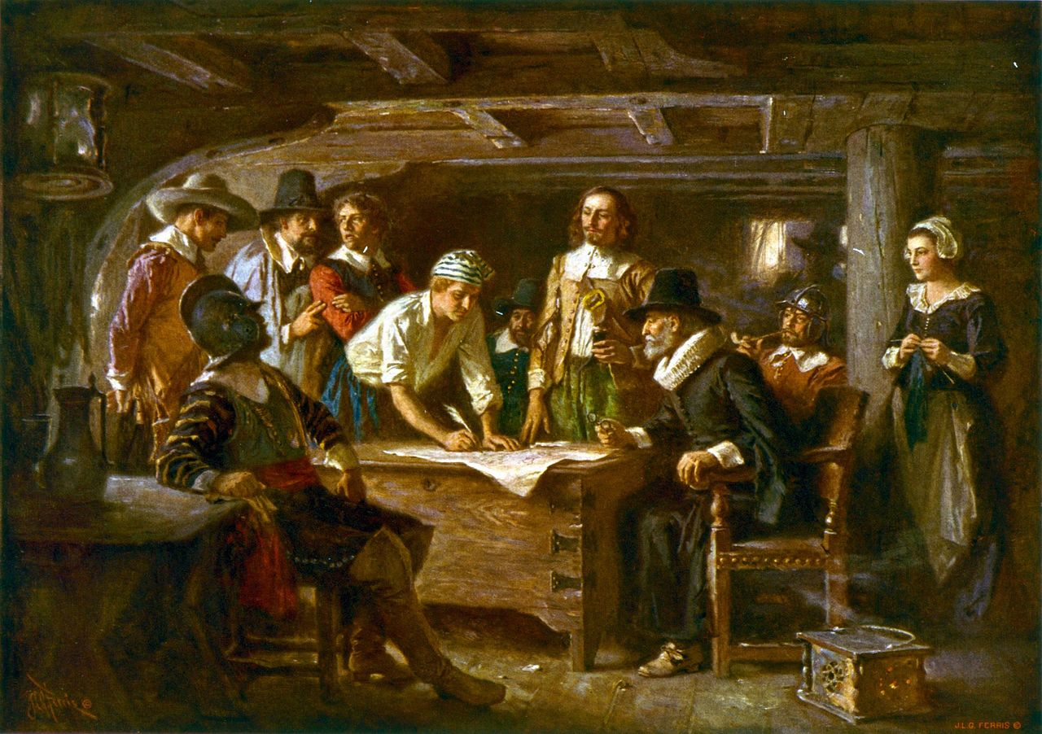
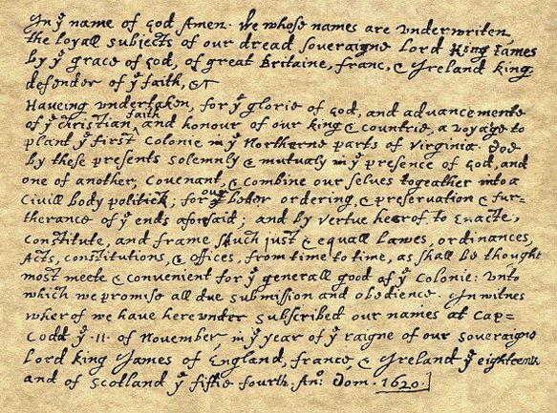
The Mayflower Compact
Significance of this document:
The people impose government on themselves
Voluntary submission to a government
Widespread participation
Notes:
Make just the title appear first.
Make the picture on the bottom right appear next, the bottom left next, and finally the points should “wipe” one by one

Slide 9

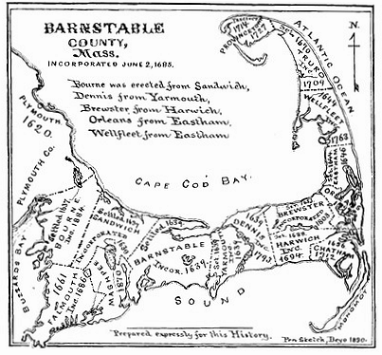
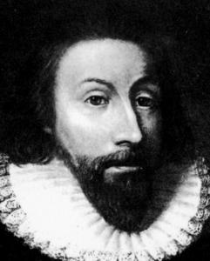
New England Landing #2
1630
Puritans
Arrived on 17 ships
Established Massachusetts Bay Colony
Notes:
Everything should appear immediately except for the bullet points which should “float in” one by one

Slide 10
Massachusetts Bay and the Indians
From early on, conflict occurred between the Puritans and the local Indians—violence was inflicted by both sides
The Puritans viewed their situation like the children of Israel coming into the promised land of Canaan—They, the Puritans, were the chosen people of God and this New World was the land that God had promised to them
Therefore they had no qualms in slaying the Indians that inhabited “their” promised land
Notes:
Bullet points should appear one-by-one using the “shape” animation

Slide 11
Puritans’ view of native Americans:
After the Pequot War in which the colonists secured their victory by burning a fort containing around 700 Pequot men, women, and children, a leader had the following to say:
…the attack against the Pequot was the act of a God who "laughed his Enemies and the Enemies of his People to scorn making [the Pequot] as a fiery Oven... Thus did the Lord judge among the Heathen, filling [Mystic] with dead Bodies.“
Let the whole Earth be filled with his Glory! Thus the LORD was pleased to smite our Enemies in the hinder Parts, and to give us their Land for an Inheritance.
Notes:
Make this slide appear with a “reveal”
No animations

Slide 12
Rhode Island
Roger Williams the troublemaker:
“It is a sin to take land from the Indians without just compensation.”
“There should be separation between church and state.”
“Only sincere followers of Jesus should be part of the visible church.”
After getting banished from Massachusetts for such radical ideas, Williams and a group of followers begin the colony of Rhode Island
Notes:
Have this slide “cover” the previous one
Only the title should appear at first.
Next, “Roger Williams, the troublemaker:” should appear with a “wipe”
Each point after that should begin with a “wipe”

Slide 13
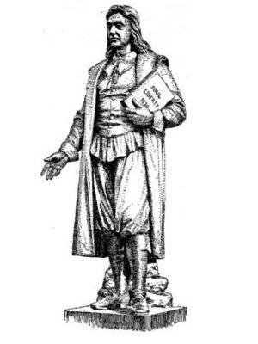
Roger Williams
Notes:
No animations

