Slide 1
US History: Progressivism
Chapter 18A
Notes:
No Animations on this slide.
Project D2: Create a powerpoint like the one shown on these pages.

Slide 2
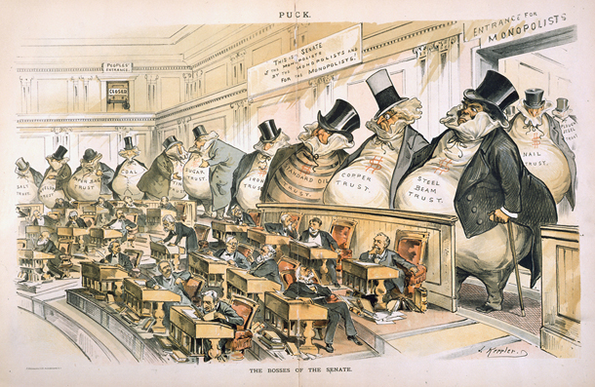
From Gilded Age to Progressivism
The turn of the twentieth century—1900—brought a new wave of ideas and values called progressivism
Reaction to the problems of the Gilded Age (greedy monopolies, poor conditions for workers, corruption in govt.)
Core principles of progressivism:
  Direct democracy
  Greater government involvement in society
  Social reforms
Notes:
Make this slide appear with a “push”
Title comes in with slide
Make each point “fly in” one at a time
Have picture “fly in” last

Slide 3
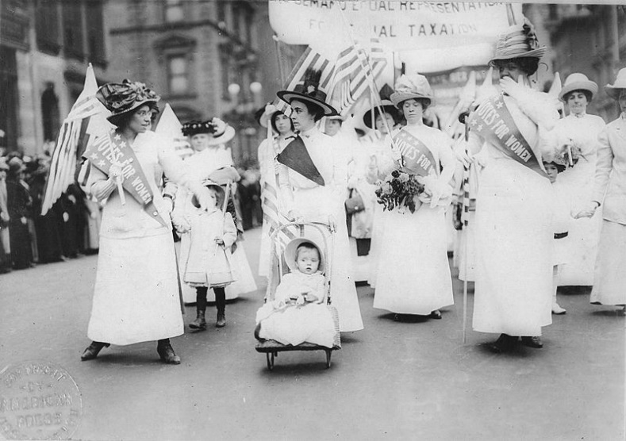
Amendments to Constitution
16th: Income tax—graduated percentage rates
17th: Direct election of US Senators (related issues: direct primaries, referendum, recall)
18th: Prohibition (of alcohol)
19th: Women’s suffrage
Notes:
Make this slide appear with “random bars”
Have title appear immediately
Make each point “wheel” in one at a time
Make the picture “wheel” in

Slide 4
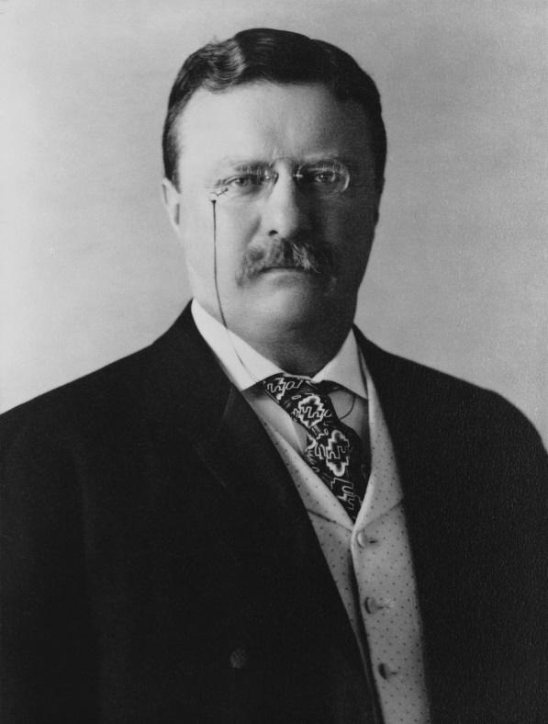
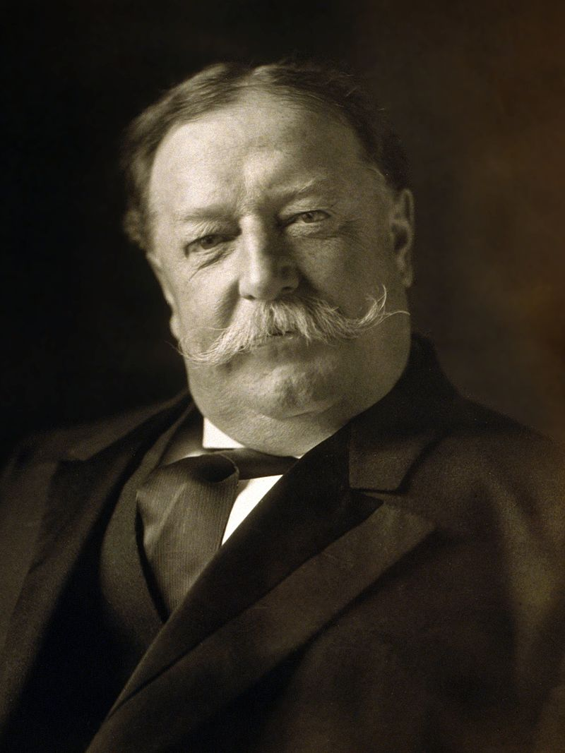
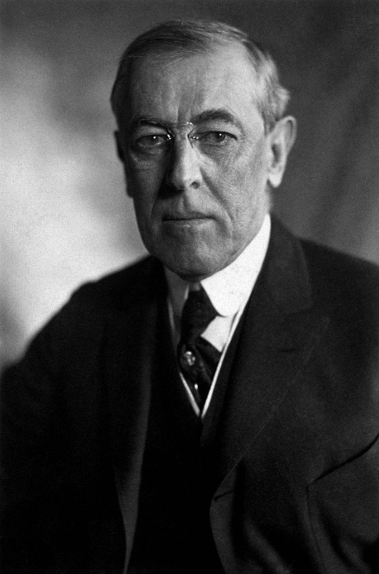
Progressive Presidents
And now abideth these three: Teddy Roosevelt, William Howard Taft, and Woodrow Wilson, but the greatest of these is Teddy.
Notes:
Make this slide appear with a “cut”
Make title and pictures appear immediately
Have text “fade” in next

