Slide 1
US History: Southern Colonies
Notes:
Project D1: Create a Powerpoint presentation like the one shown on these pages. Instructions will be given for the animations on each slide. When a picture appears on a slide, choose a picture of whatever is available on the computer that you are using and insert it into the slide at the same place as the one shown in the original—it doesn’t have to have anything to do with the topic. Try to match the original as much as possible in layout and style. Save a copy of your presentation in your personal file.

Slide 2
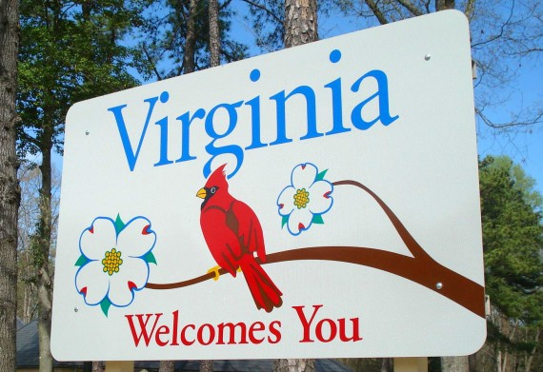
Virginia
Jamestown roots-1607
Three important events of 1619
  Formation of House of Burgesses—first representative, self-governing assembly in America
  Arrival of first Africans to America
  Arrival of a shipload of women
Tobacco—big cash crop in Virginia
Notes:
Title and picture appear immediately
All of the other points should “float in” one by one

Slide 3

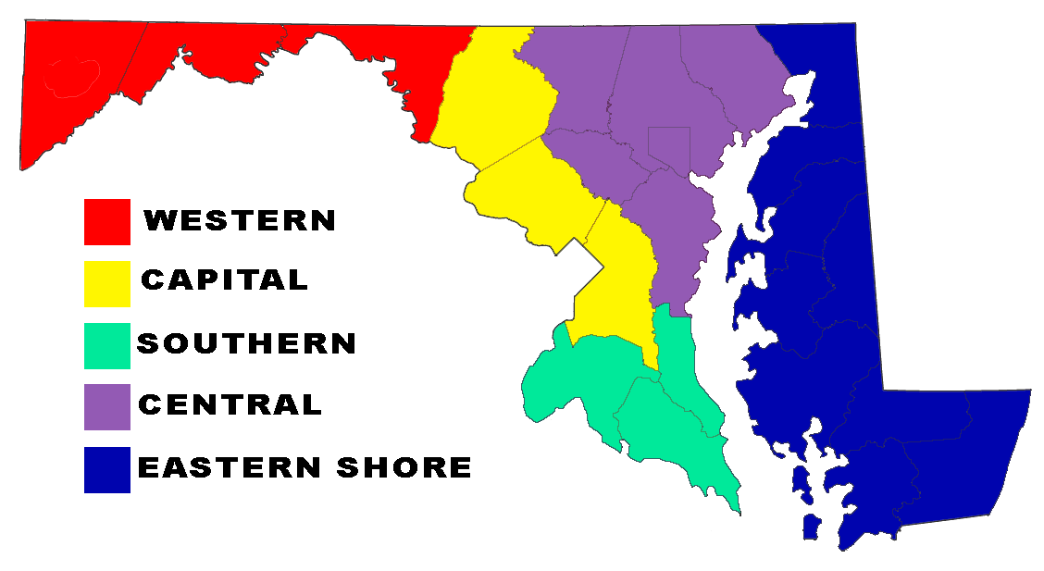
Maryland
Colony led by Cecilius Calvert, Lord Baltimore
Two reasons for colony
  Refuge for Catholics
  Commercial profit
Toleration Act of 1649 declared that all Christians would be free to practice their religion in Maryland
Notes:
Title and both pictures should appear with slide.
Each point should “fly in” one-by-one

Slide 4
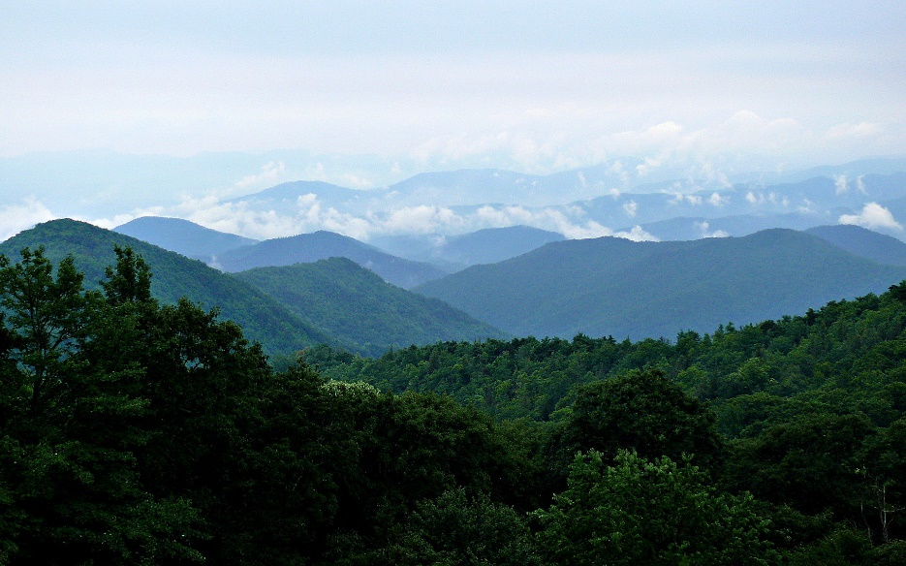
Carolinas
The Carolinas were placed under the control of a number of proprietors by King Charles I for economic development
Charleston (Charles’ Town) was the major center for social, economic, and political life
The colonies grew rice, indigo, and cotton
Notes:
The title should appear with slide.
Have each of the pictures “fade in” one after the other next.
Make each point “split” in turn next.

Slide 5

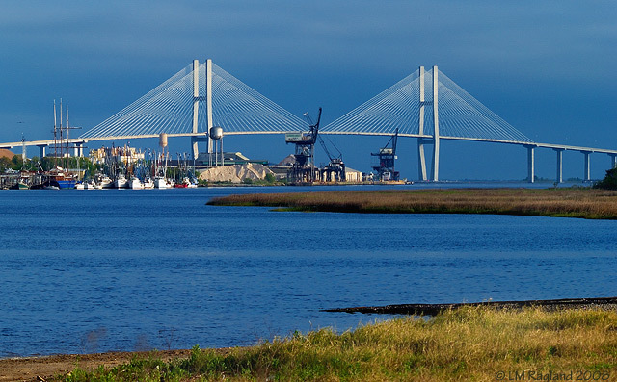
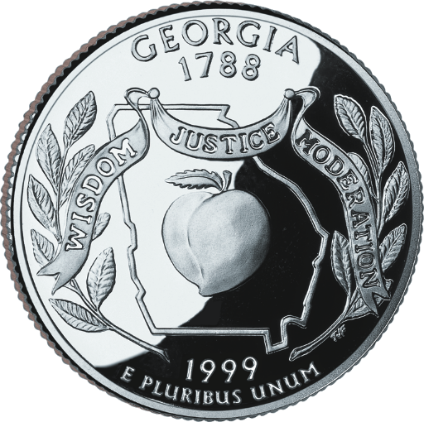
Georgia
Georgia was the last British colony to be established—1732
Georgia served two purposes
  Military buffer against Spanish
  Place for debtors and vagrants to start a new life
The effort was led by James Oglethorpe
The colony grew rapidly
Notes:
Title and pictures should appear immediately.
Each point should come in one at a time using the “wipe” motion

Slide 6
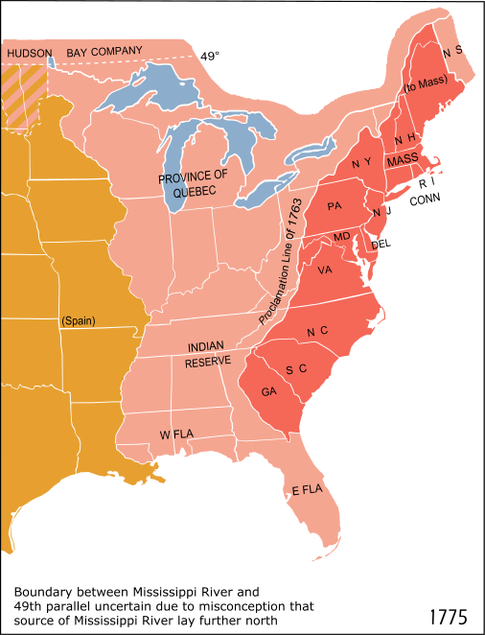
Notes:
No animation needed

