Slide 1

Poetic Language
“Artful or poetic language is…parabolic, saying one thing in terms of another.” (345)
“The ultimate direction and goal of poetry, metaphor, and symbol—to express what is inexpressible, to fuse together what still remains separate.” (351)
Siegel, Robert. “The Well at the World’s End: Poetry, Fantasy, and the Limits of the Expressible.” The Christian Imagination, edited by Leland Ryken, Shaw Books, 2002, pp. 343-356.

Slide 2
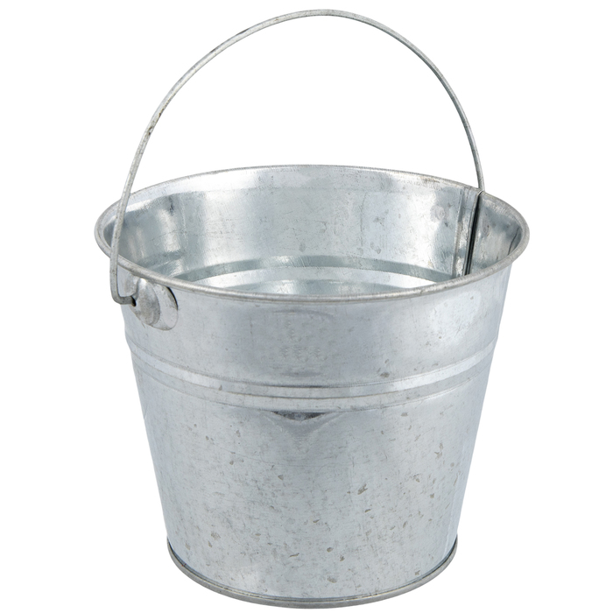
Metaphor
“to carry over”
“Figurative language that asserts a comparison between two things of unlike nature.” (118)
Two components
  Tenor: object being described
  Vehicle: object lending its traits
From The Pocket Instructor: Literature, edited by Diana Fuss and William A. Gleason, Princeton UP, 2016.

Slide 3
Homer – “rosy-fingered dawn”
Tenor | Vehicle

Slide 4
Walt Whitman – “the beautiful uncut hair of graves”
Tenor | Vehicle

Slide 5
Emily Dickinson – “Hope is the things with feathers.”
Tenor | Vehicle

Slide 6
Sonnet 18: Shall I compare thee to a summer’s day? by William Shakespeare
Tenor | Vehicle
Shall I compare thee to a summer’s day?
Thou art more lovely and more temperate:
Rough winds do shake the darling buds of May,
And summer’s lease hath all too short a date;
Sometime too hot the eye of heaven shines,
And often is his gold complexion dimm'd;
And every fair from fair sometime declines,
By chance or nature’s changing course untrimm'd;
But thy eternal summer shall not fade,
Nor lose possession of that fair thou ow’st;
Nor shall death brag thou wander’st in his shade,
When in eternal lines to time thou grow’st:
So long as men can breathe or eyes can see,
So long lives this, and this gives life to thee.

Slide 7
Sonnet 55: Not marble nor the gilded monuments by William Shakespeare
Tenor | Vehicle
Not marble nor the gilded monuments
Of princes shall outlive this powerful rhyme,
But you shall shine more bright in these contents
Than unswept stone besmeared with sluttish time.
When wasteful war shall statues overturn,
And broils root out the work of masonry,
Nor Mars his sword nor war’s quick fire shall burn
The living record of your memory.
’Gainst death and all-oblivious enmity
Shall you pace forth; your praise shall still find room
Even in the eyes of all posterity
That wear this world out to the ending doom.
So, till the Judgement that yourself arise,
You live in this, and dwell in lovers’ eyes.

Slide 8
Sonnet 73: That time of year thou mayst in me behold by William Shakespeare
Tenor | Vehicle
That time of year thou mayst in me behold
When yellow leaves, or none, or few, do hang
Upon those boughs which shake against the cold,
Bare ruin'd choirs, where late the sweet birds sang.
In me thou see'st the twilight of such day
As after sunset fadeth in the west,
Which by and by black night doth take away,
Death's second self, that seals up all in rest.
In me thou see'st the glowing of such fire
That on the ashes of his youth doth lie,
As the death-bed whereon it must expire,
Consum'd with that which it was nourish'd by.
This thou perceiv'st, which makes thy love more strong,
To love that well which thou must leave ere long.

Slide 9
Sonnet 116: Let me not to the marriage of true minds by William Shakespeare
Tenor | Vehicle
Let me not to the marriage of true minds
Admit impediments. Love is not love
Which alters when it alteration finds,
Or bends with the remover to remove.
O no! it is an ever-fixed mark
That looks on tempests and is never shaken;
It is the star to every wand'ring bark,
Whose worth's unknown, although his height be taken.
Love's not Time's fool, though rosy lips and cheeks
Within his bending sickle's compass come;
Love alters not with his brief hours and weeks,
But bears it out even to the edge of doom.
If this be error and upon me prov'd,
I never writ, nor no man ever lov'd.

Slide 10
Sonnet 146: Poor soul, the centre of my sinful earth by William Shakespeare
Tenor | Vehicle
Poor soul, the centre of my sinful earth,
Fool’d by these rebel powers that thee array,
Why dost thou pine within and suffer dearth,
Painting thy outward walls so costly gay?
Why so large cost, having so short a lease,
Dost thou upon thy fading mansion spend?
Shall worms, inheritors of this excess,
Eat up thy charge? Is this thy body's end?
Then soul, live thou upon thy servant's loss
And let that pine to aggravate thy store;
Buy terms divine in selling hours of dross;
Within be fed, without be rich no more.
So shalt thou feed on Death, that feeds on men,
And, Death once dead, there's no more dying then.

