Slide 1
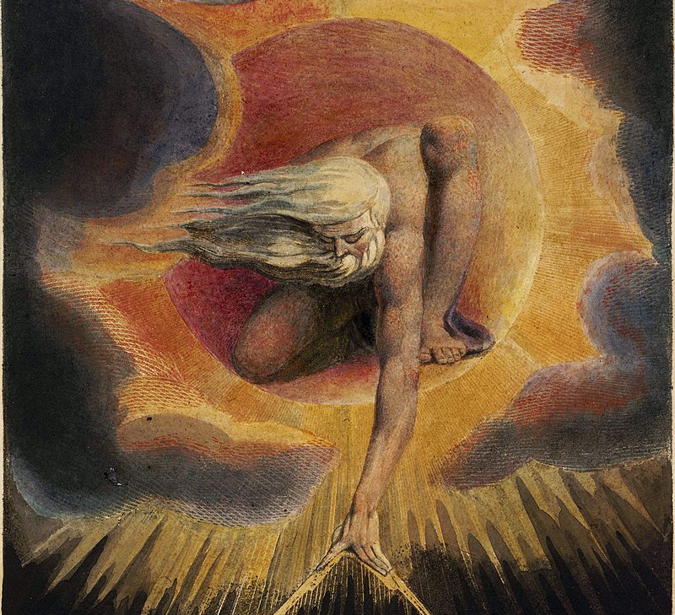
Poetry of the Romantic Age
A historical and literary introduction
Notes:
By William Blake - Tate Britain Image, Public Domain, https://commons.wikimedia.org/w/index.php?curid=2367164

Slide 2
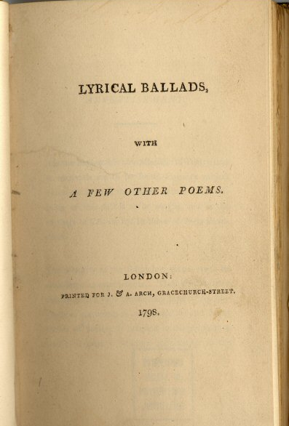
When?
Beginning
  1789 – French Revolution
  1798 – Publication of Lyrical Ballads by Wordsworth and Coleridge
Ending
  1830 – death of Sir Walter Scott

Slide 3
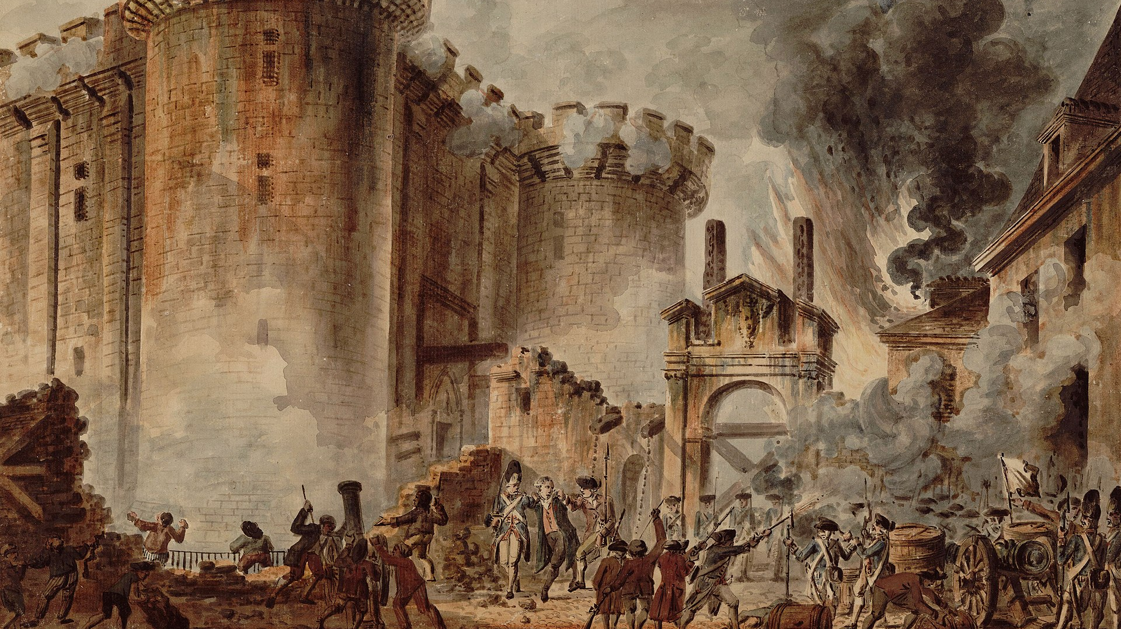
Revolution
Liberty
Equality
Notes:
By Jean-Pierre Houël - Bibliothèque nationale de France, Public Domain, https://commons.wikimedia.org/w/index.php?curid=106405

Slide 4
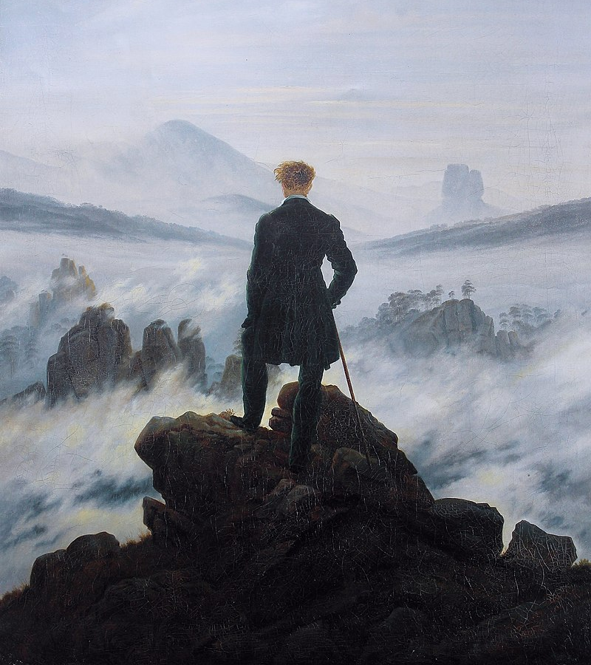
Individual
Subjective
Intuition
Experience
Notes:
By Caspar David Friedrich - The photographic reproduction was done by Cybershot800i. (Diff), Public Domain, https://commons.wikimedia.org/w/index.php?curid=1020146

Slide 5
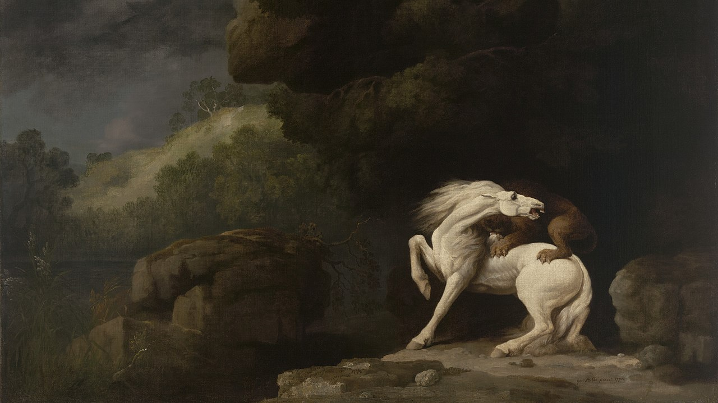
Emotion
Nature
Sublime
Notes:
By George Stubbs - https://artgallery.yale.edu/collections/objects/9850, Public Domain, https://commons.wikimedia.org/w/index.php?curid=66607055

Slide 6
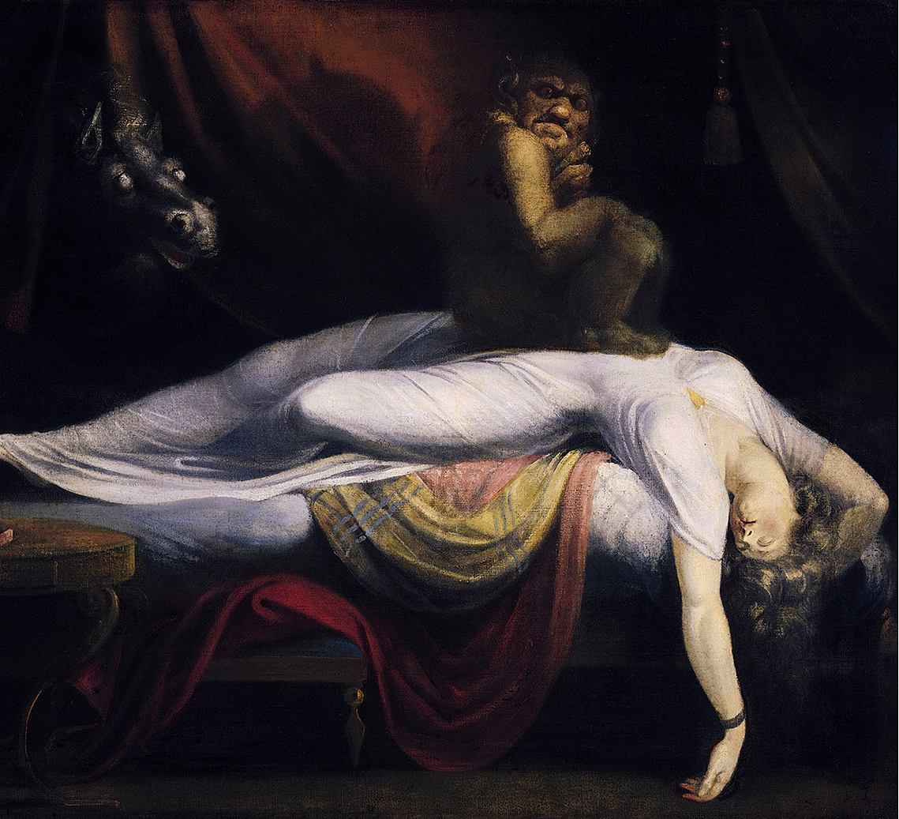
Gothic
Medieval
Supernatural
Imagination
Notes:
By Henry Fuseli - wartburg.eduimage, Public Domain, https://commons.wikimedia.org/w/index.php?curid=1170857

Slide 7
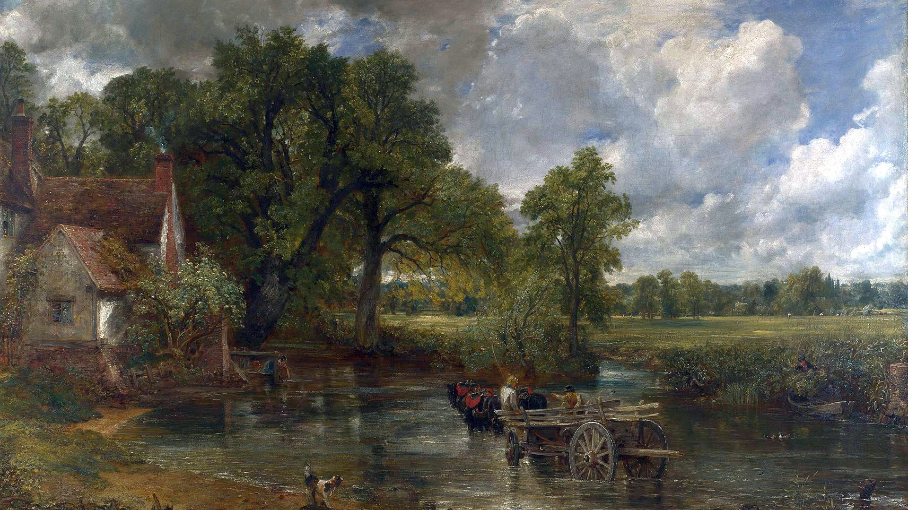
Simplicity
Rustic
Rural
Common
Pastoral
Notes:
By John Constable - John Constable, Public Domain, https://commons.wikimedia.org/w/index.php?curid=7862726

Slide 8
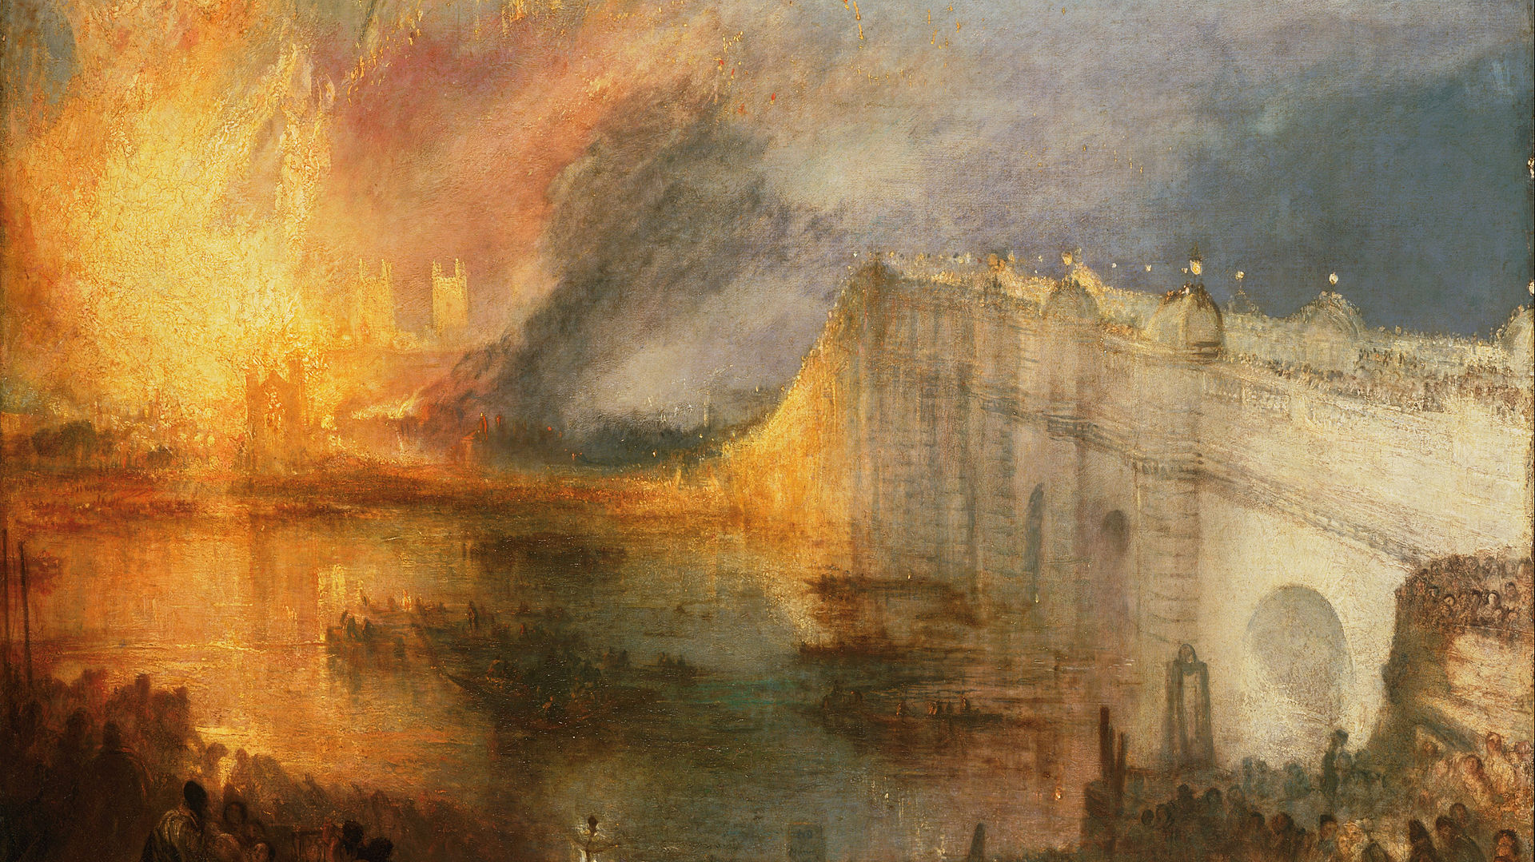
Scientific Discovery
Modernization
Industrialism
Urbanization
Rationalism
Secularism
Notes:
By J. M. W. Turner, The Burning of the Houses of Lords and Commons, 1835- UwEixmBDiZjk7A at Google Cultural Institute maximum zoom level, Public Domain, https://commons.wikimedia.org/w/index.php?curid=21886524

Slide 9
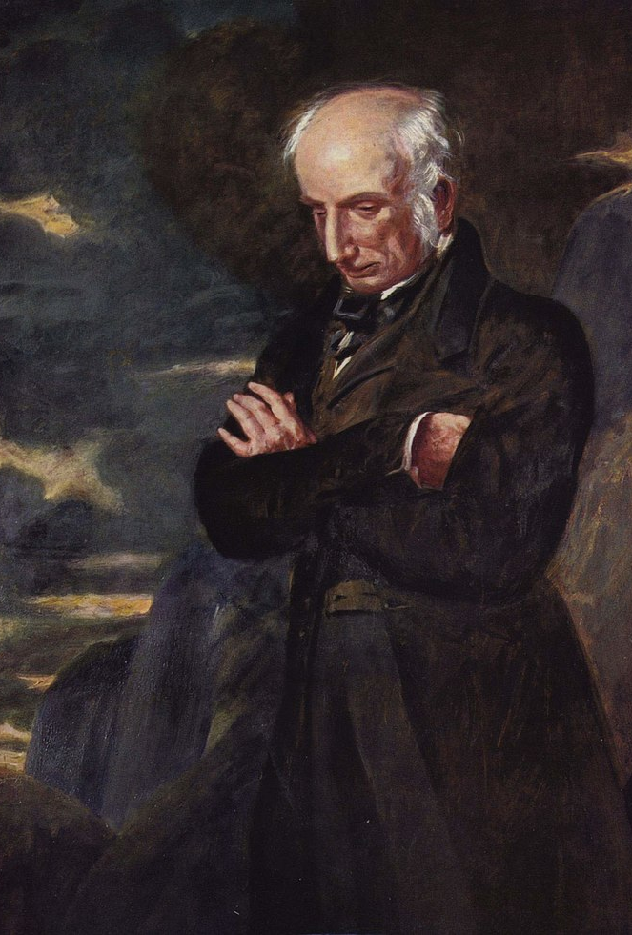
Characteristics of Romantic Poetry
EMOTIONAL – “the spontaneous overflow of powerful feelings; it takes its origin from emotion recollected in tranquility” (Wordsworth, Preface to Lyrical Ballads)
Uses COMMON SPEECH – “language really used by men” (Wordsworth, Preface to Lyrical Ballads)
Responsive to NATURE
LYRICAL
Notes:
By Benjamin Haydon - The Yorck Project (2002) 10.000 Meisterwerke der Malerei (DVD-ROM), distributed by DIRECTMEDIA Publishing GmbH. ISBN: 3936122202.English title source Gill, Stephen. William Wordsworth: A Life. Oxford: Clarendon, 1989. Plate 10., Public Domain, https://commons.wikimedia.org/w/index.php?curid=152568

Slide 10
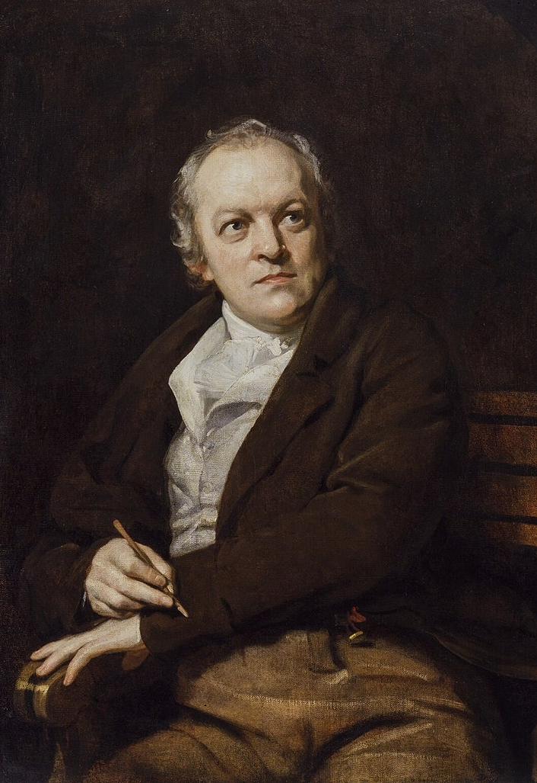
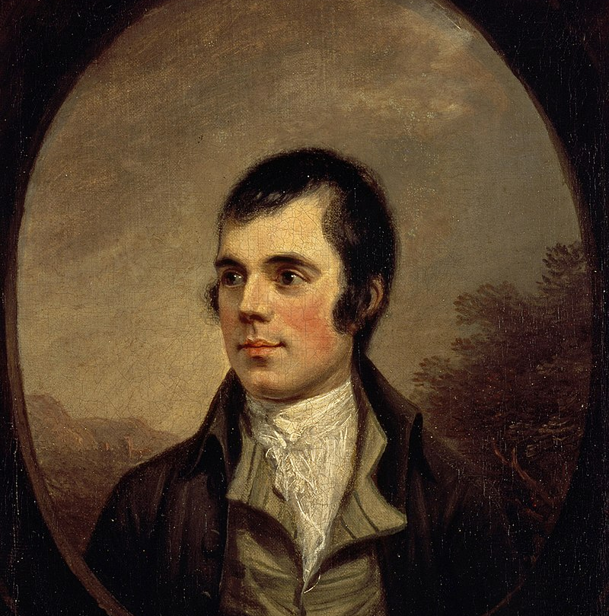
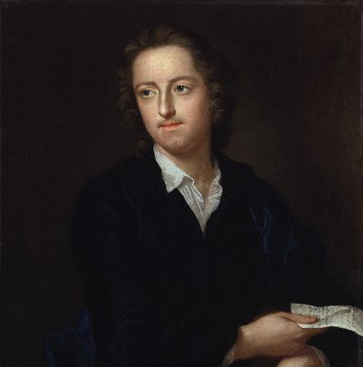
Early Romantics
Thomas Gray (1716-1771)
  “Elegy Written in a Country Churchyard”
Robert Burns (1759-1796)
  Scottish national poet
  “A Red, Red Rose” / “Auld Lang Syne” / “To a Mouse”
William Blake (1757-1827)
  Mystical, prophetic
  Songs of Innocence / Songs of Experience
Notes:
Gray, By John Giles Eccardt - Public Domain, https://commons.wikimedia.org/w/index.php?curid=7397632
Burns, By Alexander Nasmyth - http://www.nationalgalleries.org/collection/artists-a-z/N/3547/artistName/Alexander%20Nasmyth/recordId/1962, Public Domain, https://commons.wikimedia.org/w/index.php?curid=17632209
Blake, By Thomas Phillips - Public Domain, https://commons.wikimedia.org/w/index.php?curid=116437

