Slide 1
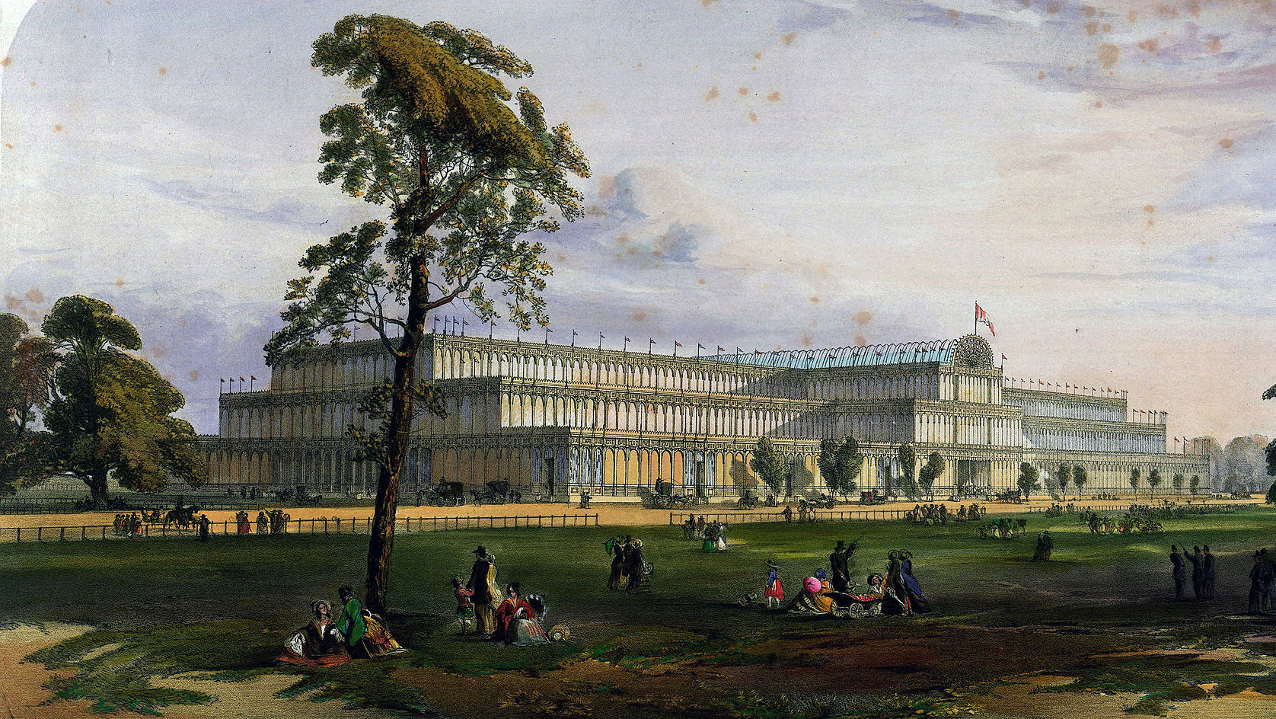
A Century of Faith and Doubt
Part I: The Victorian Age

Slide 2
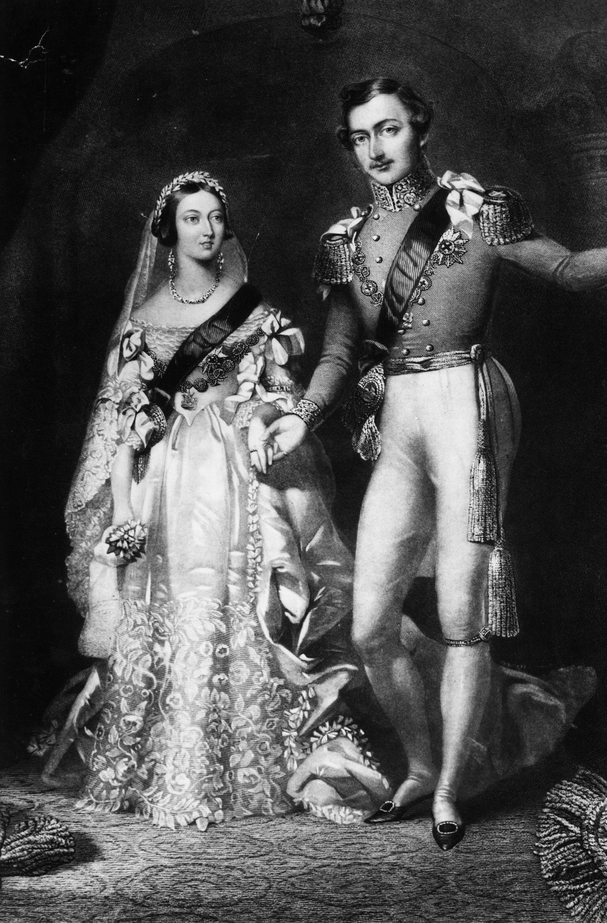
The Victorian Age
Began
  1832 (First Reform Bill)
  1837 (coronation of Queen Victoria)
Ended 1901 (death of Victoria)

Slide 3
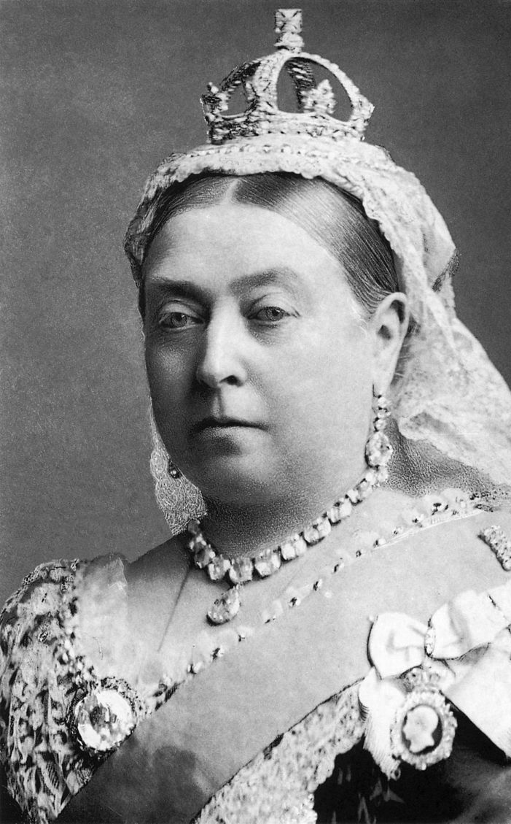
Victorian Keywords
Empire/Expansion
Transition
Industrialism
Religious Controversy
Doubt
Home/Family
Respectability
Reform

Slide 4
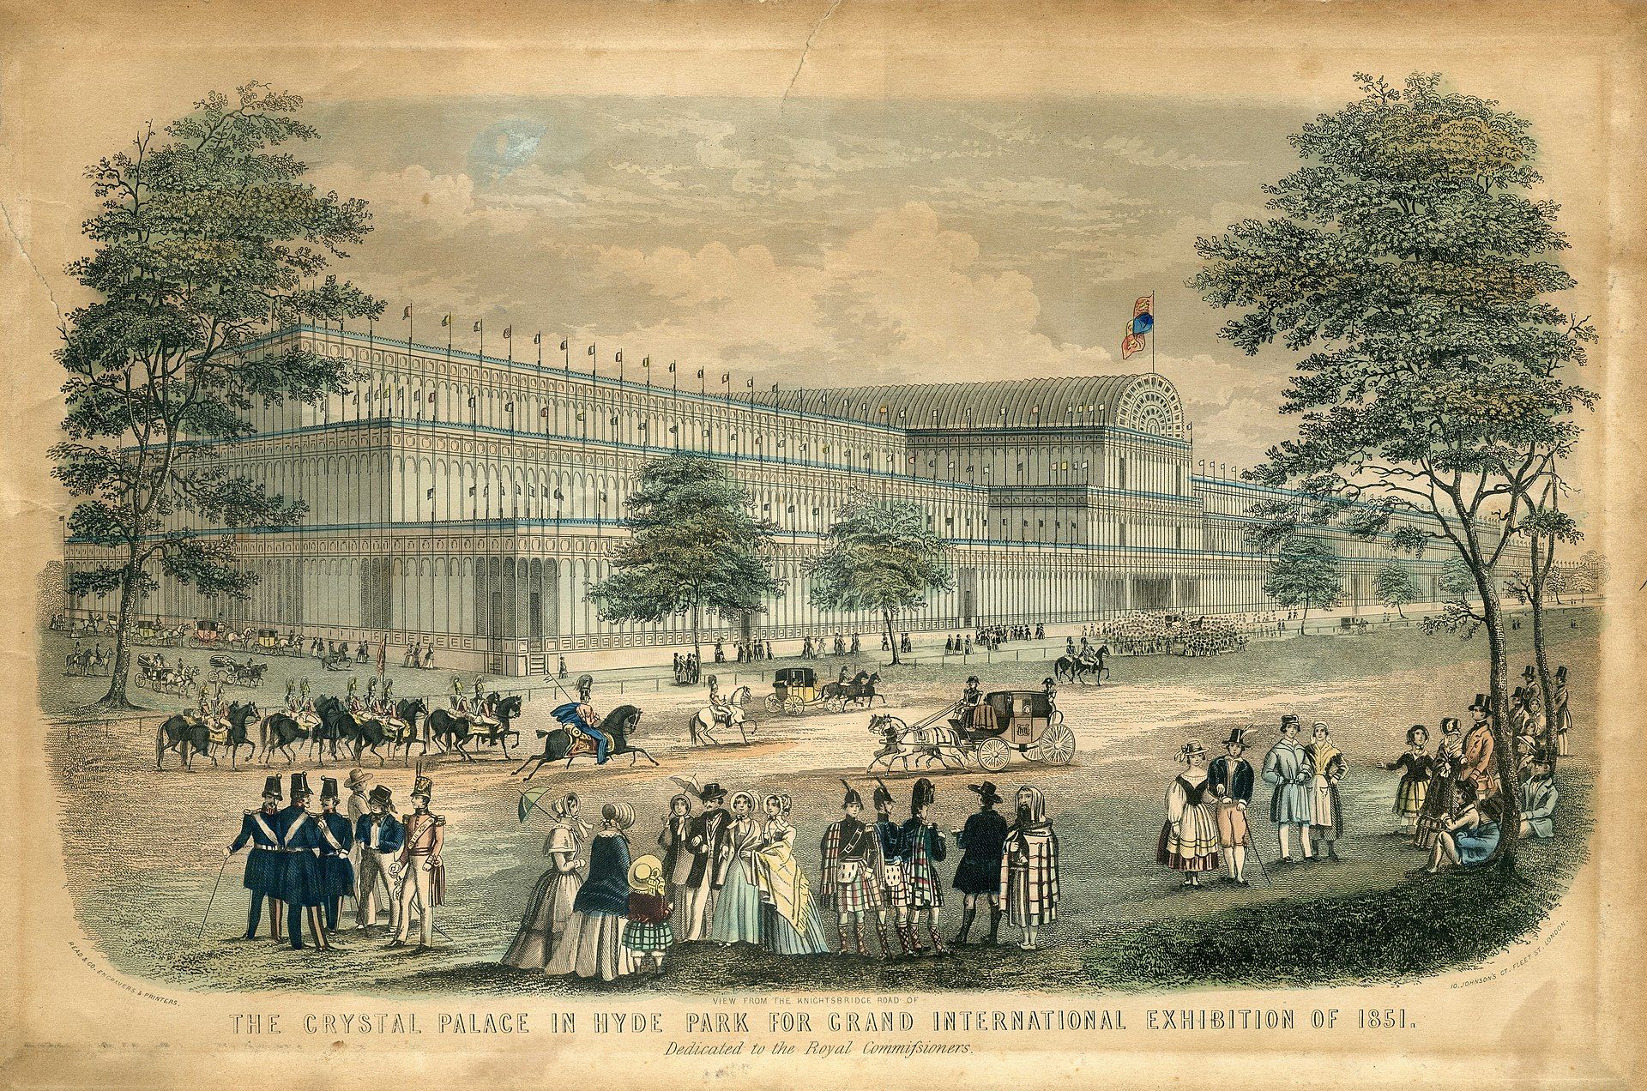
Historical Background
1832 – First Reform Bill (extended the right to vote to most white men, not just to major landowners)
1837 – Victoria’s ascension
1846 – Corn Laws repealed (allowed more imports and cheaper food)
1851 – Great Exhibition in London
1859 – Darwin’s Origin of the Species
1901 – Death of Victoria

Slide 5
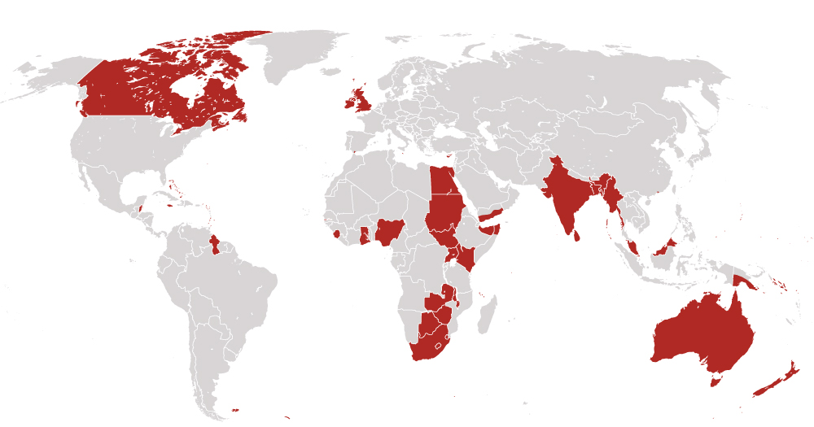
The British Empire in 1901
Source: https://www.washingtonpost.com/news/worldviews/wp/2015/09/08/map-the-rise-and-fall-of-the-british-empire/

Slide 6
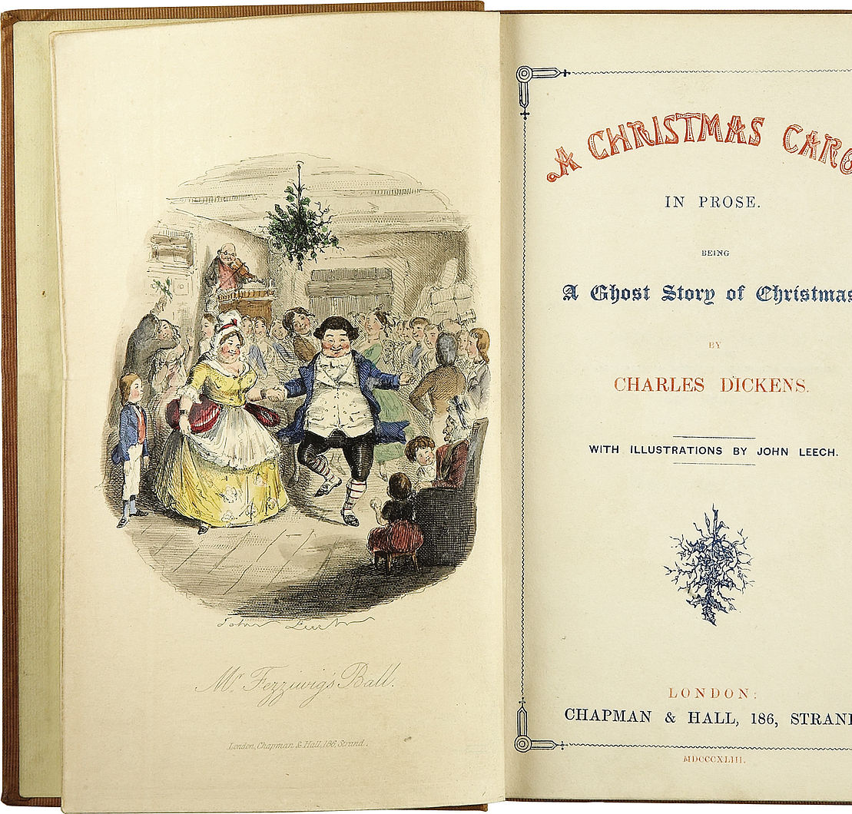
Characteristics of Victorian Literature
Earnestness – centrality of moral responsibility
Problematic gender relations
Focus on faith and doubt
Values social reform
Emphasis on character (individual), mood, and sound
Notes:
Public Domain

