Slide 1

Saskatchewan

Slide 2
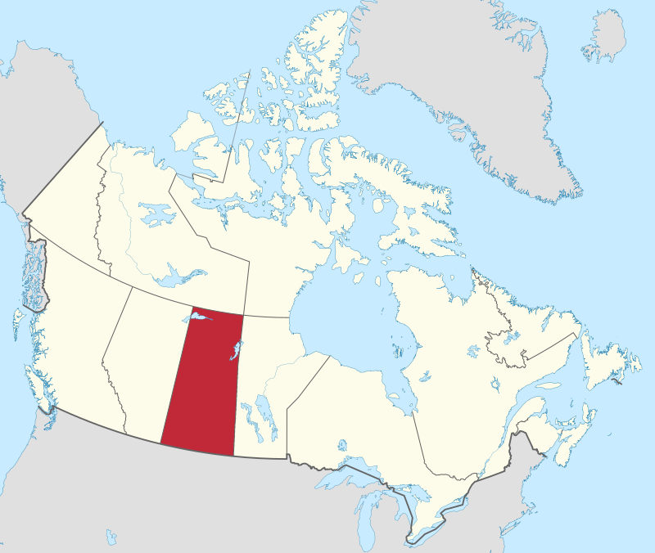
Saskatchewan
By MapGrid - Own work, CC BY-SA 4.0, https://commons.wikimedia.org/w/index.php?curid=98178882

Slide 3
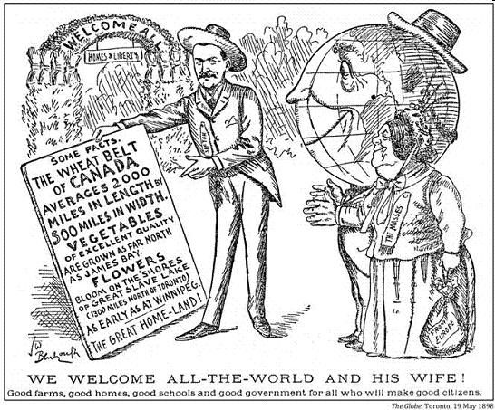
By John Wilson Bengough Work for hire Toronto Globe(Life time: 1851 – 1923) - Original publication: Toronto GlobeImmediate source: http://www.begbiecontestsociety.org/IMMIGRATION.htm, PD-US, https://en.wikipedia.org/w/index.php?curid=48493335

Slide 4
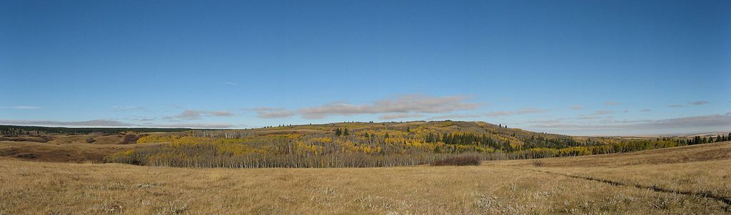
Praries

Slide 5
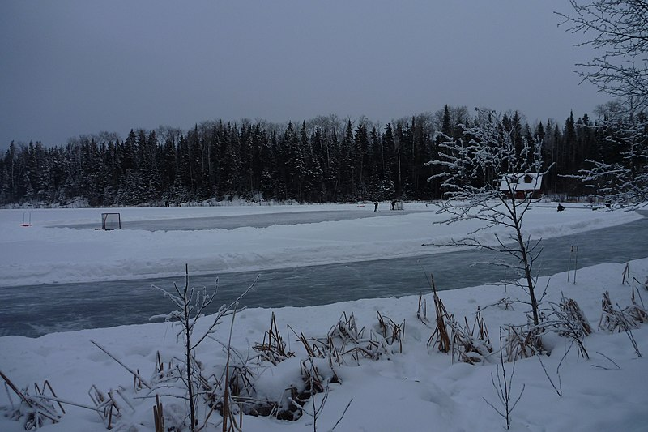
By Warren Long from Saskatoon, Canada - 2014-12-31 16-03-32 0039 KC, CC BY 2.0, https://commons.wikimedia.org/w/index.php?curid=74895272

Slide 6

Regina
By Tintaggon - Own work, CC BY-SA 3.0, https://commons.wikimedia.org/w/index.php?curid=25468202

