Slide 1
Quebec

Slide 2
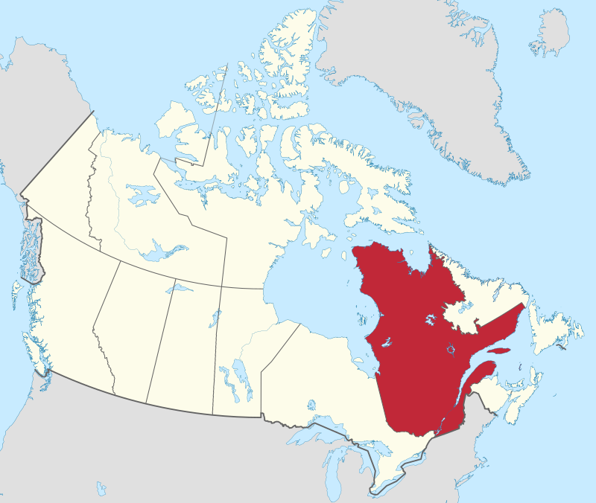
Quebec
By MapGrid - Own work, CC BY-SA 4.0, https://commons.wikimedia.org/w/index.php?curid=98178996

Slide 3
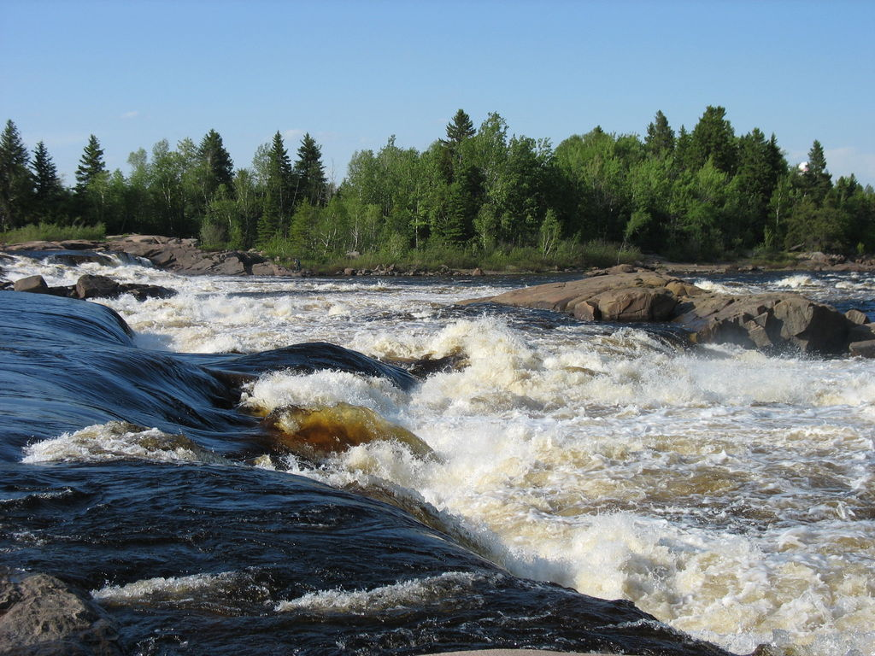
By Clou - Own work, CC BY-SA 3.0, https://commons.wikimedia.org/w/index.php?curid=4651780

Slide 4
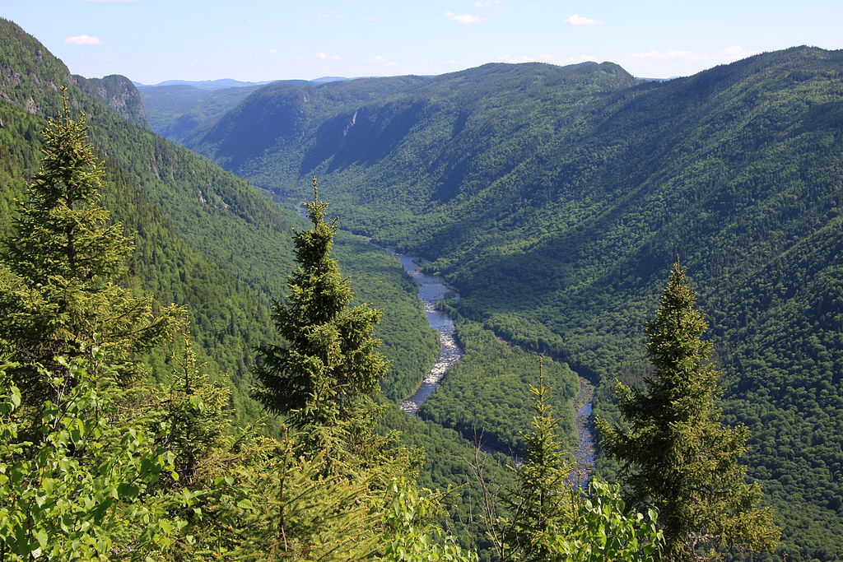
Jacques-Cartier River
By Cephas - Own work, CC BY-SA 3.0, https://commons.wikimedia.org/w/index.php?curid=7117171

Slide 5
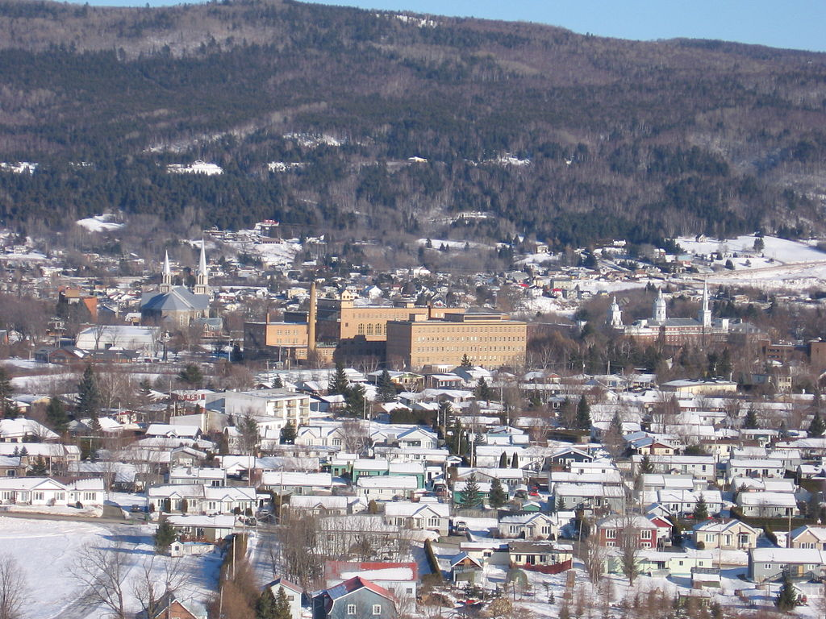
By Harfang - Own work, CC BY-SA 3.0, https://commons.wikimedia.org/w/index.php?curid=12621313

Slide 6
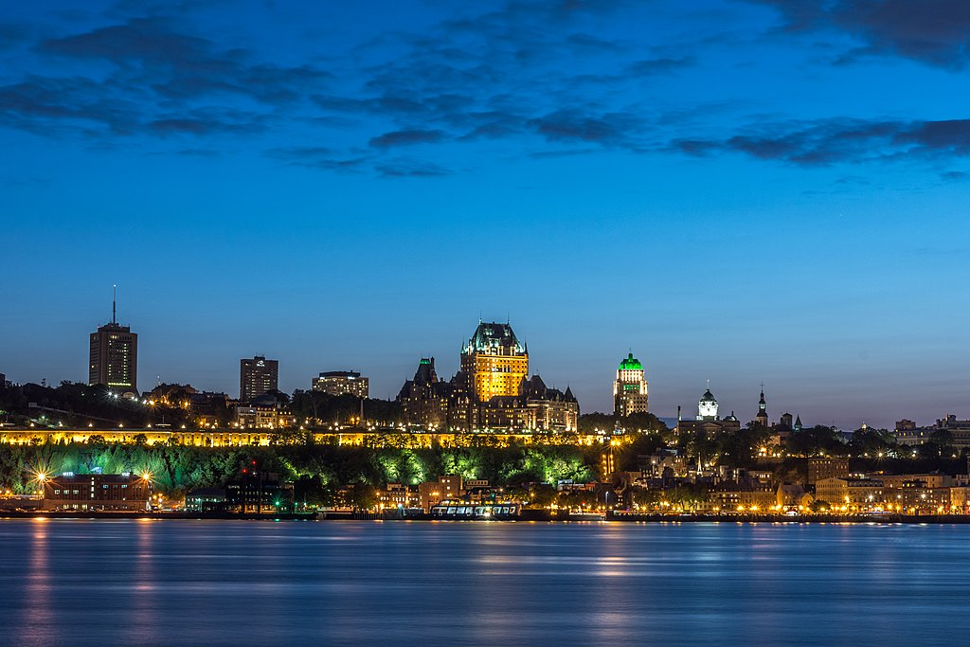
Quebec City
By Wilfredor - Own work, CC BY-SA 4.0, https://commons.wikimedia.org/w/index.php?curid=61977397

