Slide 1
Prince Edward Island

Slide 2
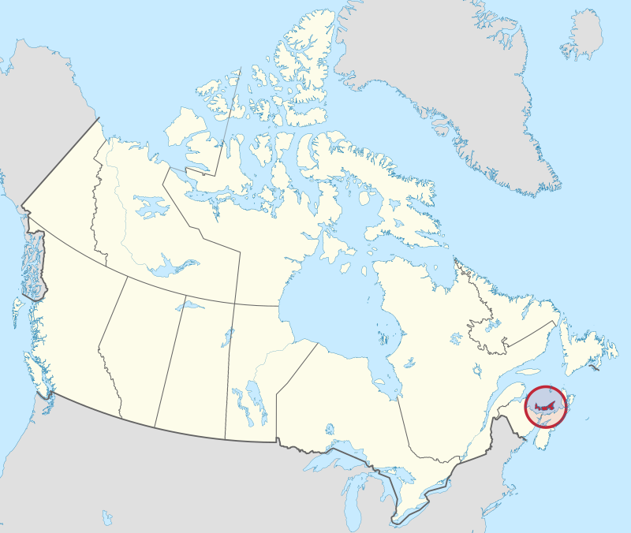
Prince Edward Island
By MapGrid - Own work, CC BY-SA 4.0, https://commons.wikimedia.org/w/index.php?curid=98179125

Slide 3
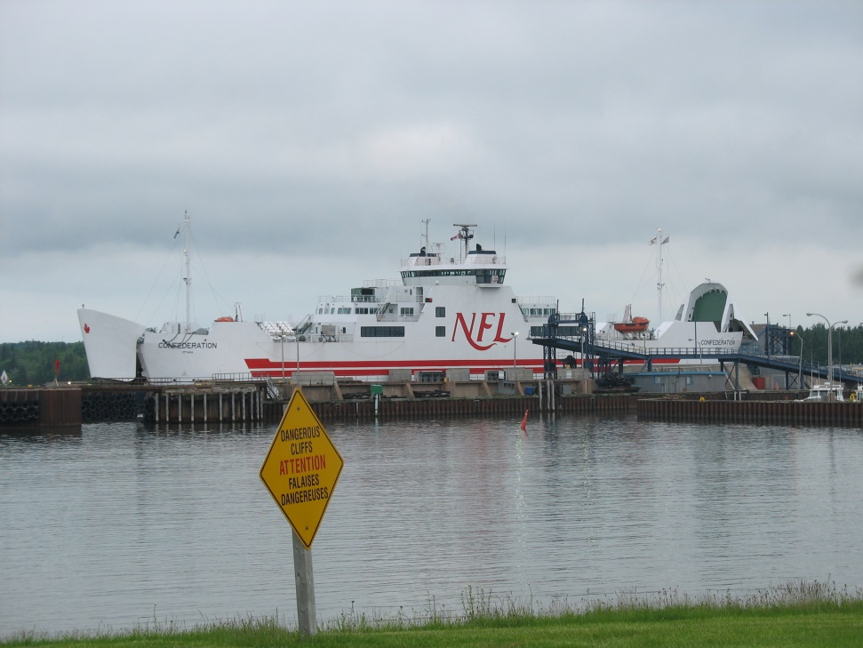
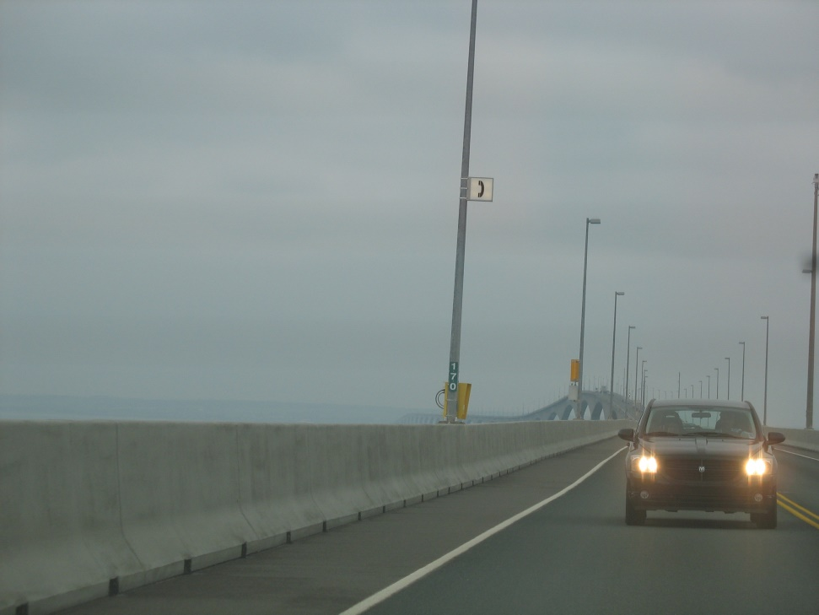
Two ways to get to the island-
Ferry
Confederation Bridge

Slide 4
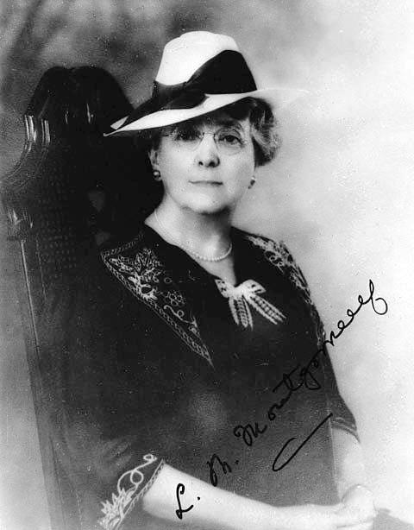
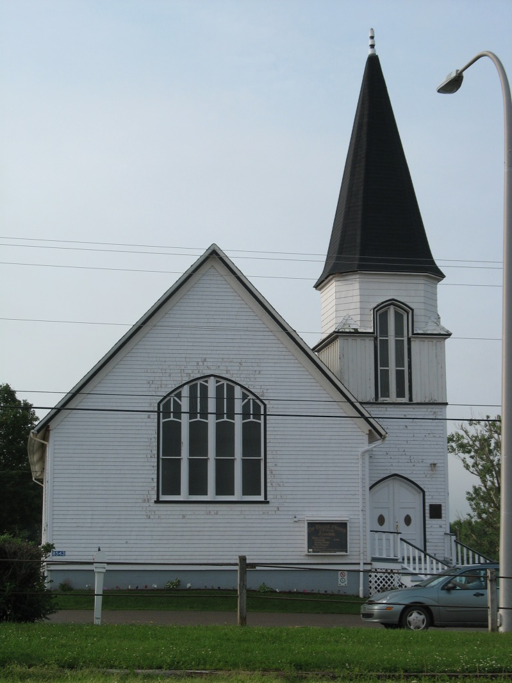
Home of L.M. Montgomery

Slide 5
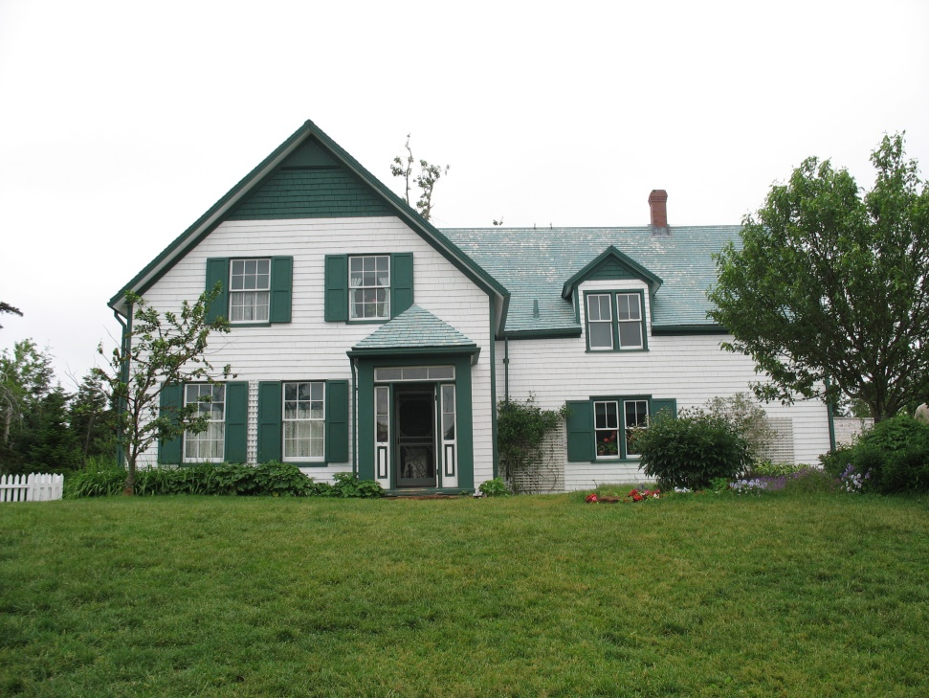
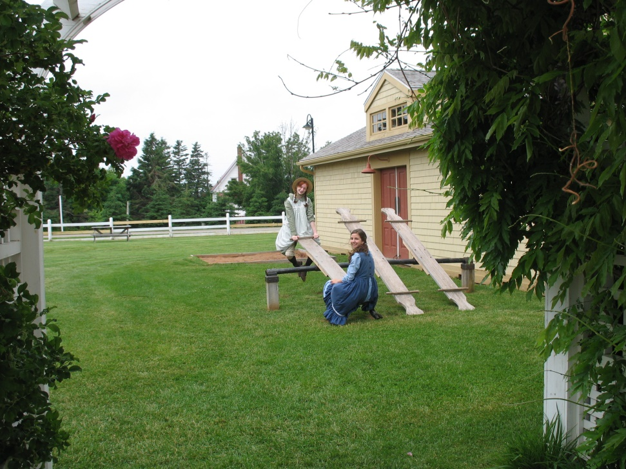
Setting for Anne of Green Gables

Slide 6
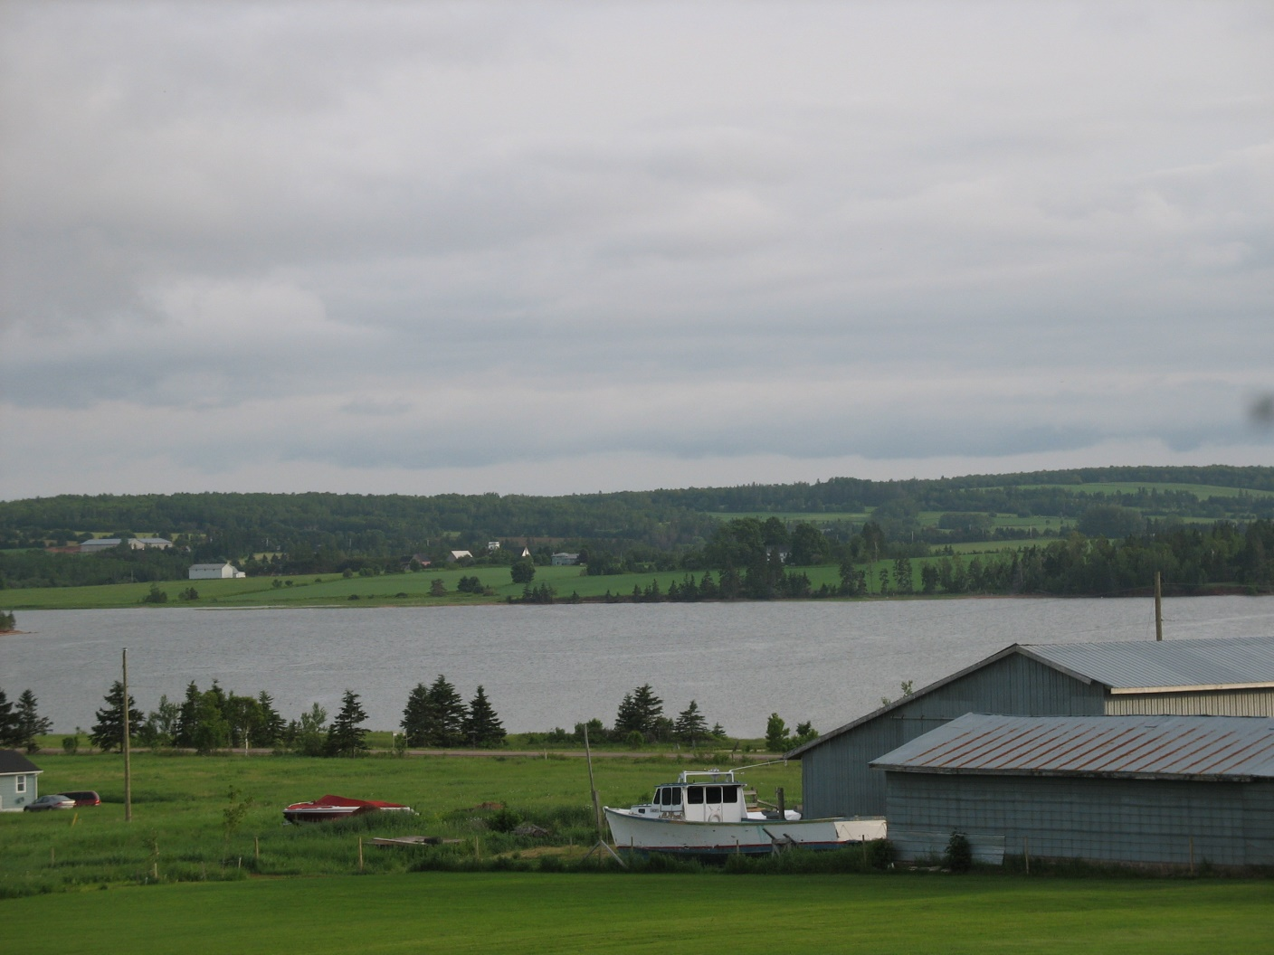
Farmland and Ocean

Slide 7
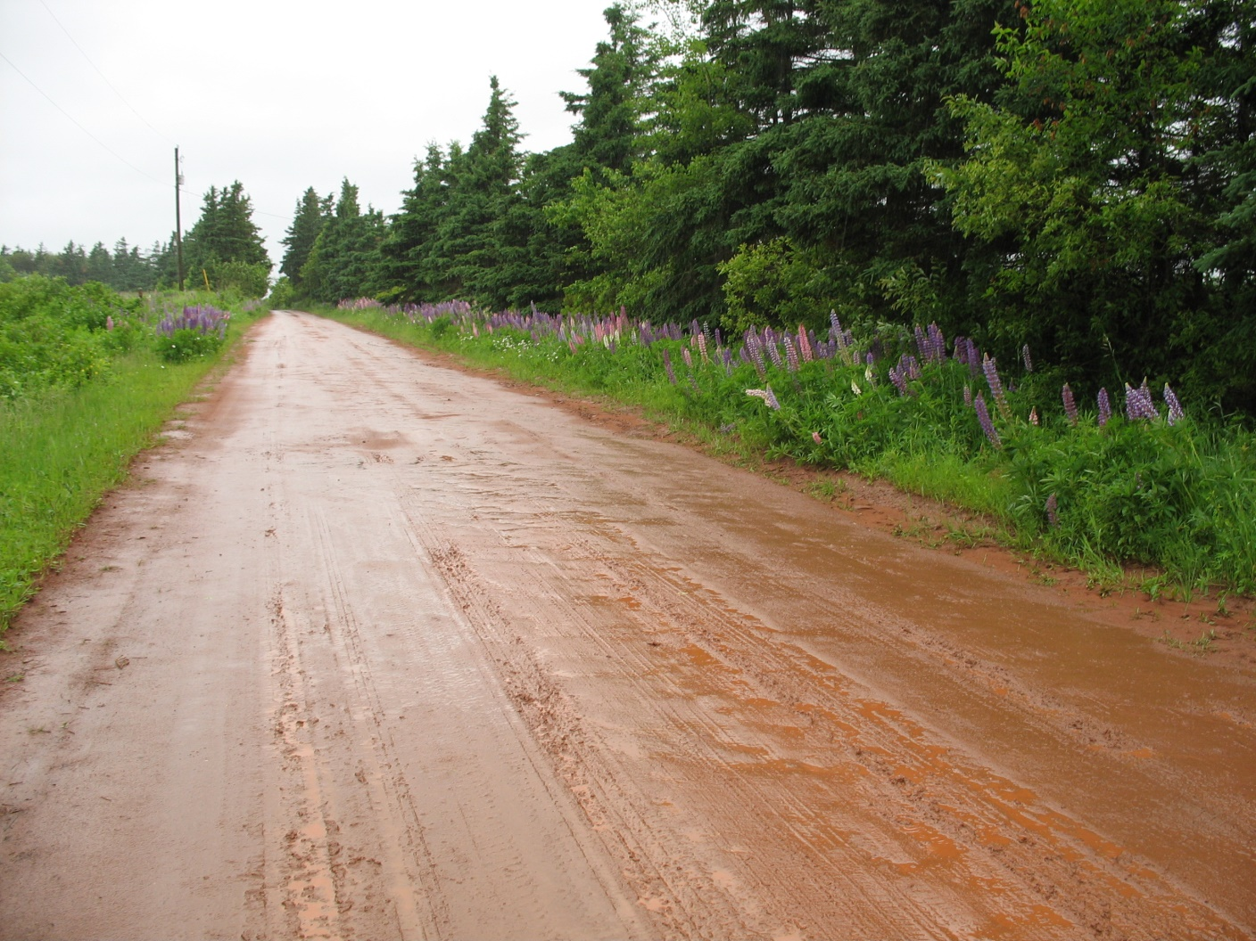
Red Roads

Slide 8
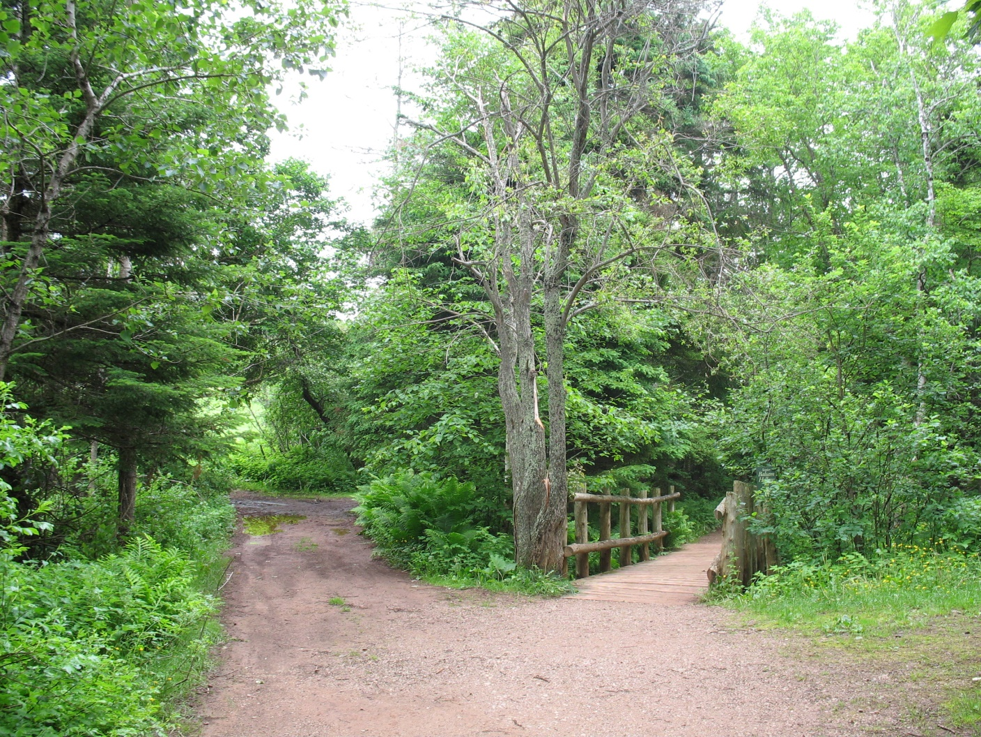
Woods

Slide 9
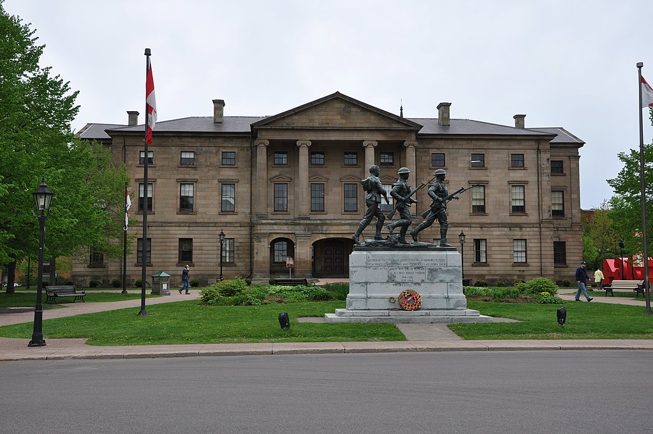
Charlottetown
By Robert Cutts from Bristol, England, UK - Rear of Province House , Charlottetown, PEI, CC BY-SA 2.0, https://commons.wikimedia.org/w/index.php?curid=74398734

