Slide 1
Ontario
Loyal she began, loyal she remains

Slide 2
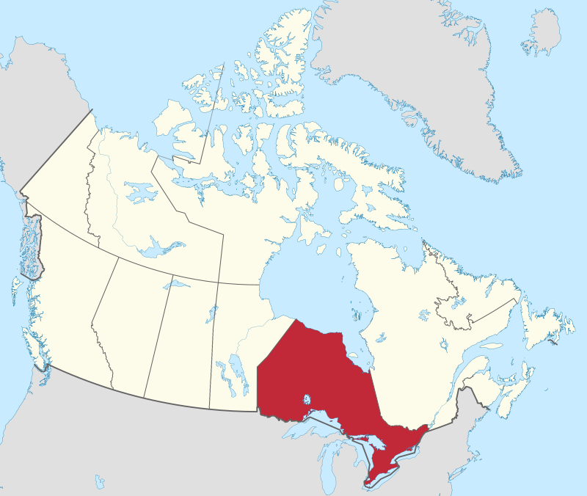
Ontario
By MapGrid - Own work, CC BY-SA 4.0, https://commons.wikimedia.org/w/index.php?curid=98178958

Slide 3
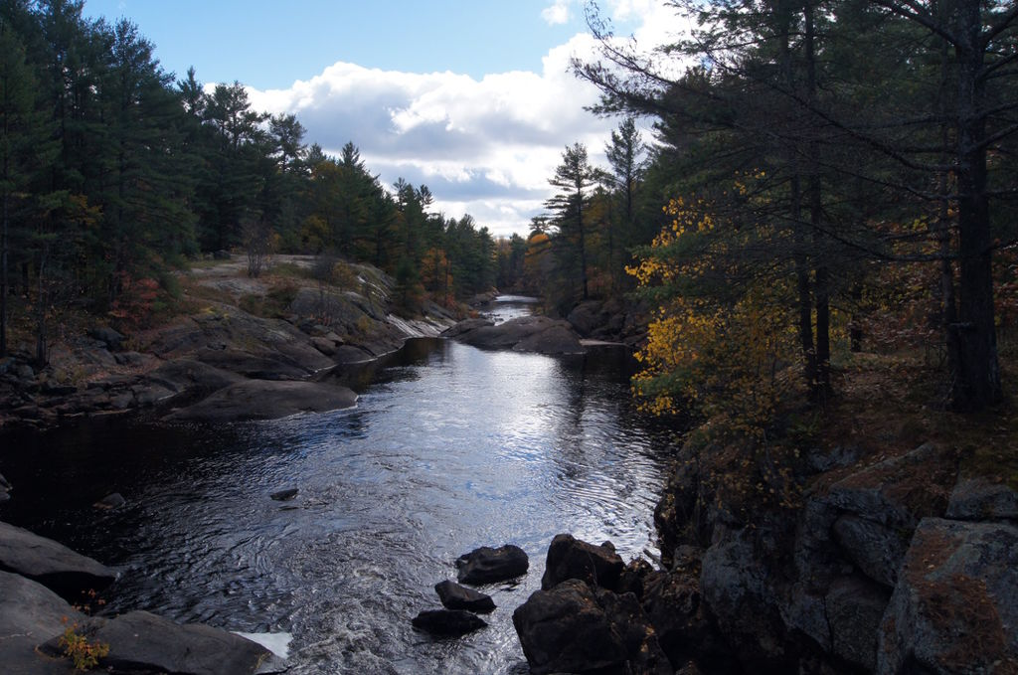
By Trick17 - Own work, CC BY-SA 4.0, https://commons.wikimedia.org/w/index.php?curid=46685780

Slide 4
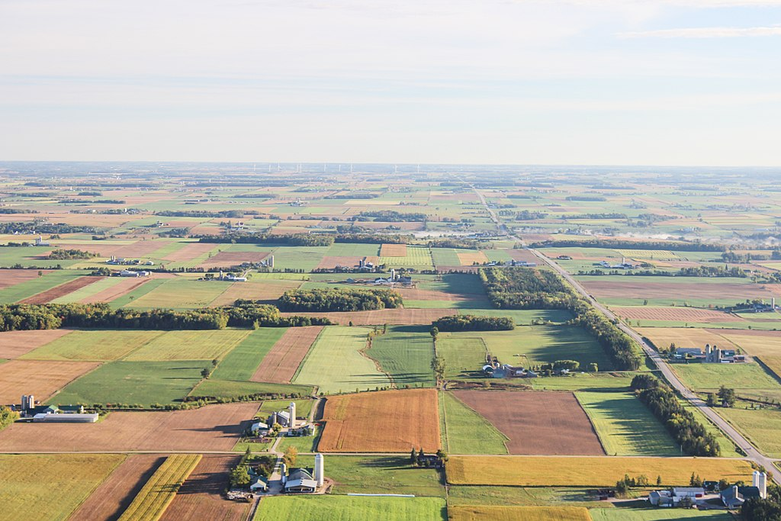
By Sveta Fedarava svetacreative - https://unsplash.com/photos/v1ar8e1dOjgarchive copyImage, CC0, https://commons.wikimedia.org/w/index.php?curid=61726545

Slide 5
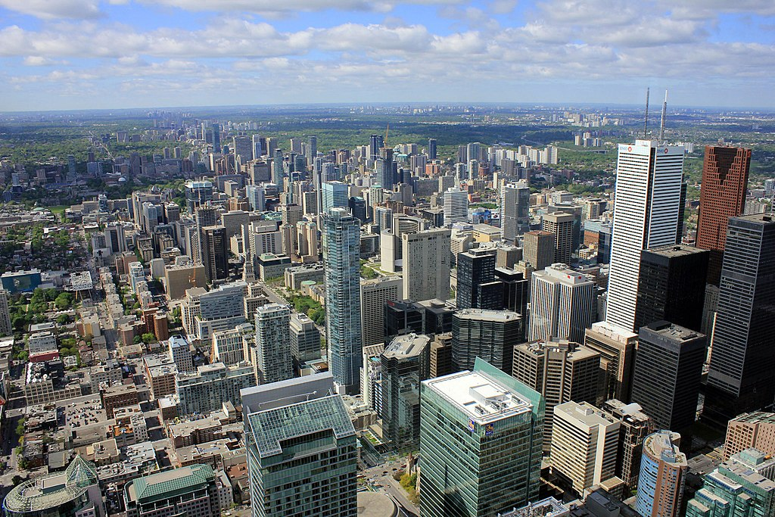
Toronto
By Yinan Chen - https://www.publicdomainpictures.net/en/view-image.php?image=41579&amp;picture=toronto, CC0, https://commons.wikimedia.org/w/index.php?curid=87552889

