Slide 1
Nunavut
Newest, largest and northernmost territory

Slide 2
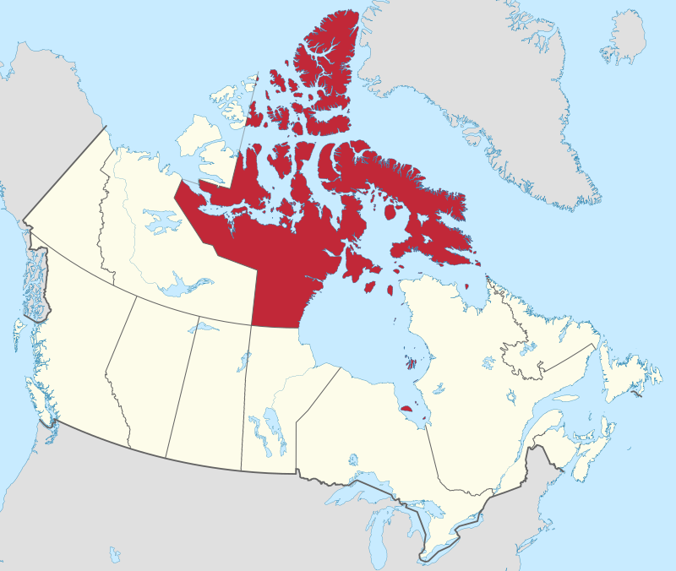
Nunavut
By MapGrid - Own work, CC BY-SA 4.0, https://commons.wikimedia.org/w/index.php?curid=98179397

Slide 3
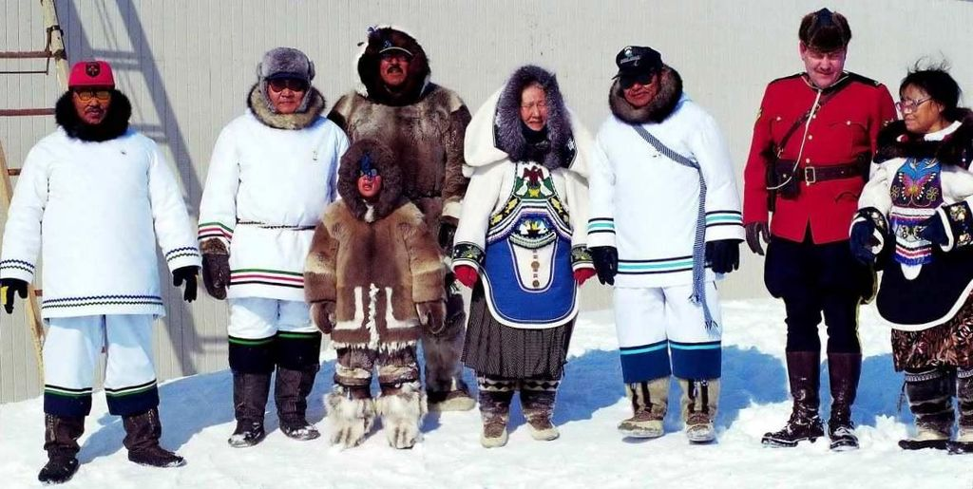
Established April 1999
By Ansgar Walk, CC BY-SA 3.0, https://commons.wikimedia.org/w/index.php?curid=11990983

Slide 4
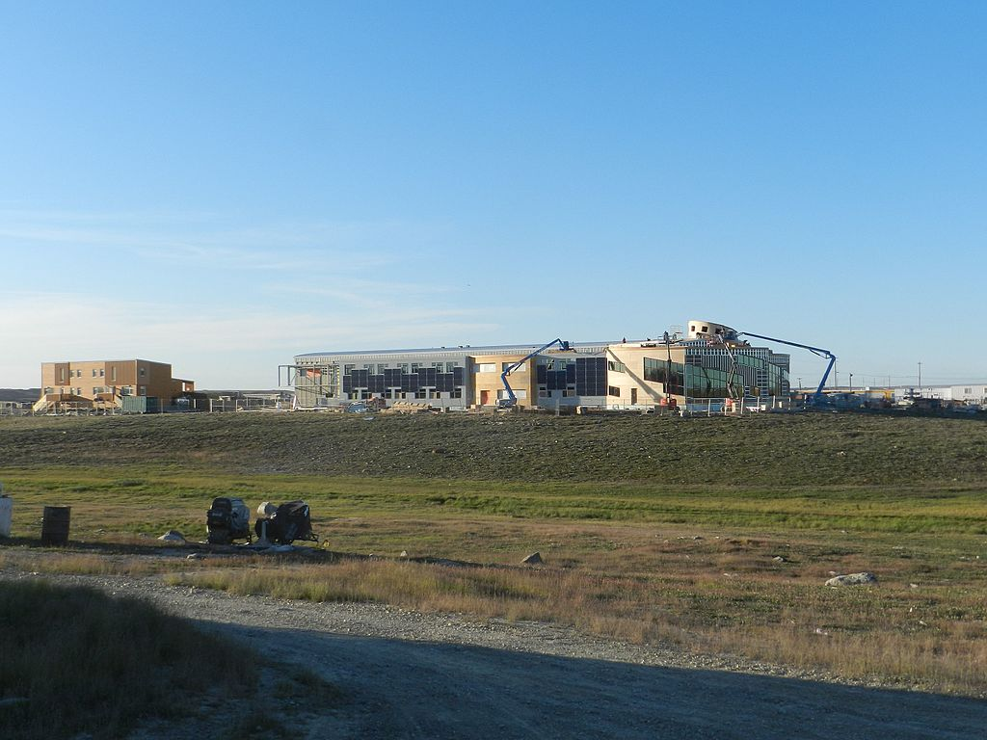
Artic Research Stations
By CambridgeBayWeather - Own work, CC BY-SA 4.0, https://commons.wikimedia.org/w/index.php?curid=50516615

Slide 5
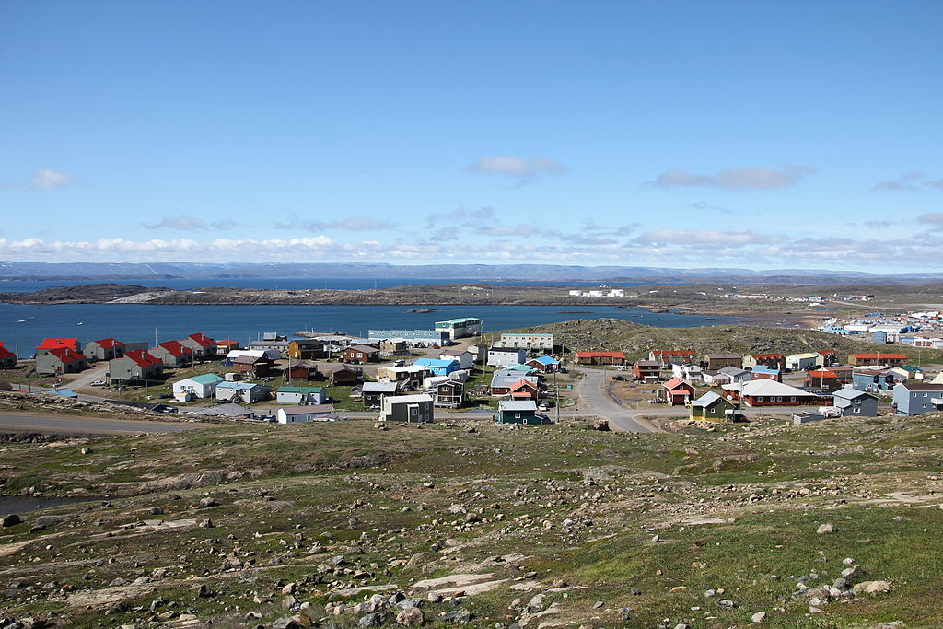
Iqaluit
By Sebastian - Own work, CC BY-SA 3.0, https://commons.wikimedia.org/w/index.php?curid=19330894

