Slide 1
Northwest Territories

Slide 2
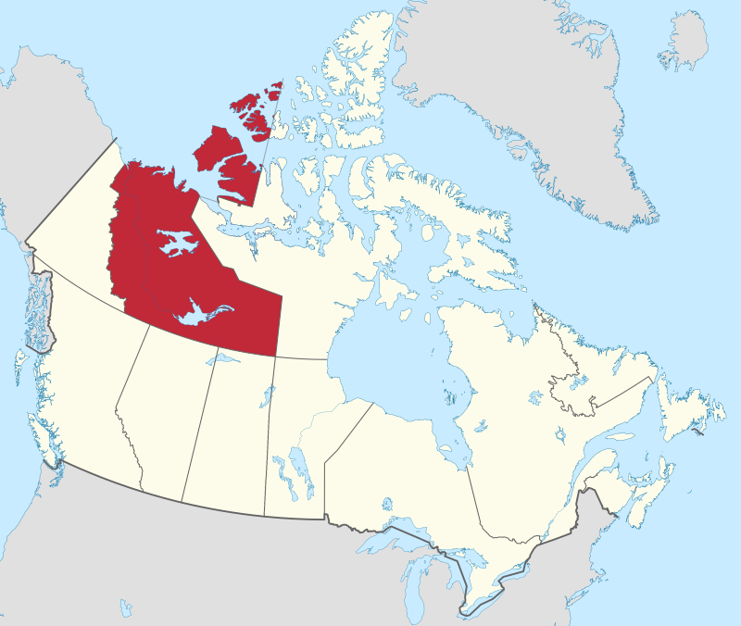
Northwest Territories
By MapGrid - Own work, CC BY-SA 4.0, https://commons.wikimedia.org/w/index.php?curid=98179352

Slide 3
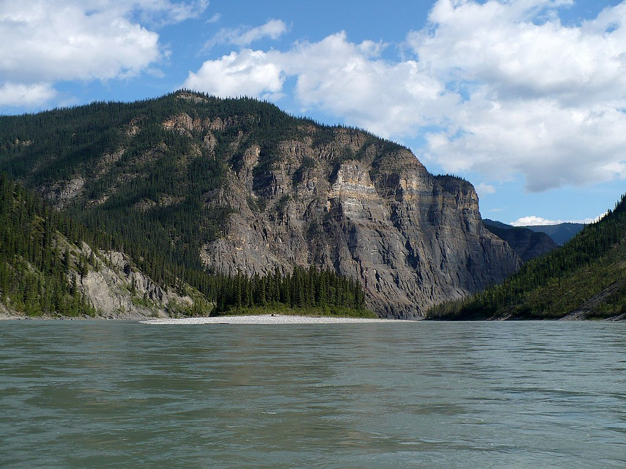
By Paul Gierszewski - Own work, Public Domain, https://commons.wikimedia.org/w/index.php?curid=8957602

Slide 4
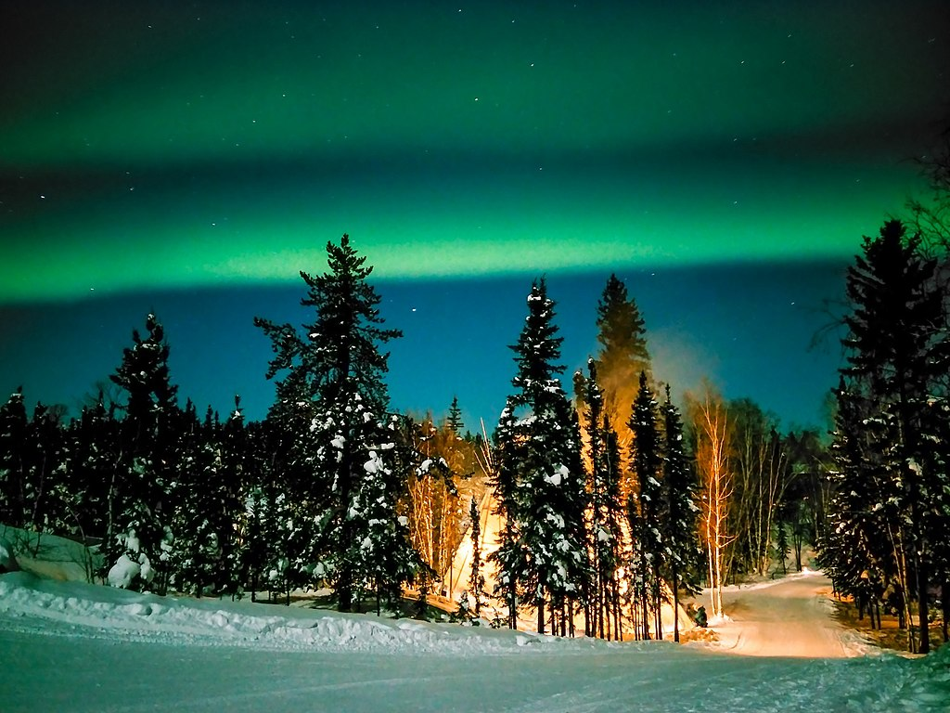
Northern Lights
By LG전자 - ‘LG G프로2’, 세계 최초 오로라 촬영 성공This file comes from LG Electronics&#039;s official Flickr.This tag does not indicate the copyright status of the attached work. A normal copyright tag is still required. See Commons:Licensing., CC BY 2.0, https://commons.wikimedia.org/w/index.php?curid=39850007

Slide 5
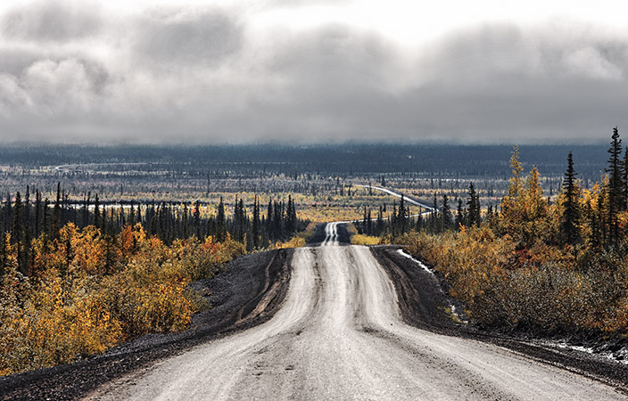
CC BY 3.0, https://en.wikipedia.org/w/index.php?curid=26375587

Slide 6
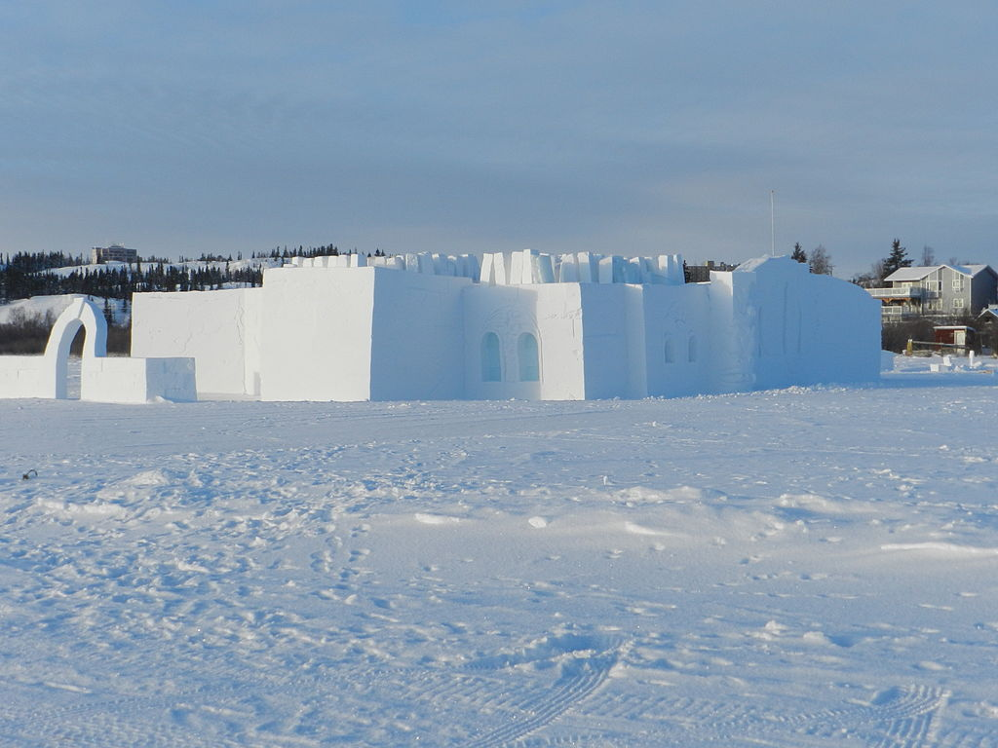
By CambridgeBayWeather - Own work, CC BY-SA 3.0, https://commons.wikimedia.org/w/index.php?curid=25825939

Slide 7
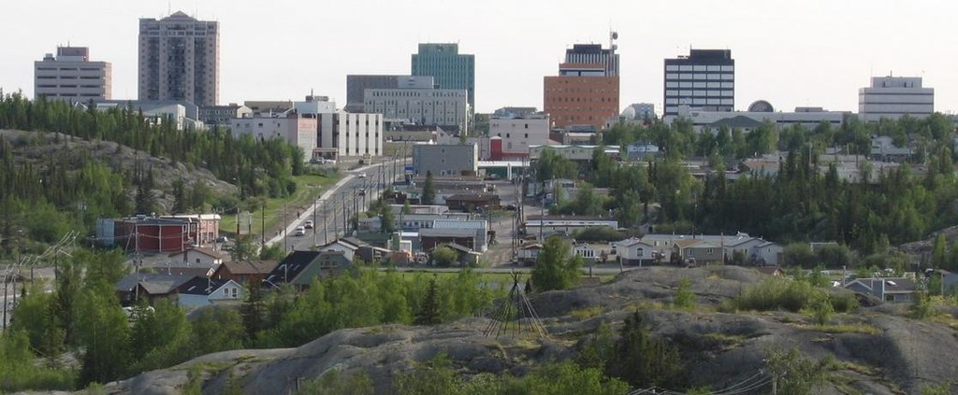
Yellowknife
By user:Trevor MacInnis - http://en.wikipedia.org/wiki/File:Downtown_Yellowknife_2.jpg, CC BY-SA 1.0, https://commons.wikimedia.org/w/index.php?curid=31374457

