Slide 1
Newfoundland and Labrador
The easternmost and last Province

Slide 2
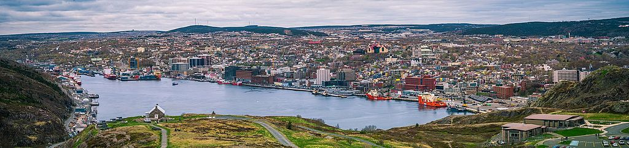
St. John’s
By Sébastien Blanchard - Own work, CC BY-SA 4.0, https://commons.wikimedia.org/w/index.php?curid=59766488

Slide 3
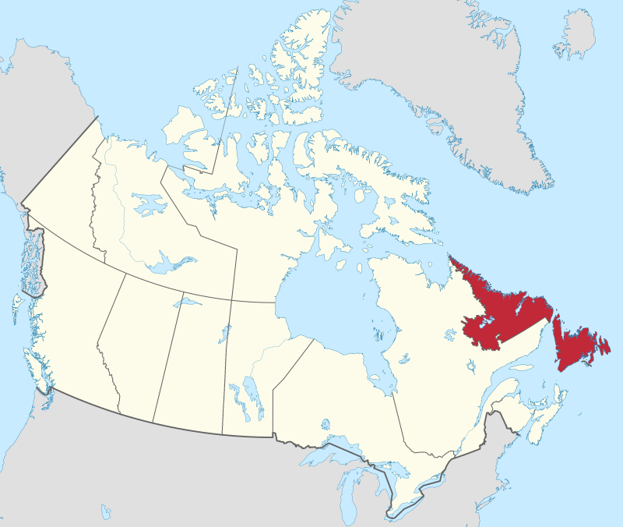
Newfoundland and Labrador
By MapGrid - Own work, CC BY-SA 4.0, https://commons.wikimedia.org/w/index.php?curid=98179202

Slide 4
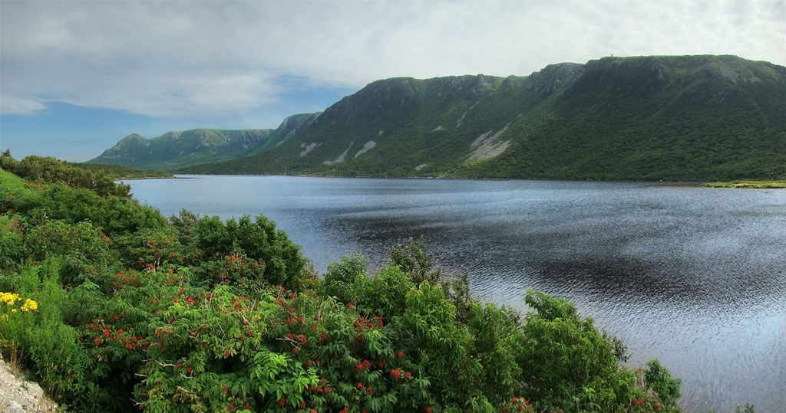
Long Range Mountains
By Tango7174 - Own work, CC BY-SA 4.0, https://commons.wikimedia.org/w/index.php?curid=7822006

Slide 5
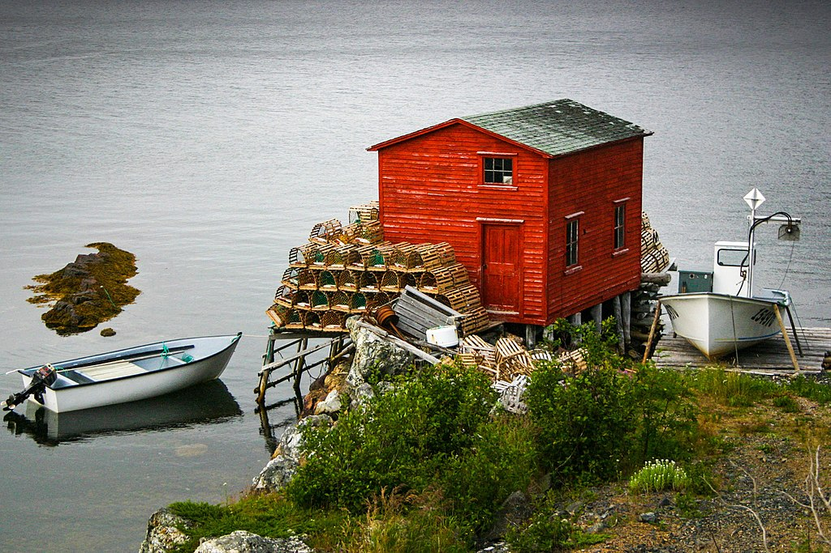
Lobster Traps
By Sallyledrew - Own work, CC BY-SA 4.0, https://commons.wikimedia.org/w/index.php?curid=60356424

